Slide 1
大學生涯-II Supporting Academic Success-II
112-1 義守大學秋季外國新生入學説明會
2023 Fall Semester International Student Orientation
國際及兩岸事務處
Office of International and Cross-Strait Affairs

Slide 2
外國學生入學輔導講習 教務處報告
Orientation for International Students by Academic Affairs Office
‹#›

Slide 3
教務諮詢
‹#›

Slide 4
Office Location and Contact Numbers
The location of the Curriculum Section and Registration Section offices are both on the 1st flr. of the Administration Building.
Curriculum Section is responsible for the students’ affairs concerning course selection, absence, and exam. (ext.2121-2128)
Registration Section is responsible for the students’ affairs concerning students’ status and grades. (ext.2113-2118)
1

Slide 5
多元課程提供選擇
一般專業課程
通識教育課程
模組教學課程
服務學習課程
全英語教學課程
實驗(實習)課程
‹#›

Slide 6
Courses Provided
1. professional courses
2. courses for general education
3. module courses
4. courses taught in English
5. practicum/Internship courses
6. field trip courses
7. community service courses
5

Slide 7
模組教學課程
每門課程授課教師至少三人，其中邀請校外領域專家學者至少二人參與授課。
藉業界師資協助在課程中導入實務經驗，提升本校教師對各產業脈動之掌握度，以及培育學生實務技術能力 ，使學生所學能與產業接軌，提升學生進入職場應具備之能力。
‹#›

Slide 8
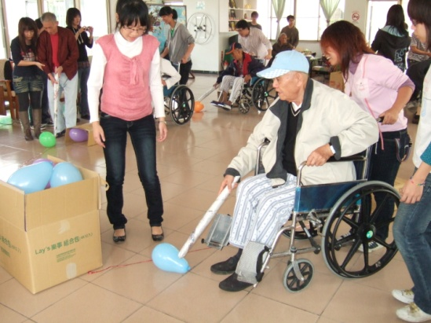
服務學習課程
將「服務」與「學習」並重的經驗教育概念，融入各類專業課程中，透過課程的實施，引領學生投入社區服務，藉由課堂知識的獲取、校外服務學習的體驗，將公益與助人的精神內化於心中。
以服務弱勢及偏遠落後族羣為對象。
‹#›

Slide 9
教學活動管理措施
實施課堂點名：如安排座位、簽到或唱名等點名方式。教師於課後一週內會至本校「應用資訊系統」完成點名登錄，請同學隨時上網查詢。
保持舒適整潔的學習環境：每節課後負責同學應擦淨黑（白）板，而學生個人應將垃圾自行攜離教室。
實施節約能源：請同學於離開教室前，應關閉所有電源。
NEXT
‹#›

Slide 10
應用資訊系統
學生應用系統帳號：isu + 學號
密碼預設為：學號（請重新設定,才可使用）
應用資訊系統主要功能
基本資料
授課計畫表
學生選課/停修
請假、曠課查詢
即時學習狀況、期中預警
教師辦公室諮詢office hour
網路課業輔導
教學意見調查
成績查詢
‹#›

Slide 11
Service Provided by the Information System
1. Your personal information
2. Course syllabus
3. Course selection and withdrawal
4. Tracking your attendance
5. Reminding of failing the course
6. Checking teachers’ office hours
7. Academic guidance and assistance
8. The survey of teaching performance
9. Your academic record
4

Slide 12
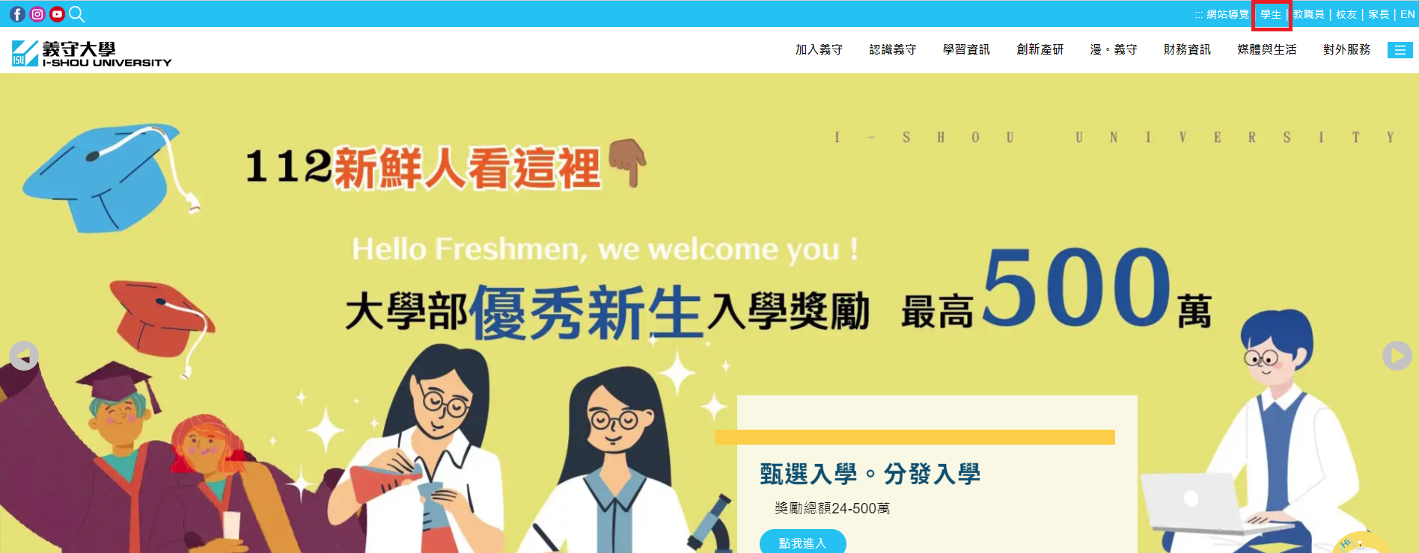
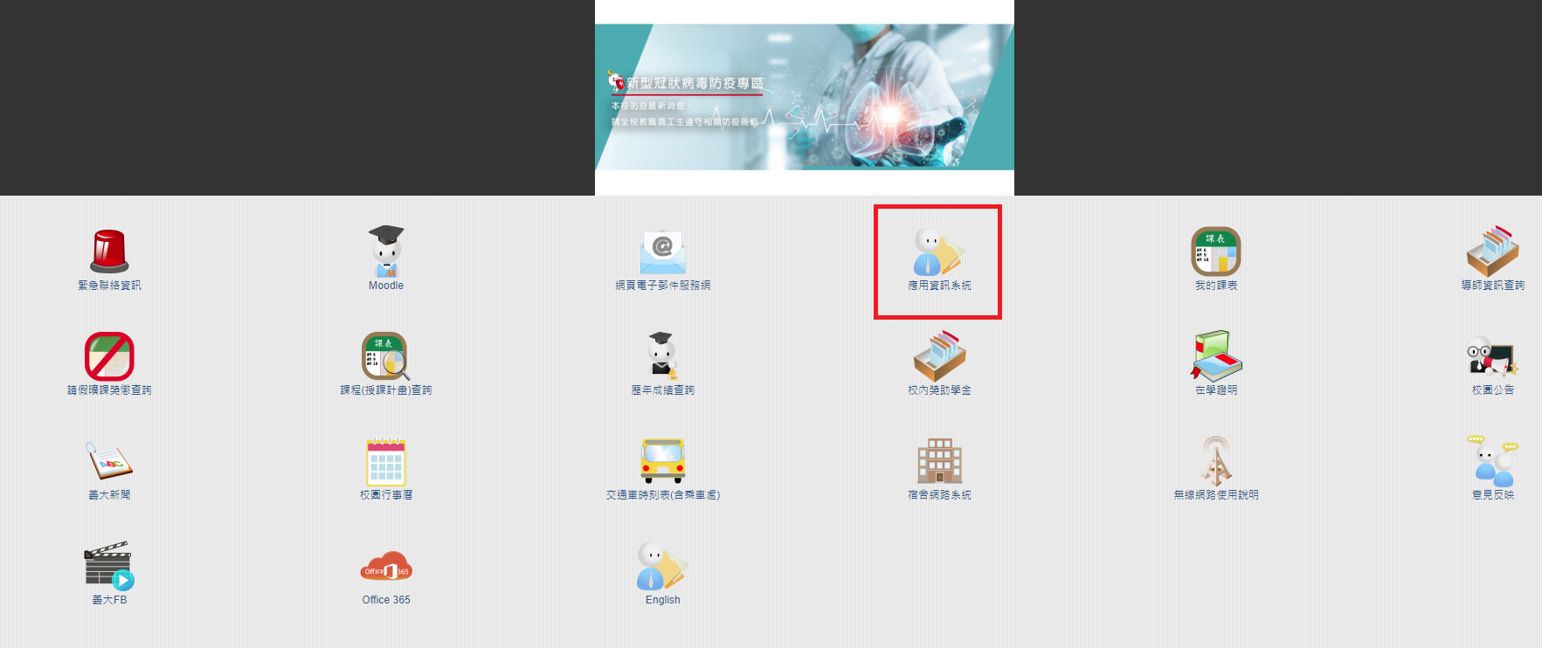
如何進入應用資訊系統 ?
至學校首頁
點選學生
點選應用資訊系統
‹#›

Slide 13
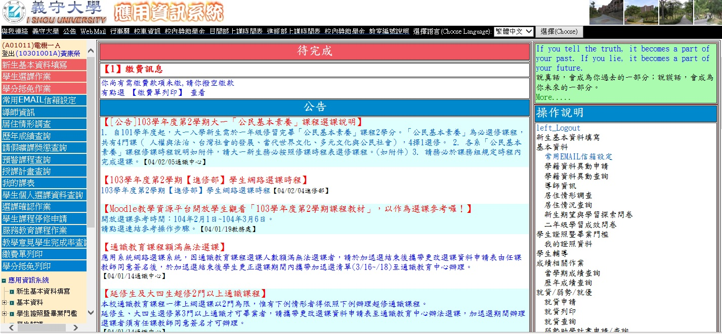
Step1.登入帳號密碼
Step2.點選欲查詢之項目
BACK
‹#›

Slide 14
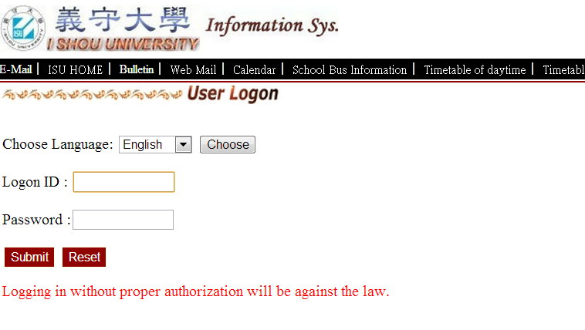
Information System
1. Your personal account:
your student ID
2. Password: Please get the preset password from
International Office and you may reset
a new one.
http://www.isu.edu.tw/en1/
Current Students
Information System
http://netreg.isu.edu.tw/wapp/
3

Slide 15
選課作業
2月19日(一)9:00~2月25日(日)24:00 網路加、退選課以及尚未選課同學。
開學後第二、三週辦理選課更正， 請填寫更改選課單送授課教師及系主任簽核。
修習之學分數
一~三年級至少需修習15學分，至多25學分;四年級至少需修習6學分，至多25學分
以同等學歷申請學士班同學，須加修12學分
研究生請依各研究所修課要點辦理
因特殊需求申請超修者，應依規定繳交學分費。
‹#›
Notes:
‹#›

Slide 16
Course Selection Procedure
1. Add and Drop : Feb. 19 (09:00) ~ Feb. 25 (24:00)
2. Conditional correction: fill the form and get the signature from your head of department to get the confirmation.
3. Minimum and Maximum Credits :
Undergraduate : 15 – 25
Graduate : at least 1 (course selection must be approved by advisor)
4. Extra fees has to be paid for extra selected credits.
8

Slide 17
課程停修申請作業
應用資訊系統辦理停修
5月6日至5月17日辦理停修
停修不限科目數 (成績單註記Ｗ）
停修後不得少於最低應修習學分數
‹#›
Notes:
‹#›

Slide 18
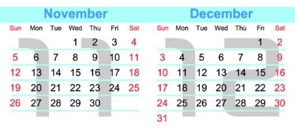
Course Withdrawal Application
1. Via Information System
2. From Week 12 to 13 (May 6, 2024 ~ May 17, 2024)
3. You have to meet the minimum required
9

Slide 19
曠課資料上網查詢
同學若未依規定完成請假
教師網路登錄曠課資料
同學即時查詢曠課狀況
‹#›
Notes:
‹#›

Slide 20
Absence Record
❖ You may check your absence record from Information System.
12

Slide 21
預警作業
學習成就偏低學生（如：作業或報告未按時繳交；上課出席狀況不佳；平時考或期中考成績不佳等）
授課教師透過網路提供學生名單
5月2日起開放網路查詢
授課教師、導師及系主任進行輔導以提高學生之學習成效
‹#›
Notes:
‹#›

Slide 22
Precaution Mechanism
1. Subjects: low academic performance and low attendance.
2. Name lists are provided by lecturers via Information System.
3. Refer to system from May 2, 2024.
4. Guidance and assistance will be provided by tutors and heads of departments.
11

Slide 23
教學意見調查
本學期調查時間 期中教學調查 : 3月25日 ~ 4月12日 期末教學調查 : 5月13日 ~ 6月14日
請同學完成專業課程、通識課程、體育課程、實習及英文授課課程之調查。
問卷調查以匿名方式進行，請同學依時間登入應用系統填寫。
調查結果之數據、意見將提供給授課老師，作為教學改進之參考。
‹#›
Notes:
‹#›

Slide 24
The Survey of Teaching Performance
1. Survey time:
Mar 16~ Apr 12(before Mid-Term Exam)
May 13~Jun 14 (before Final Exam)
2. Survey has to be completed for the following courses: professional courses, physical education courses, course taught in English, and practicum/internship courses.
13

Slide 25
The Survey of Teaching Performance
3. Survey will be undertaken anonymously.
4. Survey results will be beneficial for teachers’ improvement.
5. Real-time Learning Diagnostics:
Course instructors can provide up-to-date information on students’ learning diagnostics.
14

Slide 26
課業輔導
課後輔導時間(office hour)
網路課業輔導(應用資訊系統)
免費補救教學課程(教師親自授課)
教學助理（TA)
‹#›
Notes:
‹#›

Slide 27
Academic Guidance and Assistance
1. Make appointments with teacher( office hour).
2. Guidance and Assistance from school’s website
3. Remedial Instruction provided by teachers.
4. Assistance by TA
5. Workshop held by Center for Learning
Development.
6. “Learning and Teaching Journal” published
by Center for Learning Development.
10

Slide 28
成績處理作業
成績核計採百分記分法，100分為滿分。
學士班以60分為及格，學業成績未達60分者不給予學分。
碩士班以70分為及格，學業成績未達70分者不給予學分。
學業成績可利用本校應用資訊系統查詢，學期結束由國際事務處郵寄至原就讀學校 。
成績複查請於學校應用資訊系統學期成績公告後10日內提出。
如需成績證明單，請於離開前至註冊組申請。
‹#›

Slide 29
Grade
1. Grades will be given by percentage; the full mark is 100%.
2. The passing score for undergraduate is 60%; students who receive less than 60% won’t be able to get the credits.
3. The passing score for postgraduate is 70%; students who receive less than 70% won’t be able to get the credits.
4. Students may check their scores via the Information System.
5. Score review should be applied for within ten days after the announcements of results.
15

Slide 30
遵守智慧財產權
提醒各位同學
使用原版教科書
利用二手書機制
活動中心-書局
二手書交易平台(學務處)
‹#›

Slide 31
Abide by the Intellectual Property Rights
1. Please use the original edition textbooks.
2. Sell/Buy second-hand textbooks via E-Da Bookstore
(in Student Activity Center).
17

Slide 32
圖書與資訊處
Office of Library and Information Services

Slide 33
內容
義守大學網頁服務
學生宿舍網路
校園授權軟體
電子郵件服務與Office365
校園無線網路
媒體實作教室
應用資訊系統
學習系統

Slide 34
Contents
ISU Web Service
Dormitory Network
Campus Student Software Authorization
Mail Service(Office 365)
Instructions on ISU Wi-Fi Connections
Media commons
Information System
Learning System

Slide 35
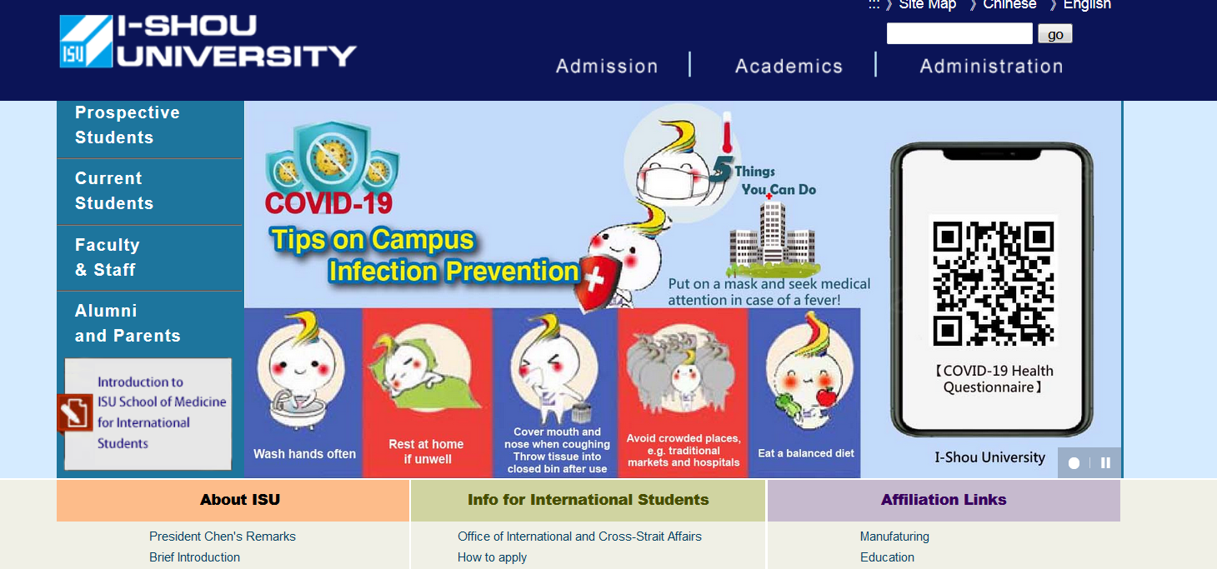
ISU English WEB
http://www.isu.edu.tw/en1

Slide 36
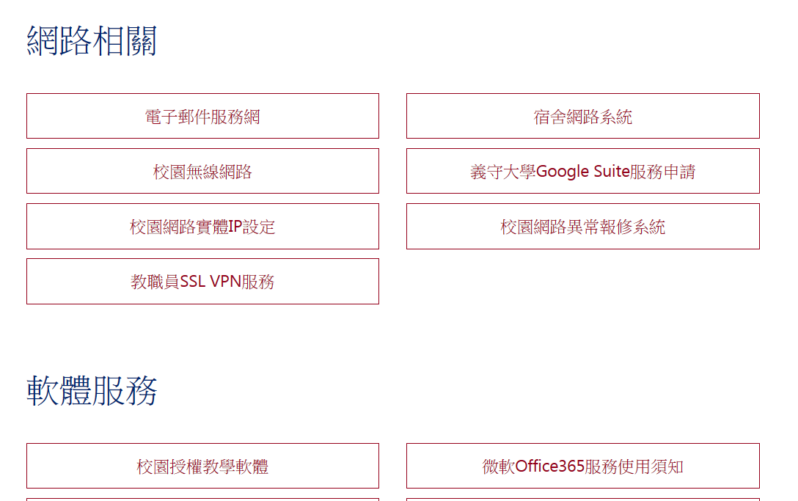
圖資處網頁服務

Slide 37
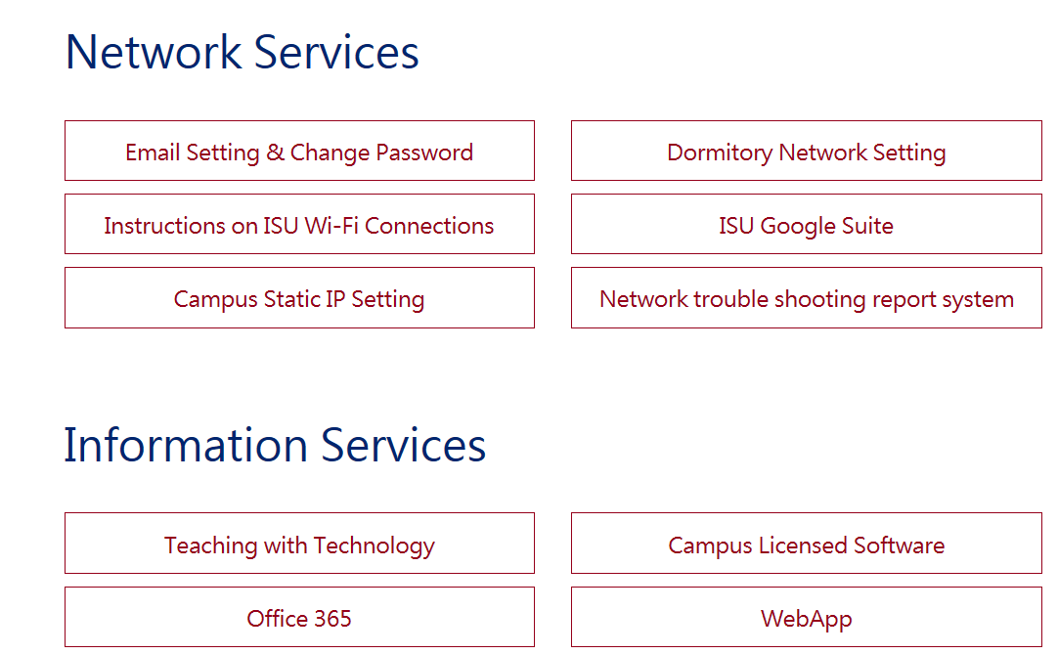
Web Path
English web->Administration->Office of Library and Information Services

Slide 38
學生宿舍網路
網路故障排除
宿舍管理站工讀生服務時間 19:00 to 23:00.
請勿下載未授權或非法軟體,影片等等.
每日每個IP下載與上傳流量總共5GB.
超過限制網路流量限制 64KB/s.

Slide 39
Dormitory Network
Network trouble report
Please come to dormitory office, the part time student operator will help from 19:00 to 23:00.
Please don't download the unauthorized digital data (including audio, video or software).
The daily transmission of the individual IP address shall not exceed 5GB/day (including uploading and downloading).
If over the quota, the network speed will be restricted to 64KB/s.

Slide 40
電子郵件信箱
學生帳號格式
isu + 學號
例如學號 11001001a 郵件帳號就是 isu11001001a, 以此類推isu11001001m, isu11001001d ….
初始密碼為學號全部英文字大寫 . 例如 : 11001001A
電子郵件格式 :
isu11001001a@cloud.isu.edu.tw
Notes:
‹#›

Slide 41
ISU Mail Account
Student mail account formation
isu + student number
if student number is 11001001a then the mail account is isu11001001a, according the rules others may be isu11001001m, isu11001001d ….
The original password is student ID with upper alphabetic character . For example : 11001001A
Email address :
isu11001001a@cloud.isu.edu.tw
Notes:
‹#›

Slide 42
郵件設定
選擇 “Exchange”
網域名稱 : cloud.isu.edu.tw
登入帳號 : isuxxxxxx@cloud.isu.edu.tw

Slide 43
Mail setting
Choose “Exchange”
Domain name : cloud.isu.edu.tw
Login : isuxxxxxx@cloud.isu.edu.tw

Slide 44
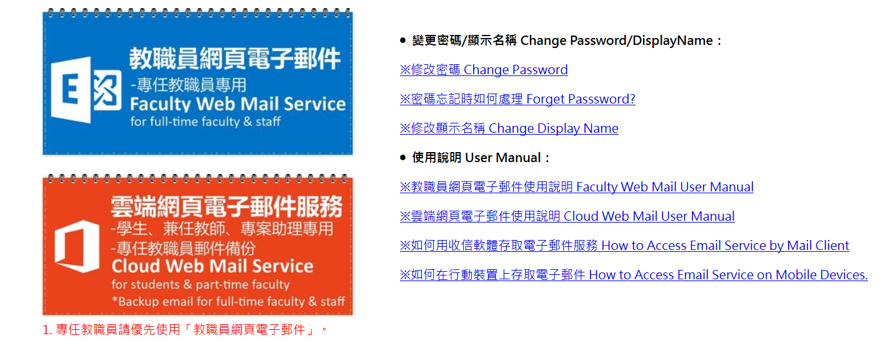
ISU 電郵服務網
The entry website: http://e-mail.isu.edu.tw

Slide 45
ISU Cloud Web Mail Service
The entry website: http://e-mail.isu.edu.tw

Slide 46
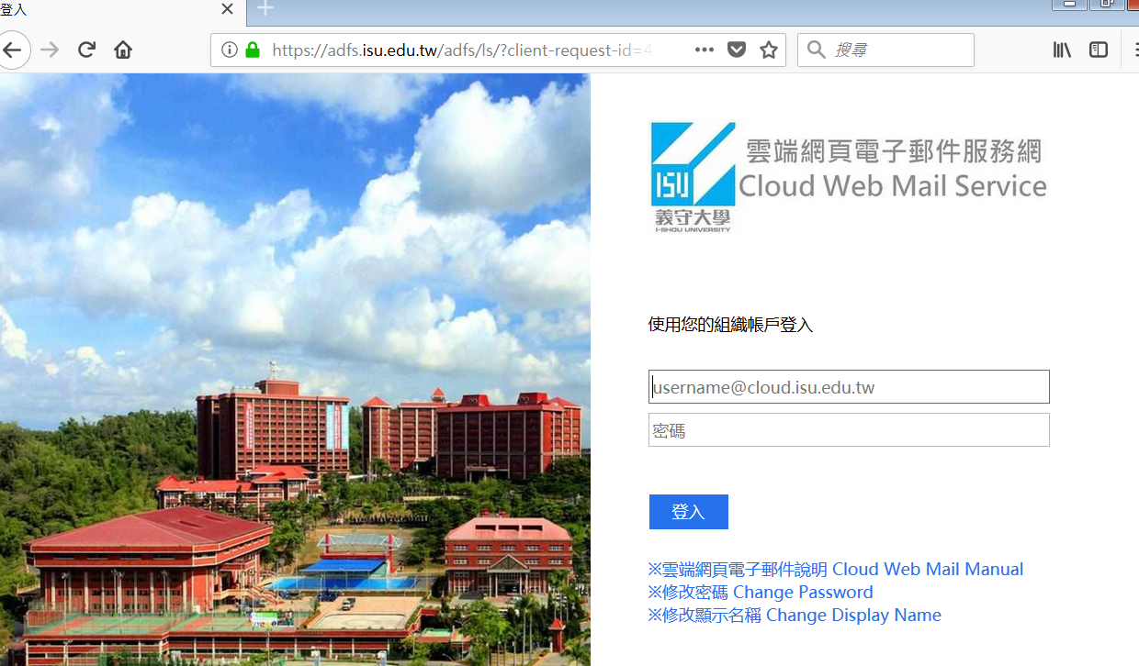
學生帳號登入

Slide 47
Student Mail Login

Slide 48
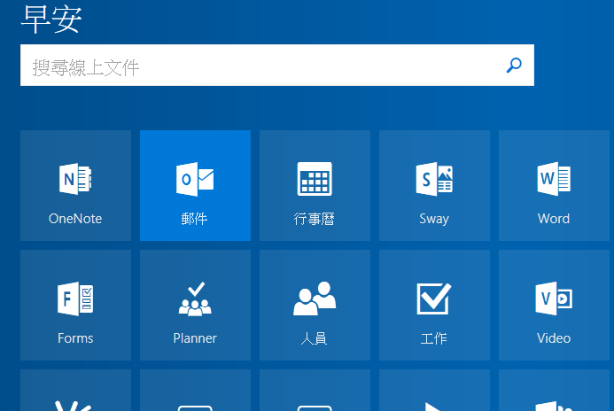
學生電郵

Slide 49
Student Mail

Slide 50
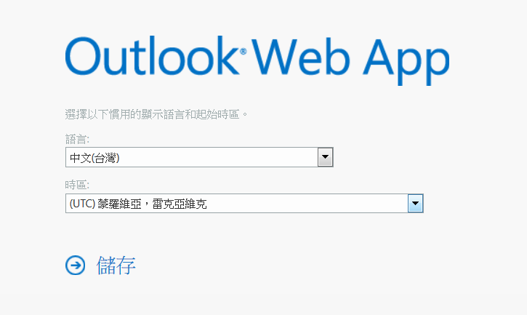
選擇語言及時區
初次登入
Language
save
Time(+8:00)

Slide 51
Select Language & Time Region
First time login
Language
save
Time(+8:00)

Slide 52
修改密碼

Slide 53
Change Password

Slide 54
校園授權軟體
Office 365
範圍 :
義守大學在學學生.
授權軟體 :
最新版Microsoft Office軟體
取得軟體
Office 365登入網頁

Slide 55
Campus Student Software Authorization – Office 365
Scope :
Every student who studies in ISU.
Authorization Software :
Latest version of Microsoft Office software
How to get the software media ?
Login office 365 website of ISU

Slide 56
Office 365

Slide 57
Office 365
在校教職員生使用學校的 Email 帳號，登入雲端網頁電子郵件服務網 就能夠開始使用所有 Office 365 服務！ 您可以在多達 5 部 PC 或 Mac、5 部平板電腦及 5 支智慧型手機上安裝 Office。
此軟件使用期限只限於在校就讀期間。

Slide 58
Office 365
Students can now enjoy a fully installed Office experience across personal PCs, Macs, tablets, and most mobile devices under the current Campus License Agreement with Microsoft with your valid ISU email address. You can install Office on up to 5 PCs/Macs + 5 tables + 5 smartphones.
The software only available while studying in ISU.

Slide 59
小心釣魚郵件
常見的偽裝寄件者account, upgrade, update, maintain, webmaster, web mail, support, admin, service .
常見的理由:系統更新,容量超過,系統維護,增加服務,,,
義守大學不會發信跟你/妳要求帳號密碼。收到此類信件時，請馬上刪除。

Slide 60
Be Aware of “phishing” Mail
The “phishing” emails may pretend to be sent from system administrator by means of some keywords shown within the received email subject or sender, such as account, upgrade, update, maintain, webmaster, web mail, support, admin, service , and then ask you to give email account and password due to a software upgrading, or system maintaining requirement.
Please delete these mails immediately. The ISU computer center would never send email for asking user to give their account and password in any circumstances.

Slide 61
無線網路連線
支援常用系統 (Microsoft, iOS or Android system)
SSID:
ISU
ISU-secure: The encryption in transmission is enabled.
使用瀏覽器軟體(IE, Firefox, Chrome…)
登入帳號與密碼

Slide 62
Instructions on ISU Wi-Fi Connections
The ISU wireless local area network (WLAN) supports network access for mobile devices (Microsoft, iOS or Android system)
Two sets of SSIDs are available if the Wi-Fi connection is enabled:
ISU
ISU-secure: The encryption in transmission is enabled.
Open browse software(IE, Firefox, Chrome…)
Login email account and password

Slide 63
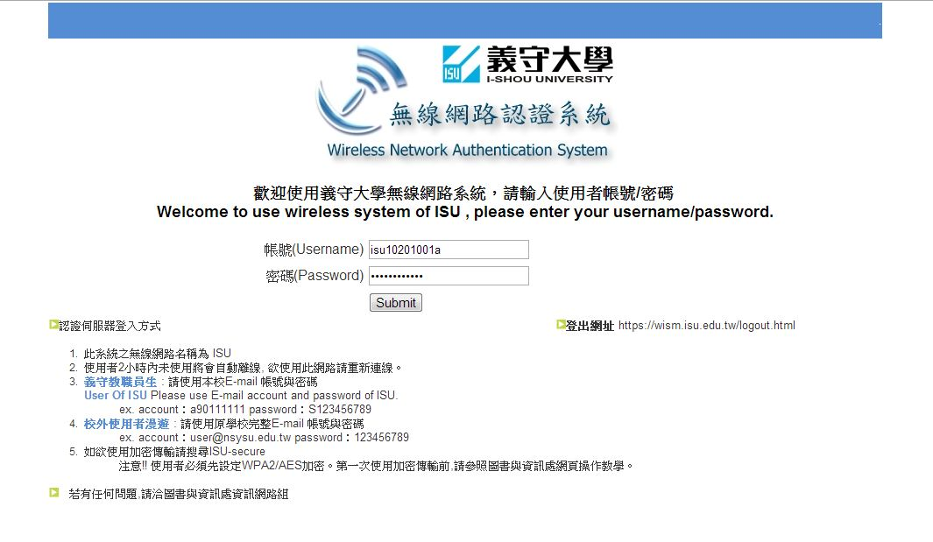
無線網路登入畫面
Notes:
‹#›

Slide 64
ISU Wireless Login
Notes:
‹#›

Slide 65
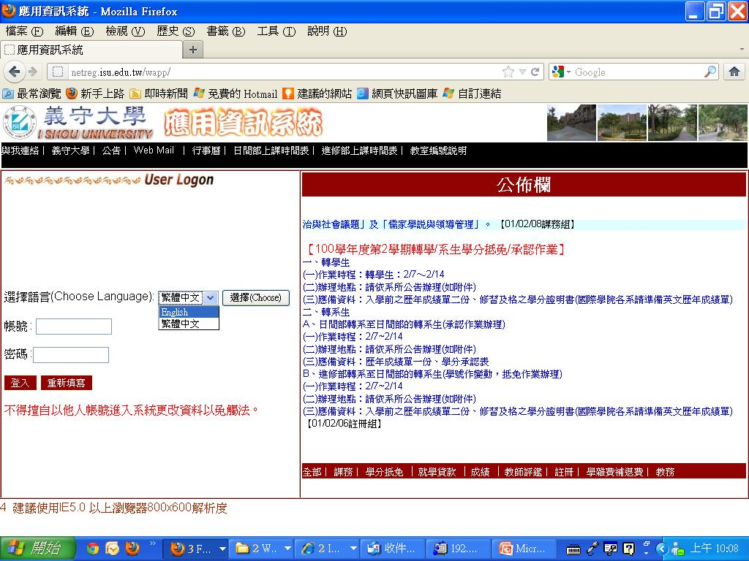
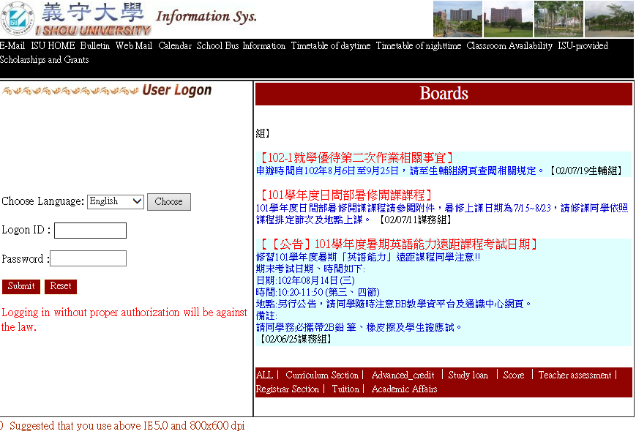
Information System
Course information, Course select, Office hour…
http://netreg.isu.edu.tw/wapp
select English

Slide 66
應用資訊系統
選課，課程資訊…
http://netreg.isu.edu.tw/wapp
select English

Slide 67
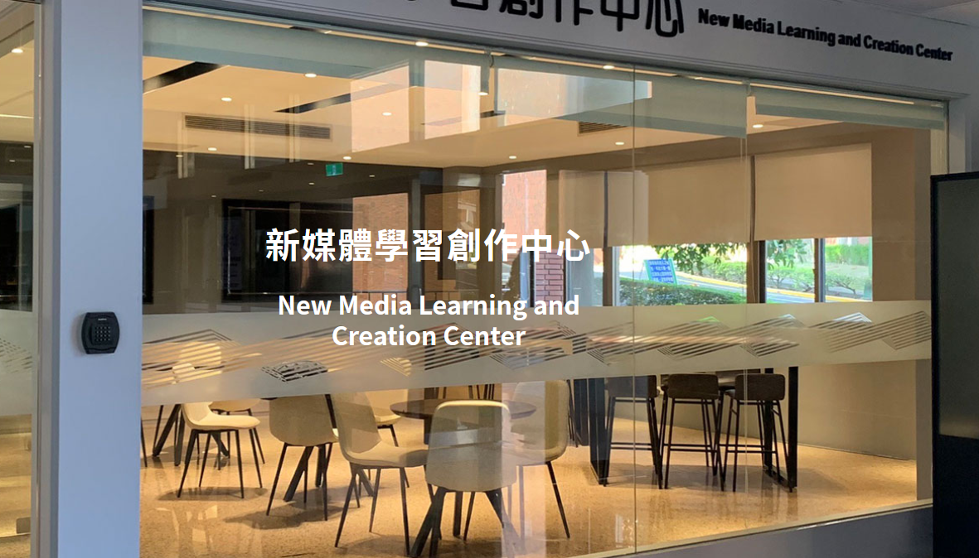
New Media Center

Slide 68
新媒體中心

Slide 69
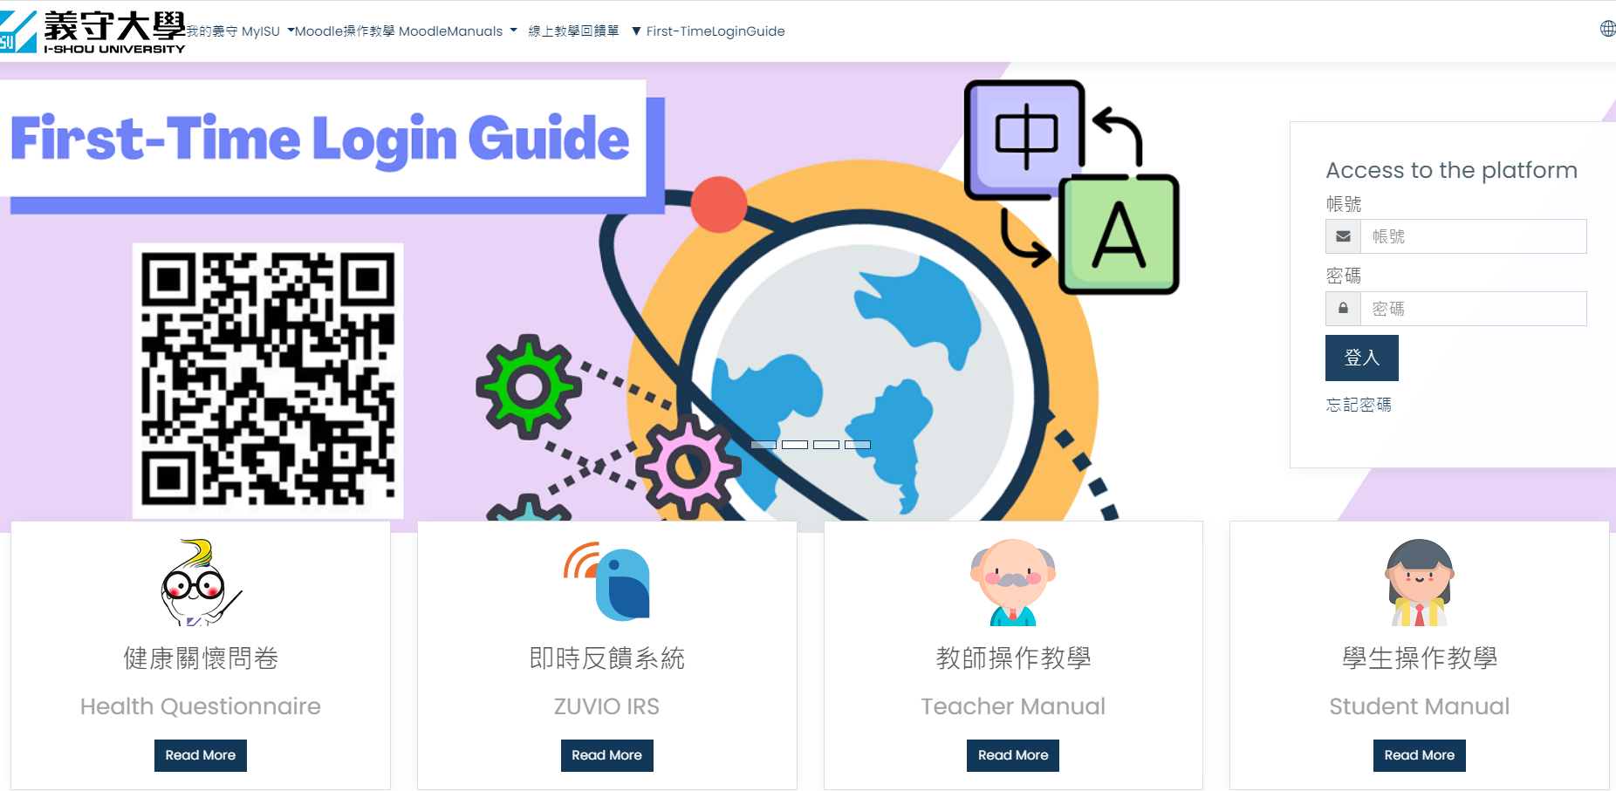
學習系統
Moodle 學習系統 (http://moodle.isu.edu.tw)

Slide 70
Learning System
Moodle Learning System (http://moodle.isu.edu.tw/?lang=en)

Slide 71
圖書館導覽
Library Orientation

Slide 72
圖書館地點
一般資訊
查找書籍
管理圖書館個人帳號
電子資源
圖書館環境介紹
小組討論室
活動

Slide 73
Location
General Information
Browsing Catalog
Personal Library Account
E-Resources
Photo Gallery
Study Rooms
Library Activities

Slide 74
義守大學圖書館
B1~3F
校本部 科技大樓
圖書總館
3F
校本部 國際學院大樓
國際分館
醫學院區
A棟
B棟
2F~3F
醫學院區 分館
3F

Slide 75
ISU Libraries
B1~3F
Main Campus
Science & Technology Building
Main Library
3F
Main Campus
International College Building
International College
Medical Campus
Medical Campus
Building A
Building B
2F~3F
3F

Slide 76
開館時間
總館
醫學分館
國際分館
圖書館 | 一~五 08:10 – 22:00 六、日 09:10 – 17:00
視聽媒體服務 | 一~五 08:10 – 19:00 六、日 09:10 – 16:50
圖書館 | 一~五 08:10 – 22:00 六 09:10 – 17:00、日12:00 – 17:00
視聽媒體服務 | 一~五 08:10 – 19:00 六、日 Closed
圖書館 | 一~五 08:10 – 17:00 六、日 Closed
視聽媒體服務 | 一~五 08:10 – 17:00 六、日 Closed

Slide 77
Opening Hours
Main Campus
Library | Monday ~Friday 08:10 – 22:00 Saturday & Sunday 09:10 – 17:00
Media Services | Monday ~ Friday 08:10 – 19:00 Saturday & Sunday 09:10 – 16:50
Medical Campus
Library | Monday ~Friday 08:10 – 22:00 Saturday 09:10 – 17:00 Sunday 12:00 – 17:00
Media Services | Monday ~ Friday 08:10 – 19:00 Saturday & Sunday Closed
International College
Library | Monday ~Friday 08:10 – 17:00 Saturday & Sunday closed
Media Services | Monday ~ Friday 08:10 – 17:00 Saturday & Sunday closed

Slide 78
開館時間
參考諮詢 Services
自修室
一~五 08:10 – 17:00
六、日 Closed
總館 | 一~日 08:00 – 23:00
醫學分館 | 一~日 08:00 – 24:00
國際分館 | 一~五 08:00 – 18:00 六、日 Closed
國定假日閉館
連續假日及寒暑假另行公告

Slide 79
Opening Hours
References and Information Services
Study Halls
Monday ~ Friday 08:10 – 17:00
Saturday & Sunday Closed
Main Library | Monday ~ Sunday 08:00 – 23:00
Medical Campus Library | Monday ~ Sunday 08:00 – 24:00
International College Library | Monday ~ Friday 08:00 – 18:00 Saturday & Sunday Closed
The Office of Library and Information Services are closed on national and school holidays.
Hours during winter and summer vacations are as announced.
Special announcements will be posted regarding intersession hours and holiday closings.

Slide 80
借閱冊數及期限
攜帶學生證入館及借書
逾期罰款：每本每天2元
 | 借書冊數 | 借閱天數
大學部 | 15 | 30
碩士生 | 20 | 30
博士生 | 25 | 30

Slide 81
Borrow、Return、Rules
Use students ID cards to borrow books
Overdue fines : 2 dollars per day per item
 | Maximum Number Of Checkouts | Loan Periods
Undergraduate | 15 | 30
Master | 20 | 30
Ph.D. | 25 | 30

Slide 82
小小叮嚀…
館內禁止飲食
手機轉無聲或震動
發揮公德心，共同維護環境清潔

Slide 83
Rules
Cherish the facilities in the library.

Slide 84
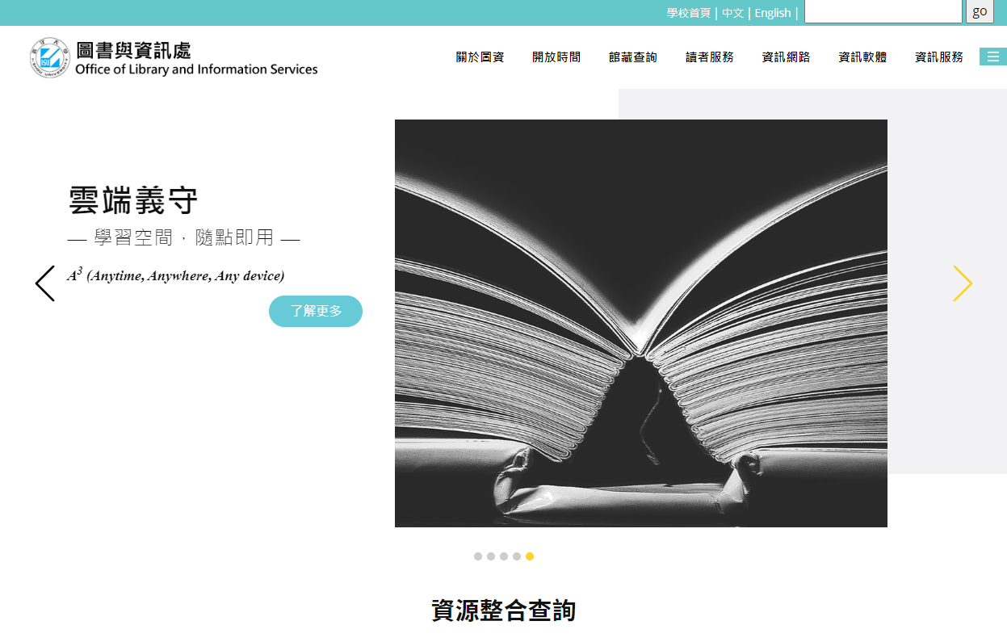
圖書與資訊處網頁
https://www.isu.edu.tw/newsite/homepage.php?dept_mno=808
學校首頁🡪 認識義守🡪行政單位🡪 圖書與資訊處

Slide 85
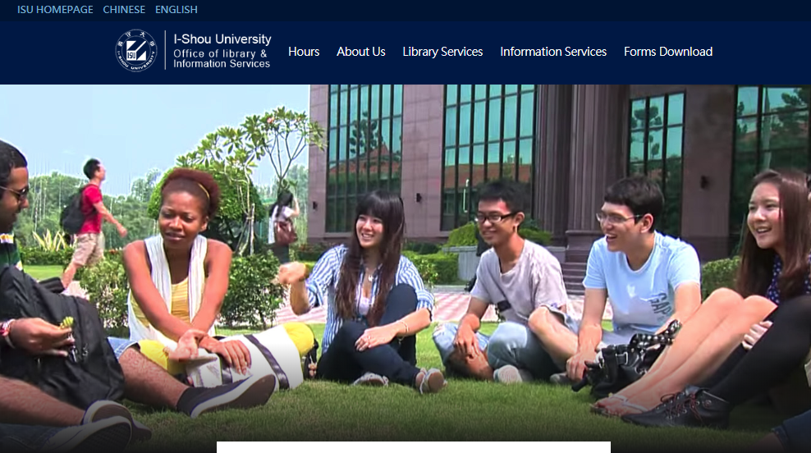
Library Website
ISU Homepage 🡪 Administration
🡪 Office of Library and Information Services

Slide 86
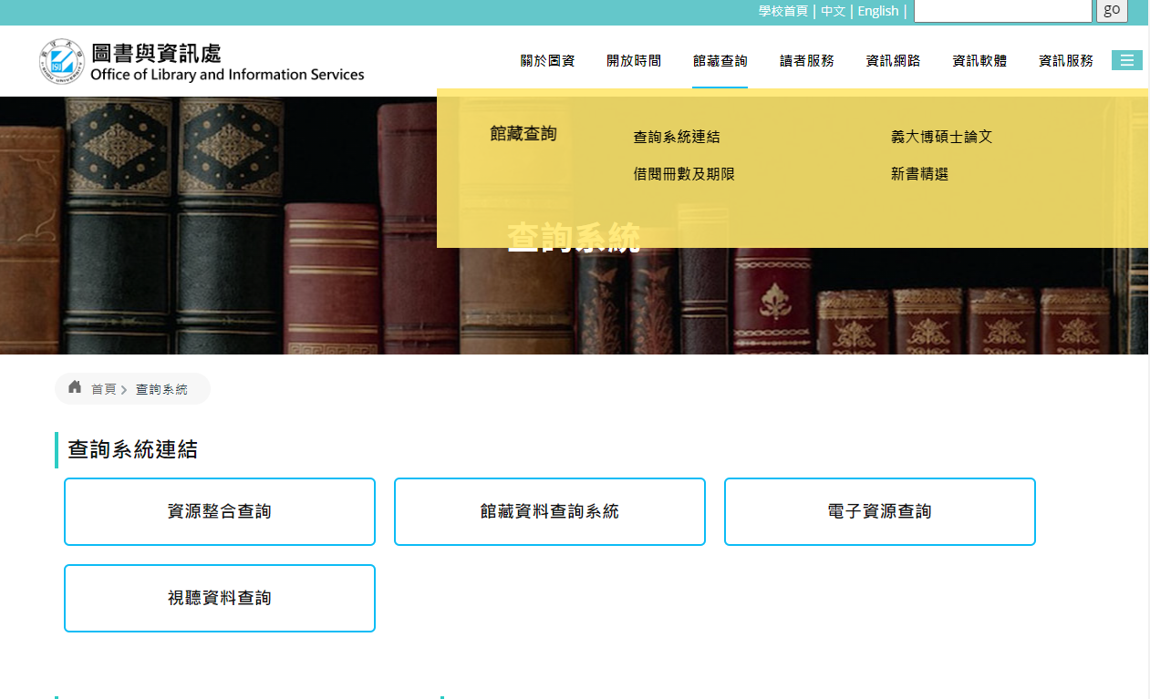
館藏資料查詢系統

Slide 87
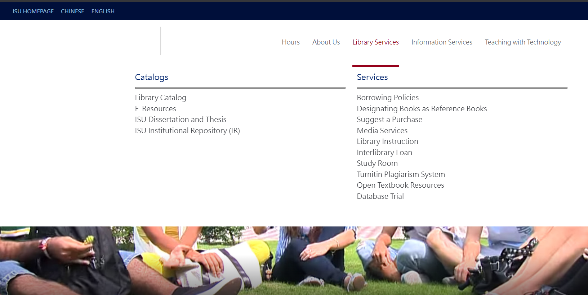
Browsing Catalog

Slide 88
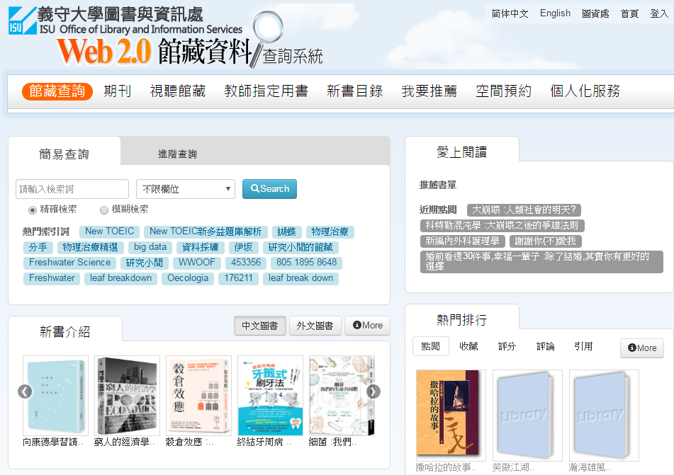
館藏資料查詢系統

Slide 89
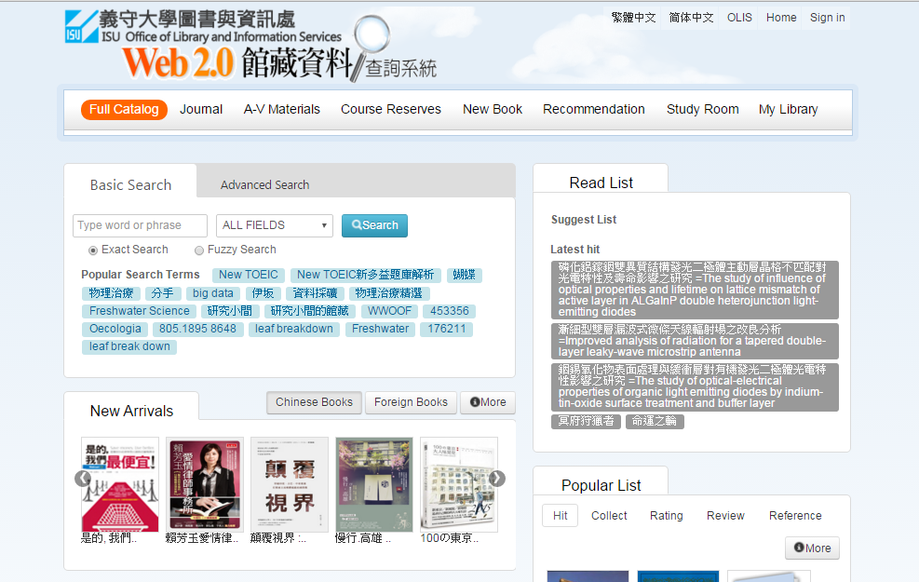
Browsing Catalog

Slide 90
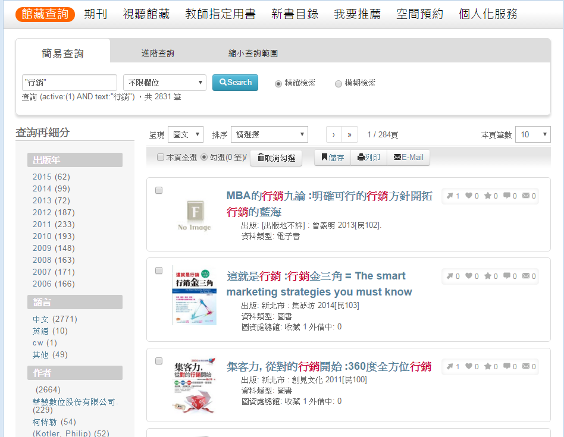
館藏資料查詢系統

Slide 91
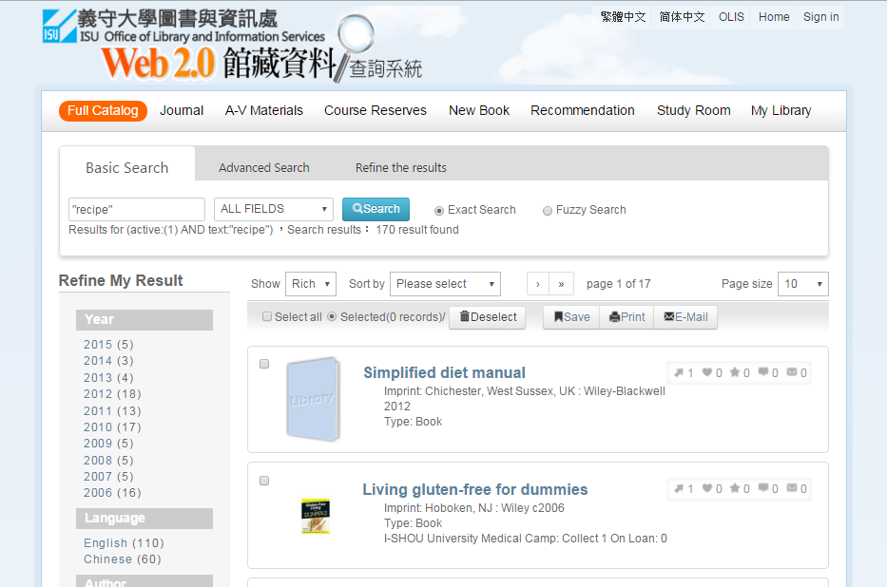
Browsing Catalog

Slide 92
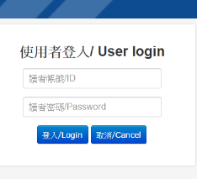
館藏資料查詢系統

Slide 93
Browsing Catalog

Slide 94
館藏資料查詢系統

Slide 95
Browsing Catalog

Slide 96
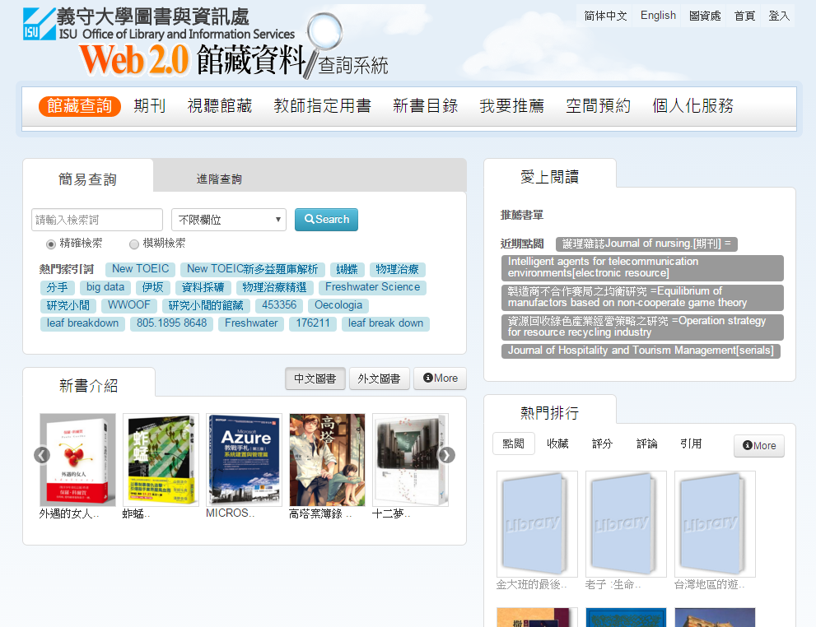
個人化服務

Slide 97
Library Account

Slide 98
個人化服務
使用者名稱

Slide 99
Library Account
User

Slide 100
個人化服務

Slide 101
Library Account

Slide 102
電子資源

Slide 103
E-Resources

Slide 104
電子資源
請使用本校郵件信箱帳號/密碼登入

Slide 105
E-Resources

Slide 106
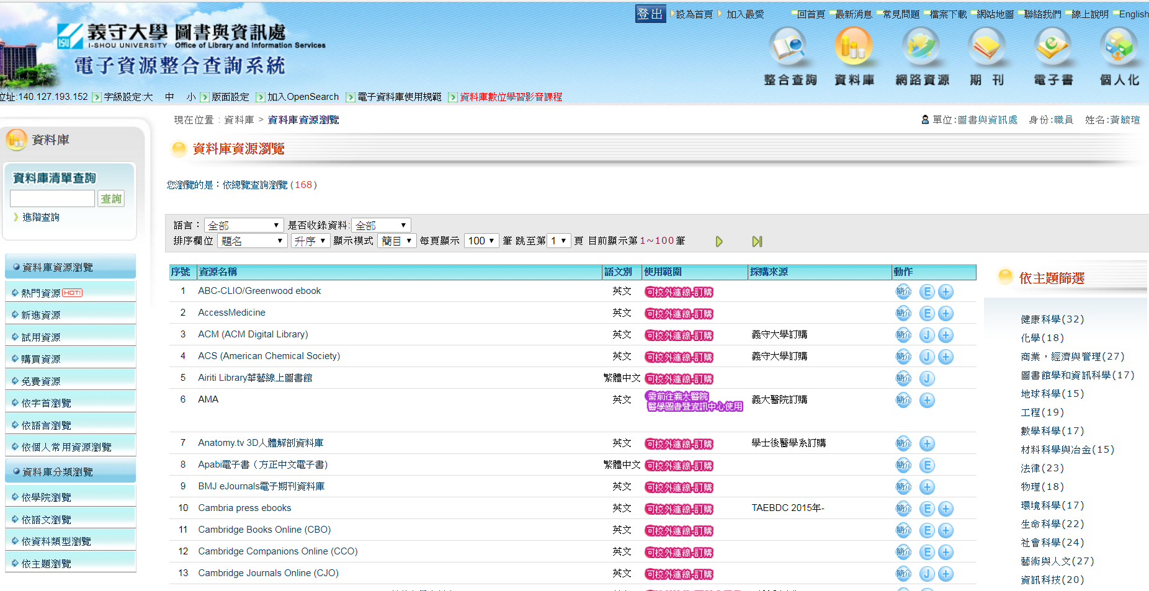
電子資源

Slide 107
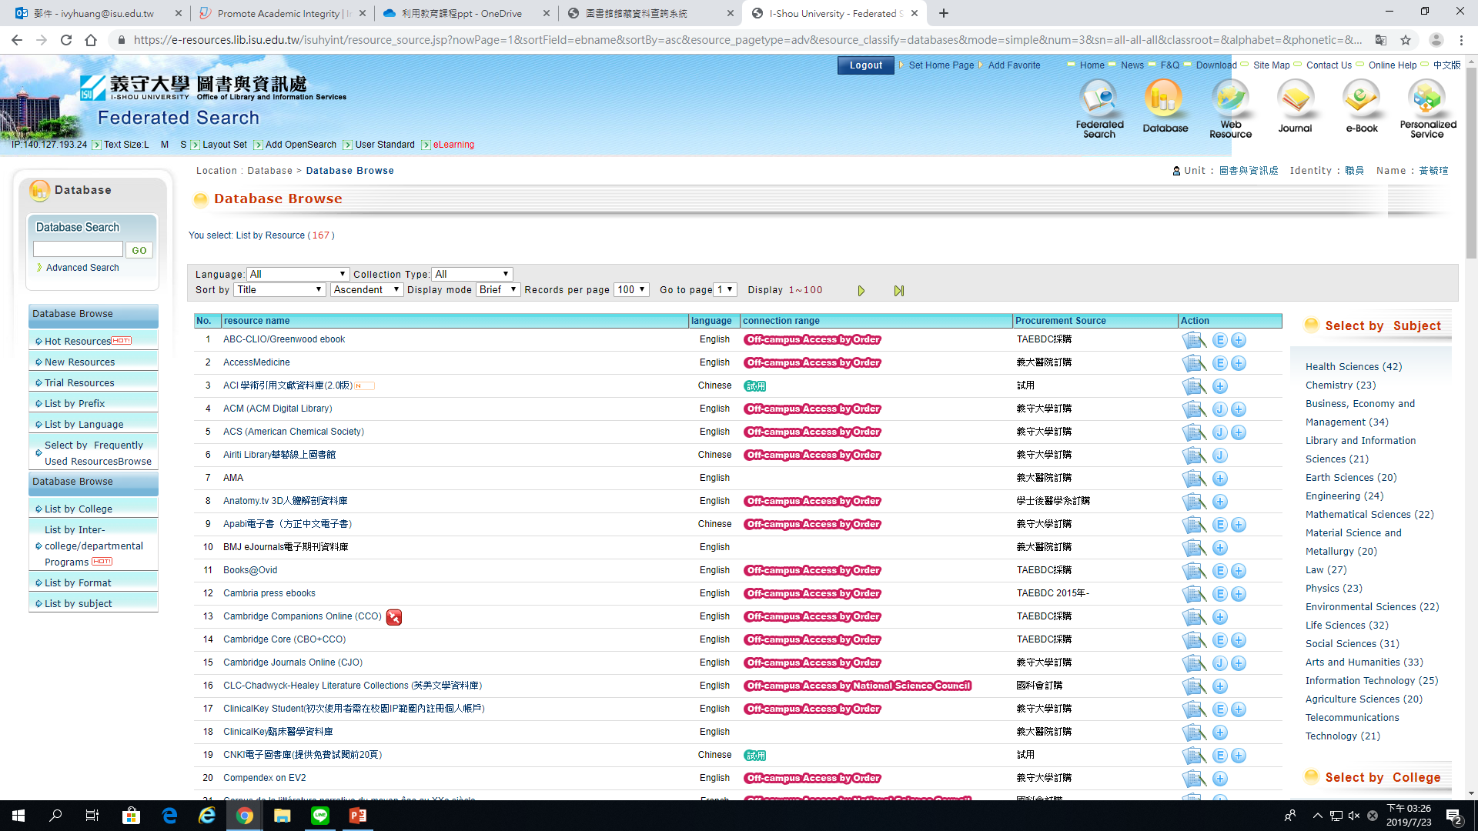
E-Resources
Read the database introduction

Slide 108
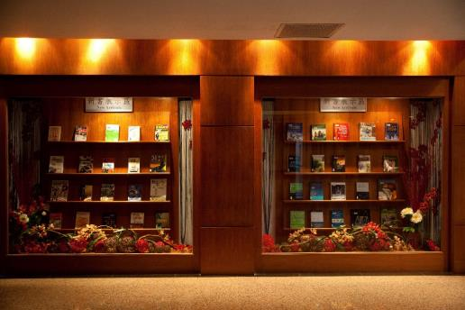
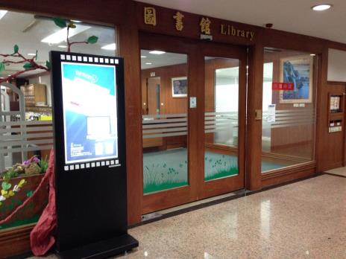
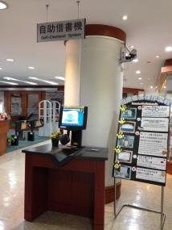
Photo Gallery

Slide 109
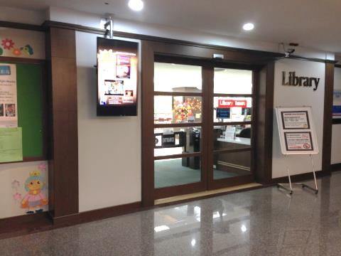
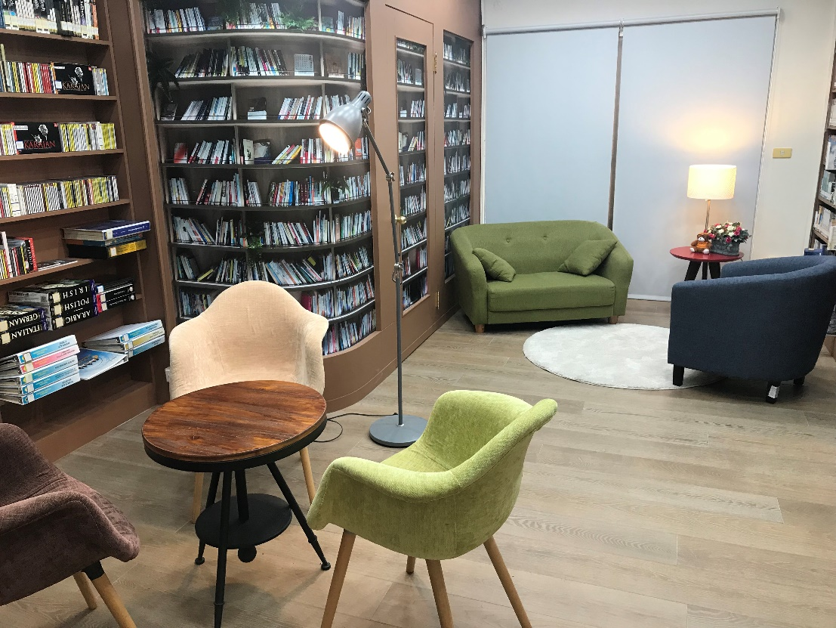
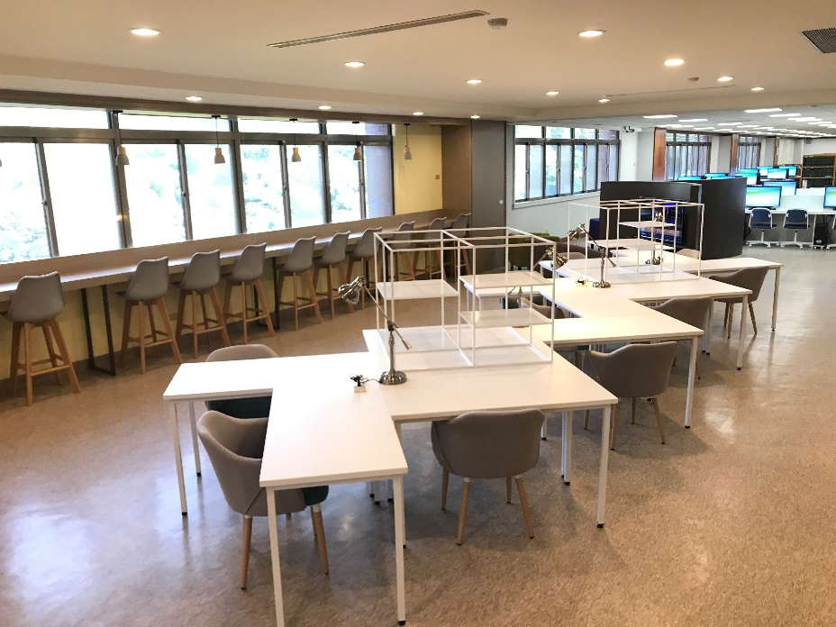
Photo Gallery

Slide 110
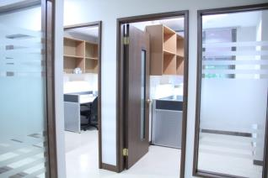
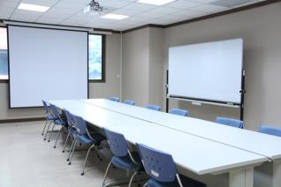
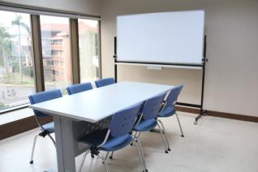
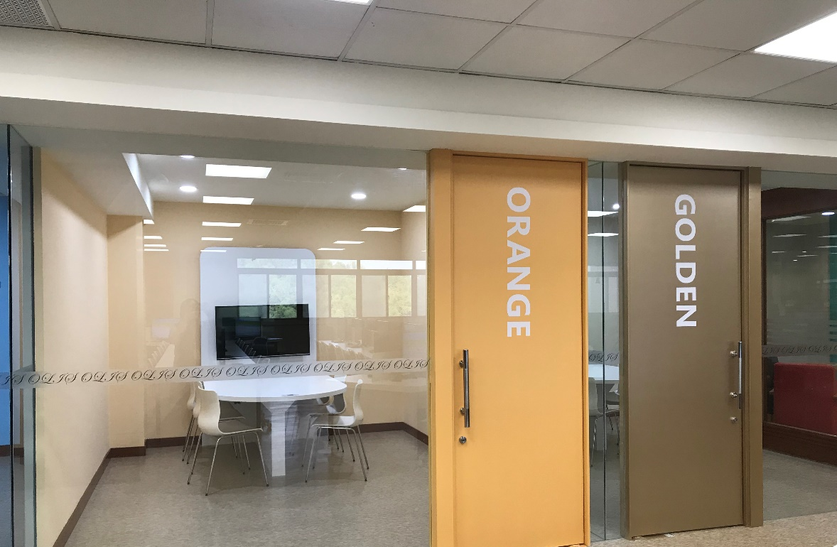
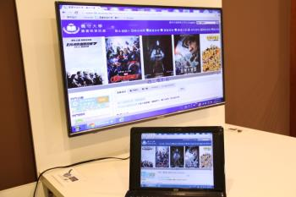
Study Rooms

Slide 111
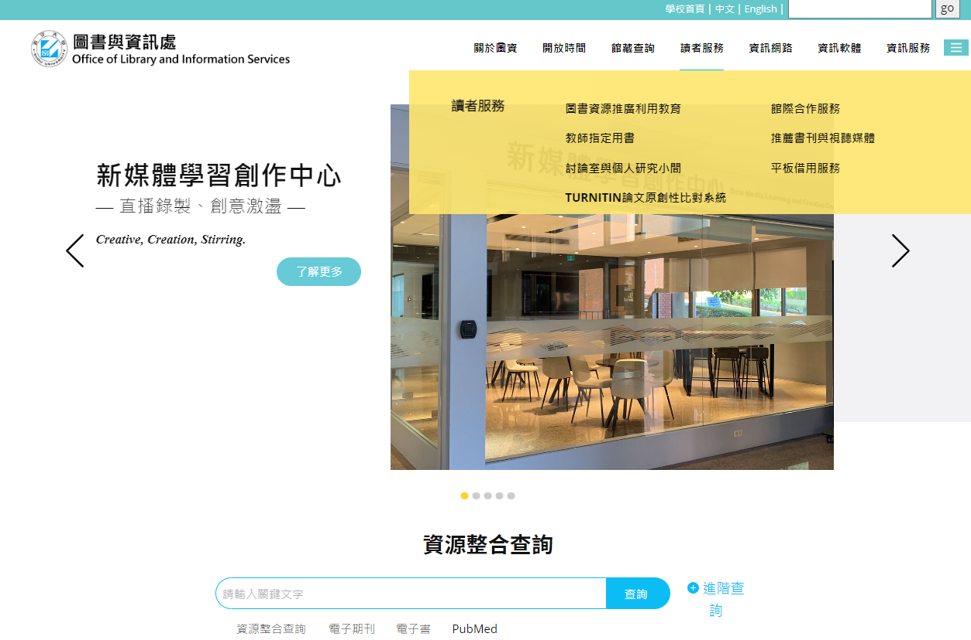
預約小組討論室

Slide 112
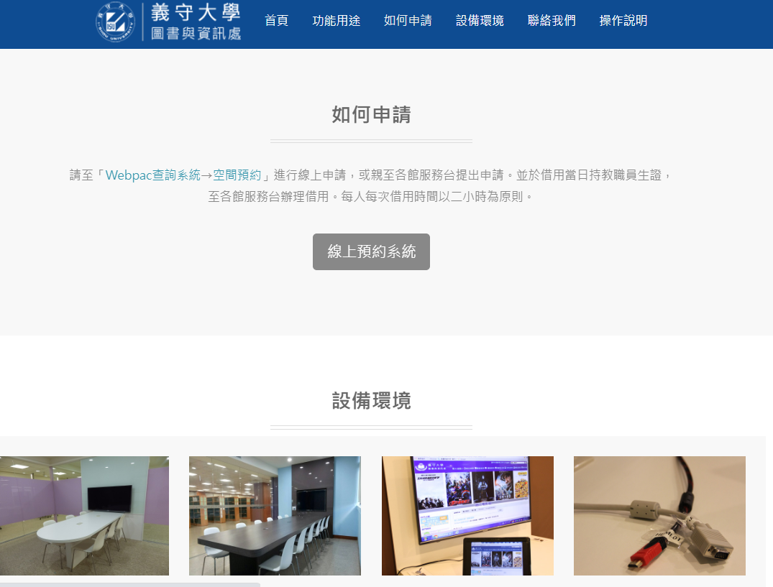
如何預約小組討論室?

Slide 113
To Reserve a Study Room
There have two ways to reserve!

Slide 114
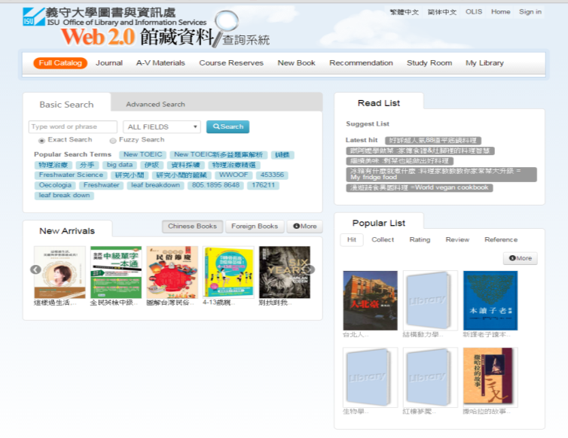
To Reserve a Study Room

Slide 115
Library Services 🡪 Media Services 🡪 Catalog
Media Services

Slide 116
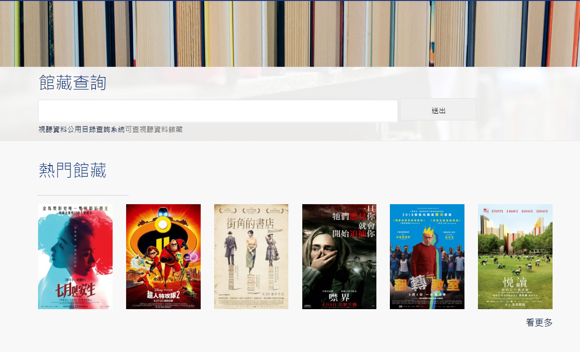
圖書服務 🡪 視聽媒體服務 🡪館藏查詢
查詢DVD館藏

Slide 117
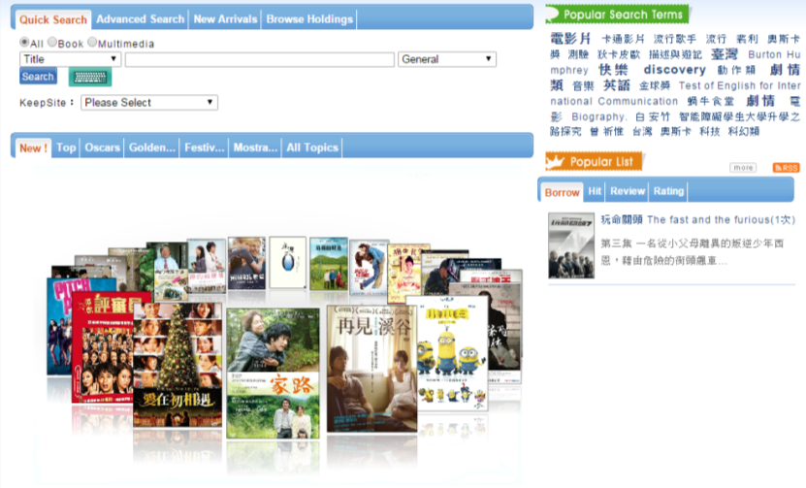
Media Services

Slide 118
Thank You

