Slide 1

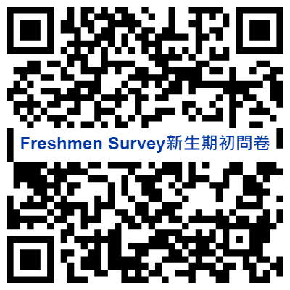
Welcome Mixer!
Overseas Student Welcome Party
境外生交流餐會
LET’S GET TO KNOW EACH OTHER!

Slide 2
Welcome Mixer!
LET’S GET TO KNOW EACH OTHER!

Slide 3
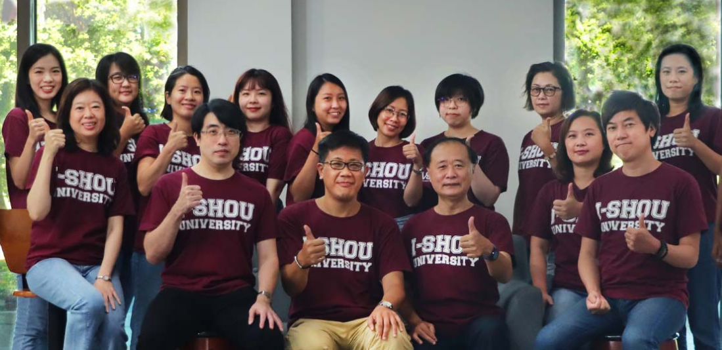
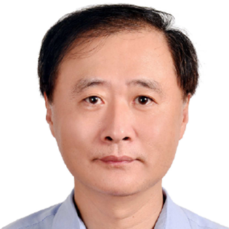
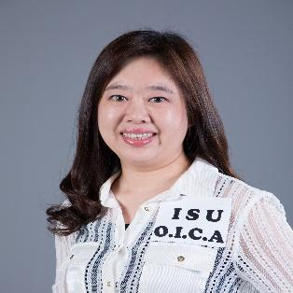
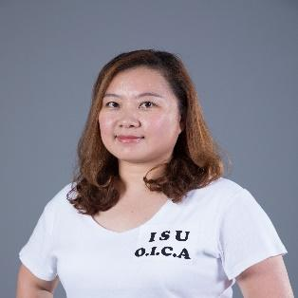
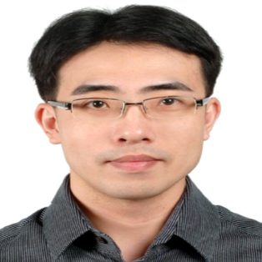
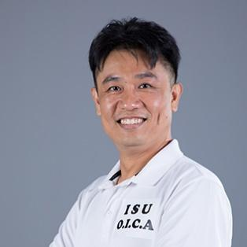
OICA TEAM
黃文琛 Dr. W.S. Huang
副處長 Vice Dean
黃文琛
Dr. W.S. Huang
吳岱栖
Dr. Taichi Wu
王尹琳 Jolin
許鳳真 Jane
林宜賢 Dr. Ethan Lin
副組長
Supervisor
Student Recruitment
副組長
Supervisor, Student Affairs
主任
Director, CLC & IFP
主任
Director, GMC
新南向專案辦公室
計畫執行長
林建良 Mark
阮秋芳 Celia
陳靜欣 Sophie
成楚琪 Alexis
簡意宜 Yiyi
方怡雅 Erin
黃郁雰 Annie
黃文怡 Gina
組員
組員
專案專員
專案組員
專員
(休假中) 組員
(代理人) 組員
專案專員
黃銘儀 Mingyi
廖經泓 Mac
王亭瓔 Kelly
陳美伶 Hanny
呂欣璇 Jessica
阮玉翠 Mia
王莉婷 Rhea
組員
組員
專案組員
專案組員
專案組員
專案組員
專案組員
郭麗涵 Lihan
黎丁高達 Joey
華語文中心 [CLC]
Chinese Language Center
專案組員
專案組員

Slide 4
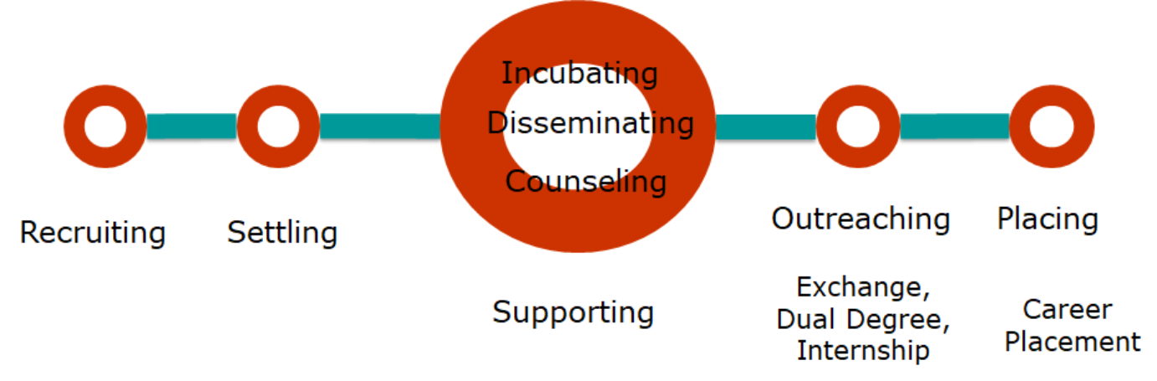
Our Mission
Enriching International Vision, Enhancing Intercultural Value
增進國際化視野、提升跨文化價值
E.I.V.
國際招生
數位行銷
學生照護
重點產業領域擴大招生計畫
數位
課程
華語文中心
國際移動力
職涯服務

Slide 5
國際及兩岸處任務
OICA Services
1. 招收境外學生TO RECRUIT OVERSEAS STUDENTS
2. 境外學生安頓TO FACILITATE THE SETTLING PROCESS FOR OVERSEAS STUDENTS
3. 協助境外學生在台生活TO PROVIDE SERVICES TO OVERSEAS STUDENTS WHILE LIVING IN TAIWAN (DOCUMENT APPLICATIONS, MENTORING & COUNSELING, ETC.)
4. 提供本校學生海外交流機會TO INCREASE OPPORTUNITIES FOR INTERNATIONAL EXPOSURE TO HOST COUNTRY STUDENTS
5. 推廣本校國際學術交流TO PROMOTE INTERNATIONAL CONNECTIONS
6. 舉辦及推廣跨文化活動，增進多元文化了解TO ORGANIZE SOCIAL AND CULTURAL ACTIVITIES TO PROMOTE INTERCULTURAL UNDERSTANDING AMONG STUDENTS
7. 扮演各行政單位與境外學生相關事務之橋樑TO ACT AS A LIAISON TO SUPPORT OTHER ISU UNITS WITH OVERSEAS STUDENTS-RELATED MATTERS
Notes:
1To recruit overseas students. 2To facilitate the settling process for overseas students.3To provide services to overseas students while living in Taiwan (document applications, mentoring & counseling, etc.).4To increase opportunities for international exposure to host country students .5 To promote international connections.6To organize social and cultural activities to promote intercultural understanding among students.7To act as a liaison to support other ISU units with overseas students-related matters

Slide 6
境外生SMILE有感輔導
連年獲教育部肯定績優輔導學校
到校前關懷、接機
基礎輔導–全方位資訊佈達、雙向溝通 :
手冊、簡報、公告、說明會、影片、社群平台、網頁
情感支持: 招生輔導一條龍、ISR、系所輔導
文化適應: 跨文化能力養成活動 (Taiwan Exploration, Global Lounge, Leadership training, I-Buddy)
語言適應: 華語文教學
友善適性就學措施: 獎助學金、彈性轉系
獎助學金
新生說明會、註冊
境外生照護
融入
在地文化
居留證、醫療保險、工作證
友善
校園
一對一
諮詢
疑難雜症

Slide 7
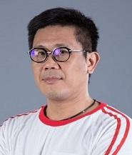
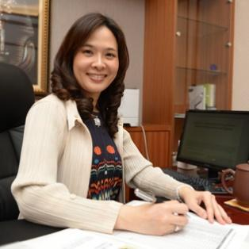
OICA TEAM
李嘉崑 Dr. Arthur Lee
林許淑謙 Dr. Anna Lin
處長 Dean
國際化資深顧問
Senior Consultant
黃文琛 Dr. W.S. Huang
吳岱栖 Dr. Taichi Wu
副處長 Vice Dean
國際化資深顧問
Senior Consultant
合作交流組
Student Recruitment Team
學生事務組
Student Affairs Team
國際專修部 [IFP]
International Foundation Program
國際移動力中心
Global Mobility Center [GMC]
黃文琛
Dr. W.S. Huang
林宜賢
Dr. Ethan Lin
王尹琳 Jolin
許鳳真 Jane
副組長
Supervisor
Student Recruitment
副組長
Supervisor, Student Affairs
主任
Director, CLC & IFP
主任
Director, GMC
林建良 Mark
阮秋芳 Celia
陳靜欣 Sophie
成楚琪 Alexis
簡意宜 Yiyi
方怡雅 Erin
魏家怡 Mita
組員
組員
專案專員
專案組員
專員
(休假中) 組員
(代理人) 組員
黃銘儀 Mingyi
廖經泓 Mac
王亭瓔 Kelly
陳美伶 Hanny
呂欣璇 Jessica
阮玉翠 Mia
組員
組員
專案組員
專案組員
專案組員
專案組員
郭麗涵 Lihan
黎丁高達 Joey
華語文中心 [CLC]
Chinese Language Center
專案組員
專案組員

Slide 8
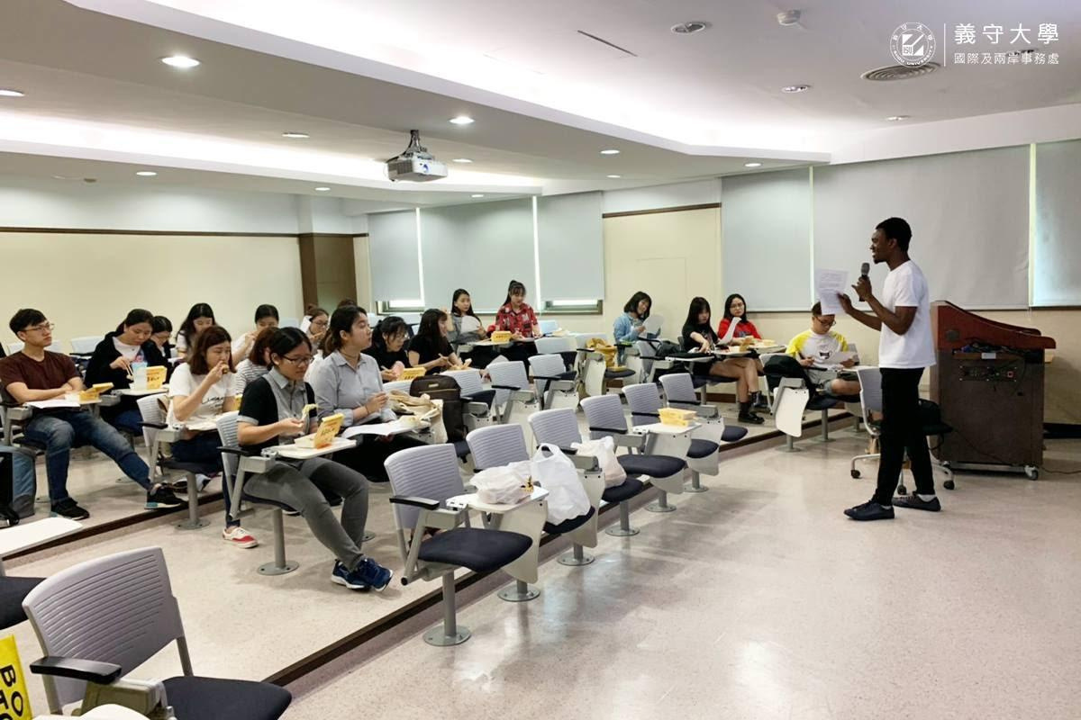
「大手牽小手」 & ELTA
Hands Together & English Learning Teaching Assistant Programs
「大手牽小手」& ELTA透過到國小高中介紹各國文化及英語學習、家鄉料理製作與各國傳統服飾展示等各種活動的舉辦，將大專院校國際學生引進台灣校園。
In order to add the color of exotic atmosphere and facilitate international students having face to face interactions with local high school students, the spindle of this program is based on “International vision, local communication” which will zoom in the world through activities such as introduce and inter-flow the national conditions, make homemade cuisine and display traditional costumes.

Slide 9
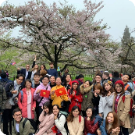
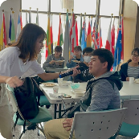


境外生年度活動規劃
序 | 項目 | 活動 | 備註
1. 學生輔導 | 1-1 台灣節慶 | 春節、端午節、中秋節 | 800人次
 | 1-2 文化適應 | 台灣探索 Taiwan Exploration | 500人次
 | 1-3 學生輔導 | 新生入學關懷、定向輔導、師生座談會、系所輔導 | 2000人次
2. 文化交流 | 2-1 義起遊世界 Global Lounge |  | 1500人次
 | 2-2 義守國際文化義術節ISUCF
 | 2-3 學伴主題活動
3. 學術教育 | 3-1 工作坊 | 多元知能: 媒體小編、社團幹部 | 400人次
 | 3-2 TEDxIShouUniversity
4. 年度行銷活動 | 國際文化之夜 Annual Gala-Cultural Ambassador |  | 1000次
5. 大學社會責任 | 大手牽小手/國中小英語教學助理 (ELTA) |  | 100人次

Slide 10

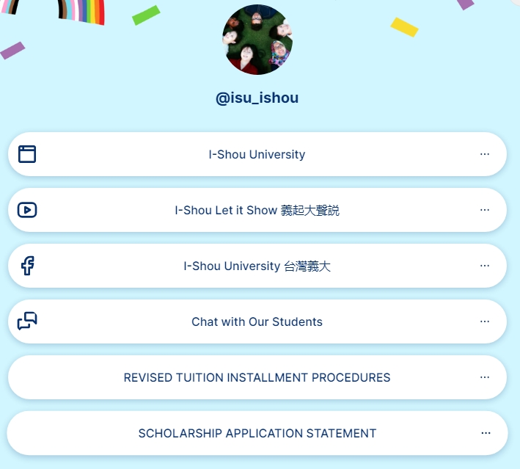
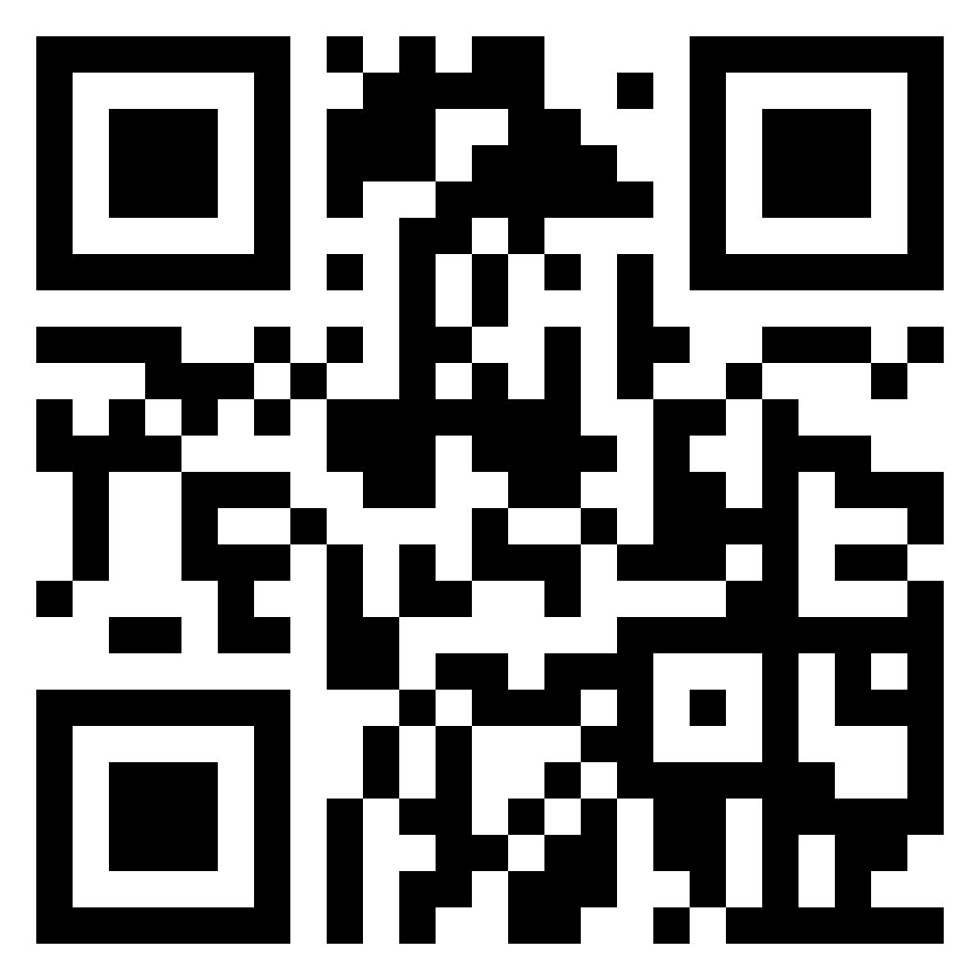
Follow us on Social Media

Slide 11

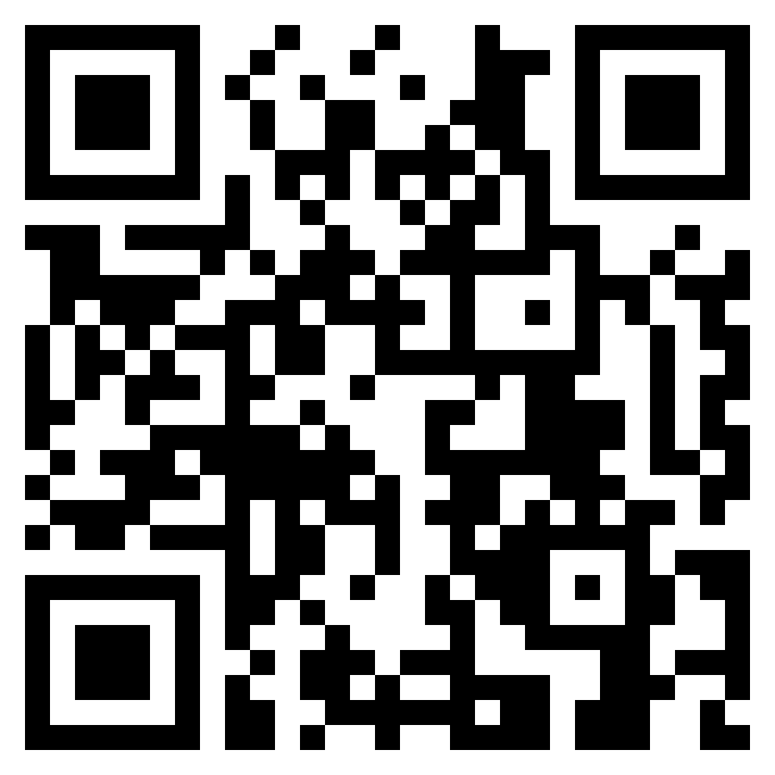
迎新活動 Welcome Party
Register Now

Slide 12

ISUISU
I-SHOU UNIVERSITY
INTERNATIONAL STUDENT UNION
義守大學無國界學生聯盟

Slide 13
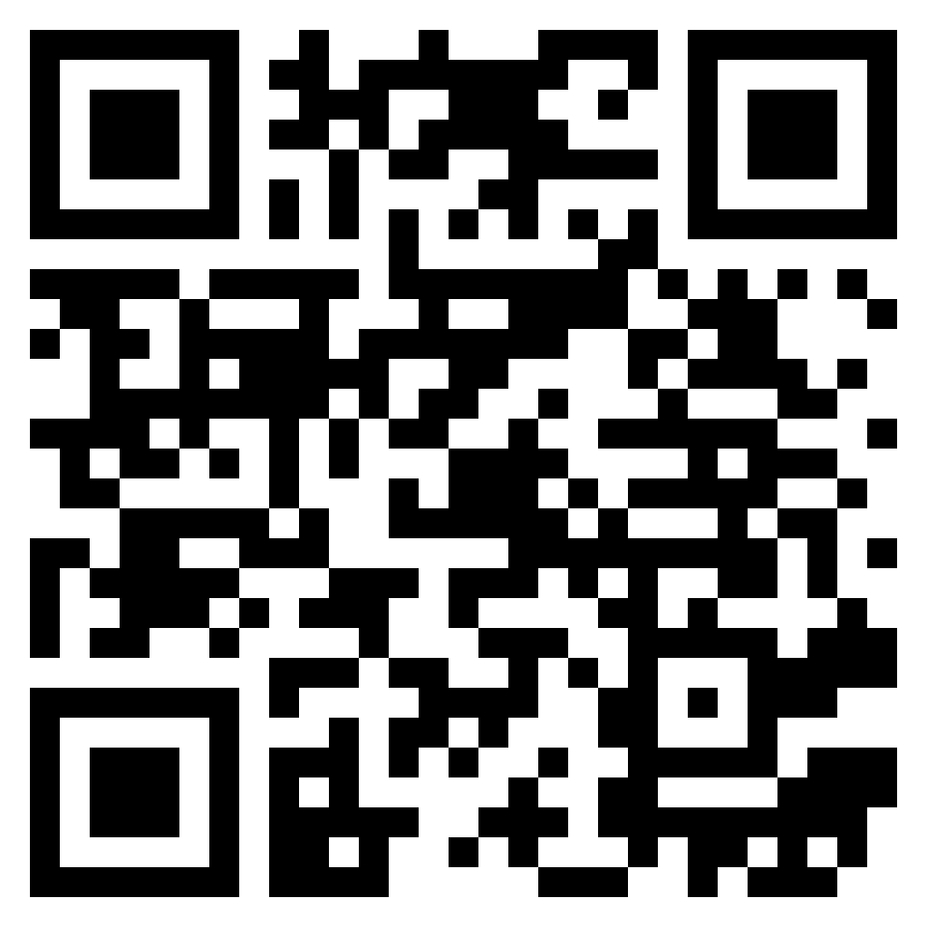
I-SHOU UNIVERSITY INTERNATIONAL STUDENT UNION
“TO REPRESENT INTERNATIONAL STUDENT BY PROVIDING PROJECT TO HELP STUDENTS TO BREAK THE BOUNDARIES THROUGH DEVELOPING GLOBAL AWARENESS, PROMOTING THEIR OWN CULTURE, AND SUPPORTING INTERNATIONAL STUDENT TO INVOLVE IN CAMPUS PROGRAMS AND ACTIVITIES.”
Notes:
Our vision is “To represent international student by providing project to help students to break the boundaries through developing global awareness, promoting their own culture, and supporting international student to involve in campus programs and activities.”

Slide 14

沉浸式學習
Academic Enhancement
我們相信文化不僅只於教科書中，它更是存在於我們的生活中。
At our prestigious institution, we believe culture doesn’t just exist in textbooks. It is in our lives.

Slide 15
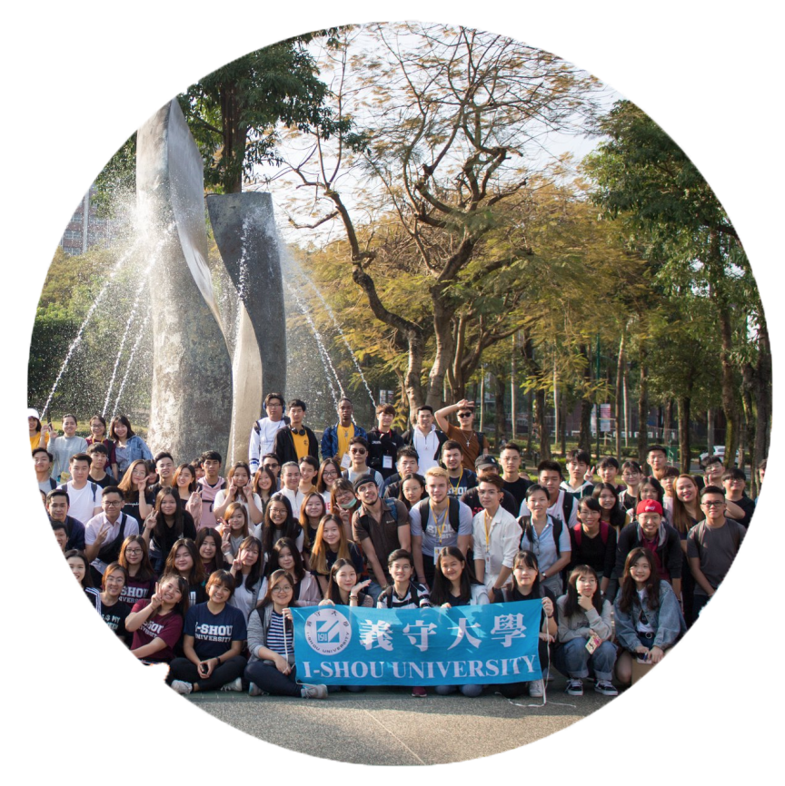
學生參與
建構四海義家
國際聚落
Student
Involvement
希望藉由了解彼此的文化，深化國際交流。
We hope to broaden your horizons with understanding of various cultures

Slide 16
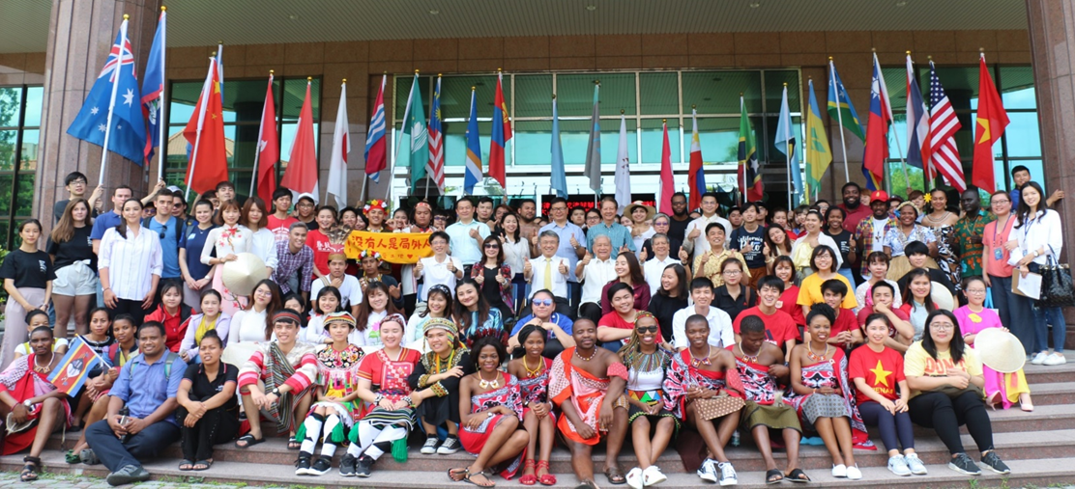

A Big International Family
1,469 students from 42 Countries
12% overseas

Slide 17












OICA
Advisors
President
會長
Chairman of Medical Campus
ISUISU Advisors
Vice President
副會長
Executive Secretary
秘書
VP Marketing
VP Finance
VP Membership
VP Student
Affairs
VP Academic Affairs
VP Audit
Media
義起大聲說
Youtube, IG, FB
Subsidy Allocation
ISR Monthly Meeting
師生座談月會
Cultural Festival
文化義術節
ISR Summit / TEDx
青年領袖論壇
Laws and Regulations
Taiwan Exploration
在地文化探索
Laws and Regulations
Alumni
海外校友會
Property Management
Hands2gether / ELTA
大手牵小手
Laws and Regulations
Merchant
Fund Raising
Current student (satisfaction survey)
在校生滿意度調查
IPAS
表演藝術
Performance Tracking
Global Lounge
世界交誼廳
(本地、境外交流平台)
All Students

Slide 18
Student Affairs Team
活動部

Slide 19
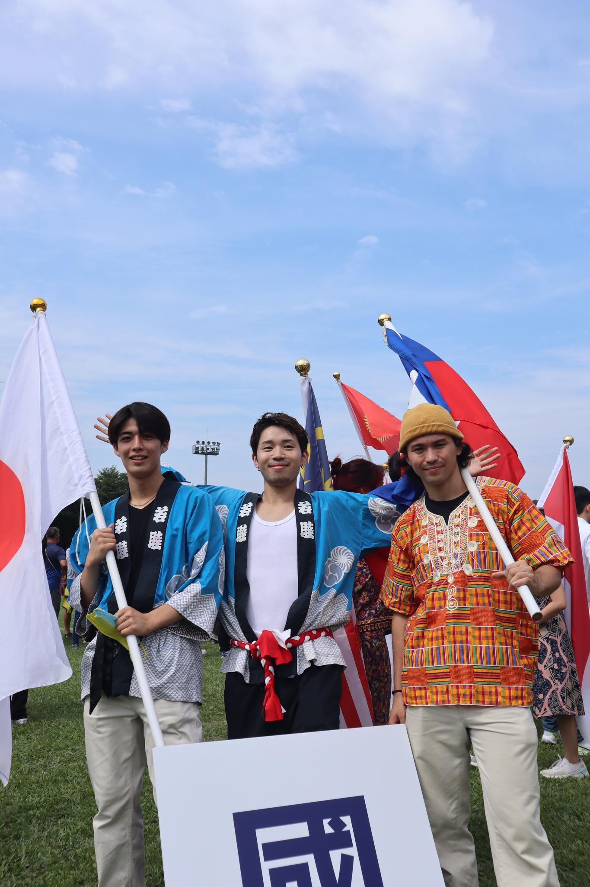
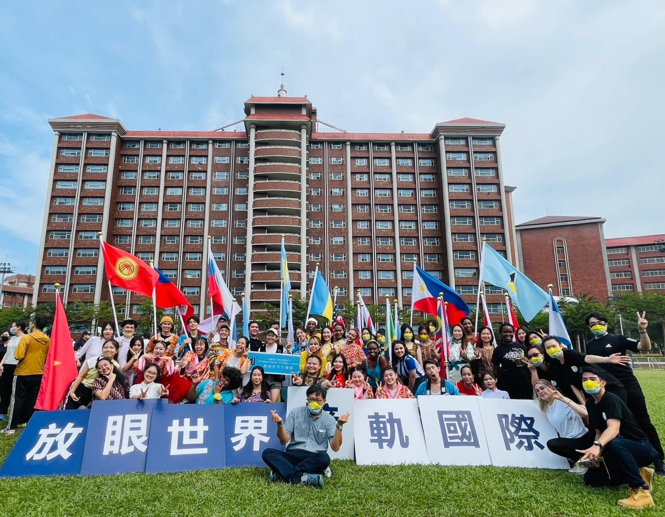
CULTURE FESTIVAL 國際文化義術節

Slide 20
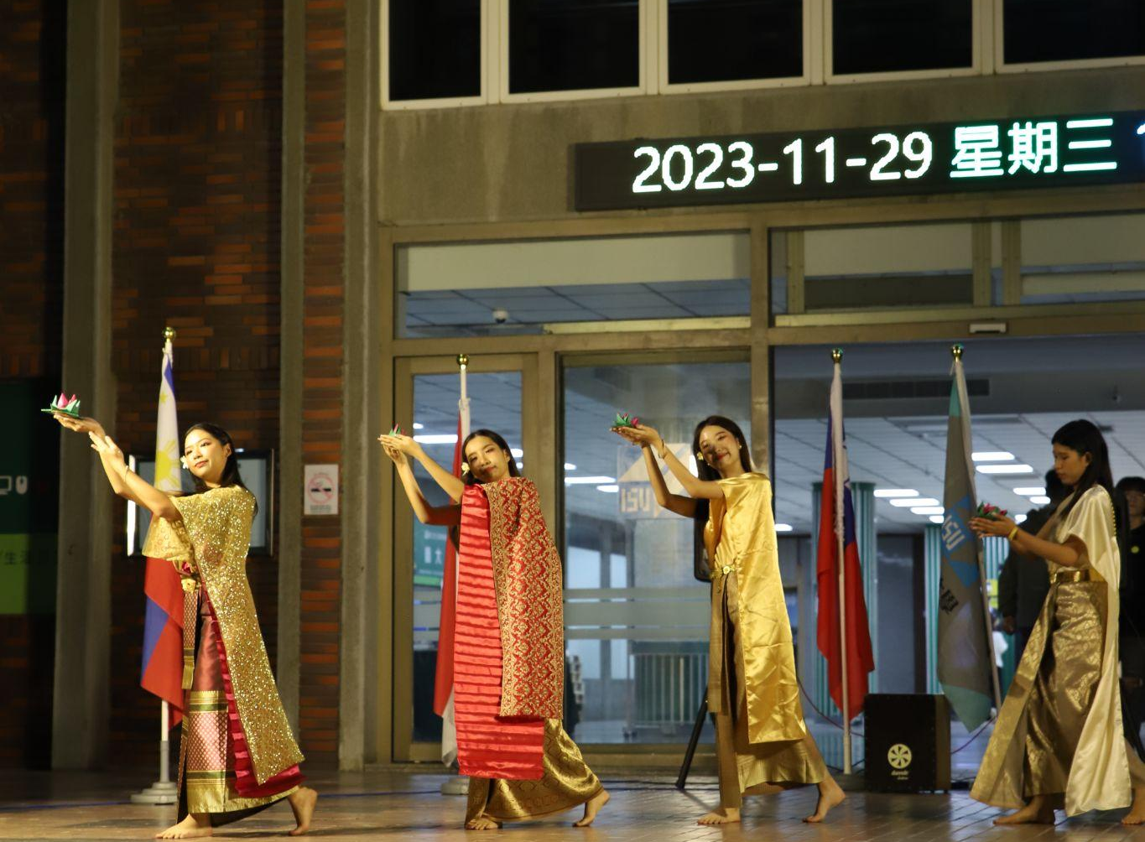
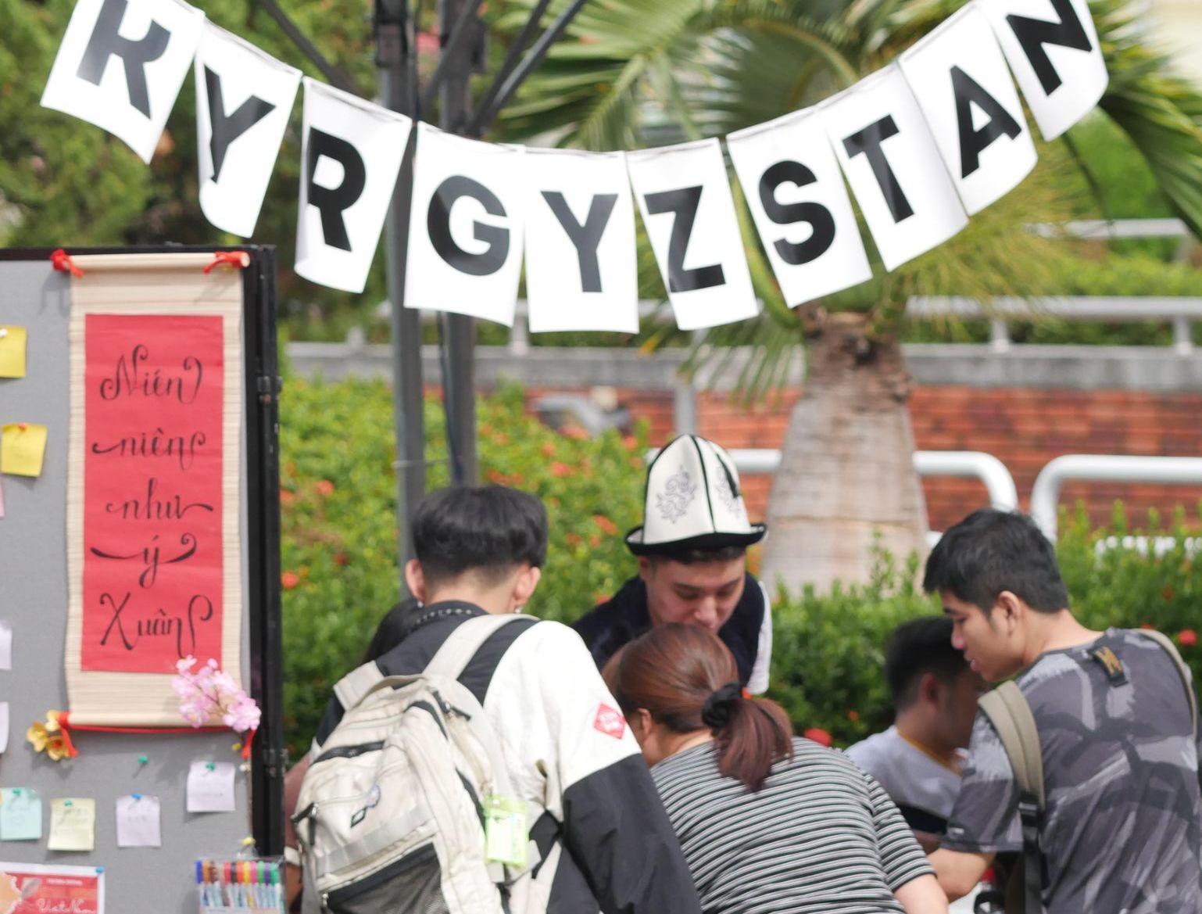
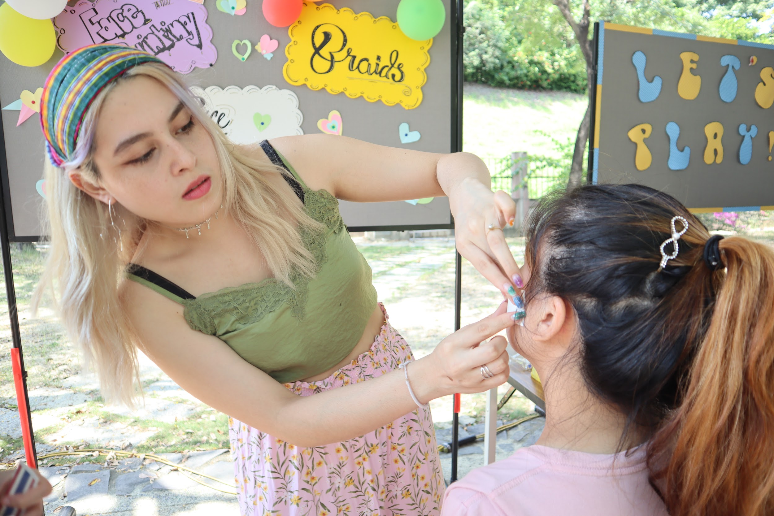
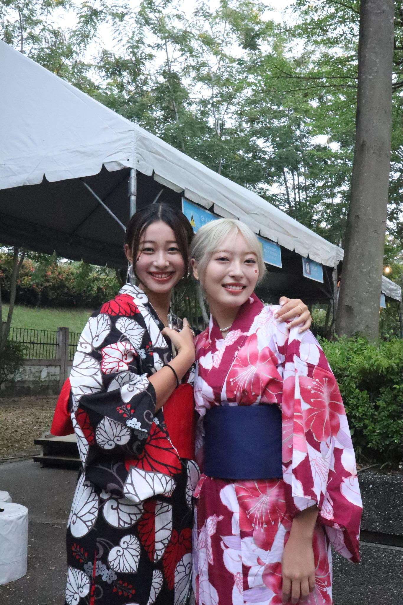
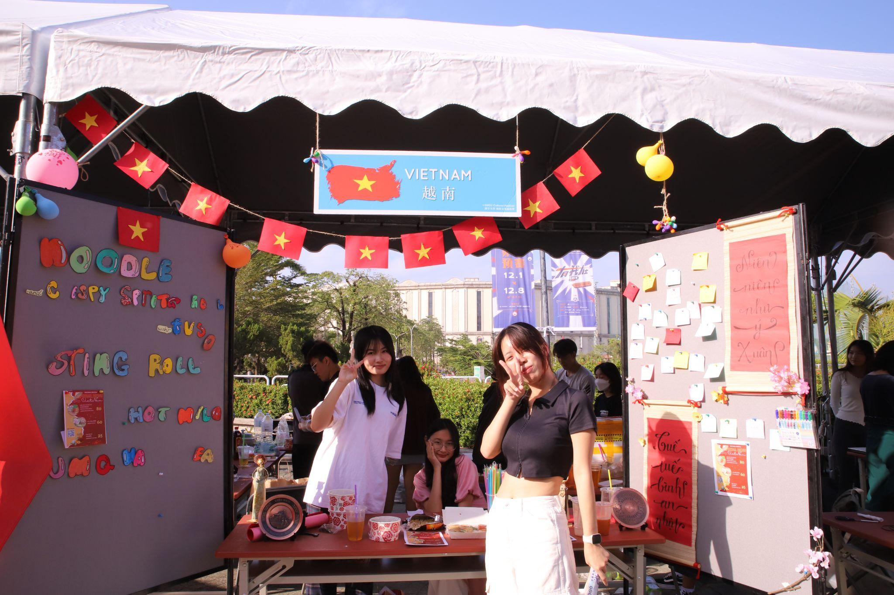
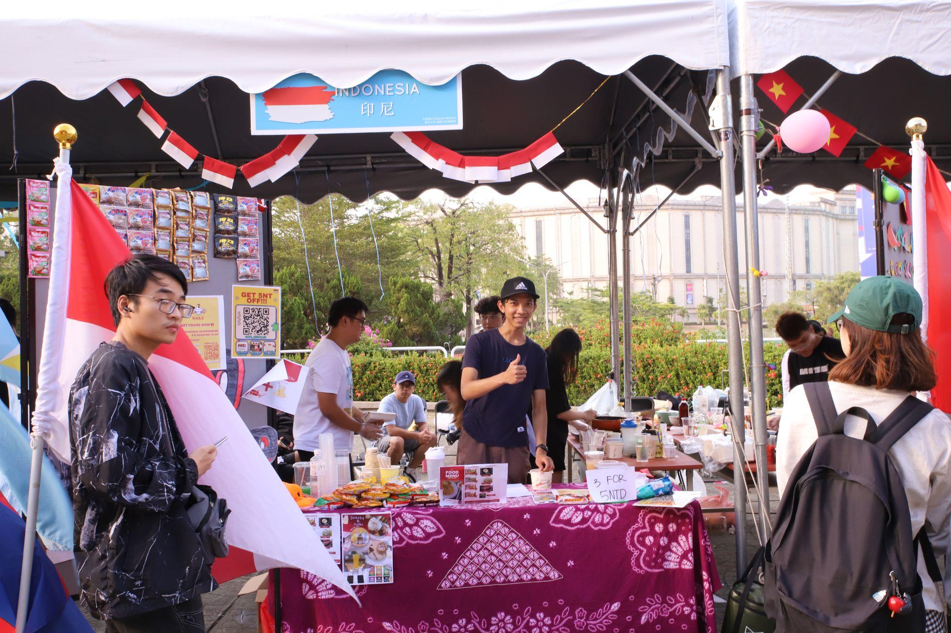

Slide 21
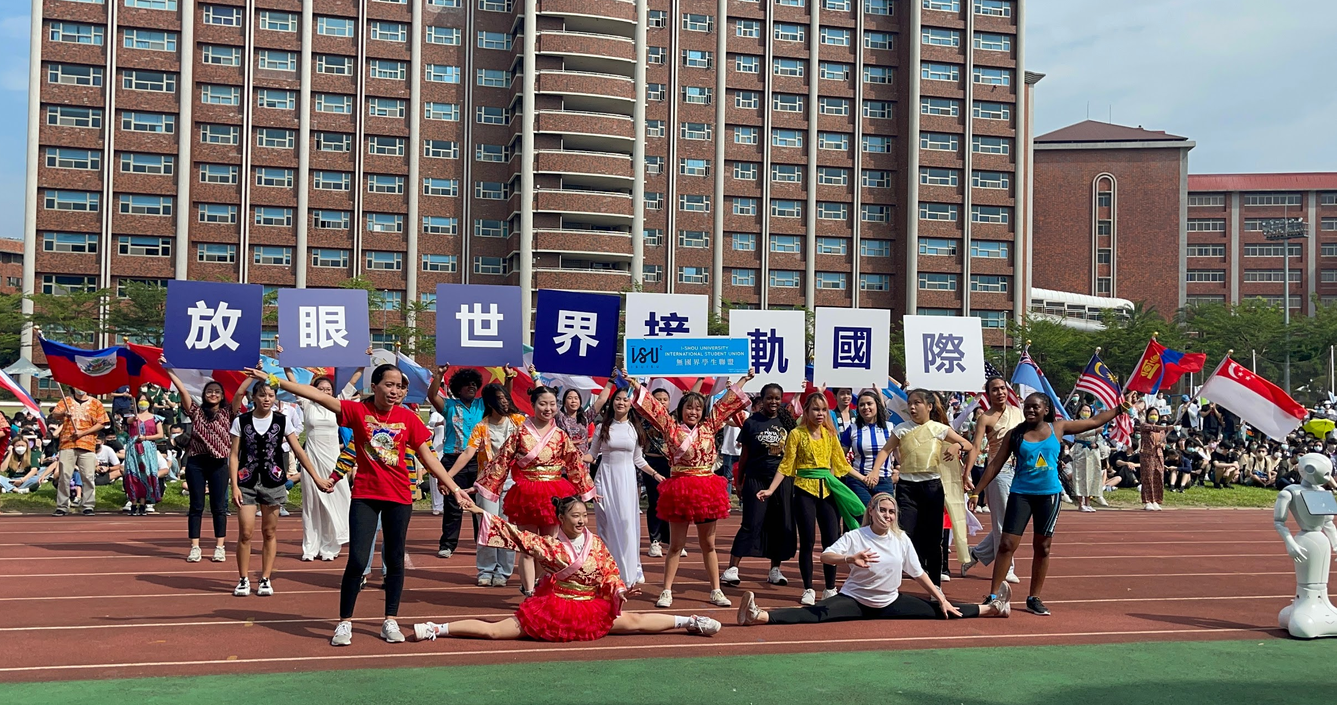
PARADE 遊行

Slide 22
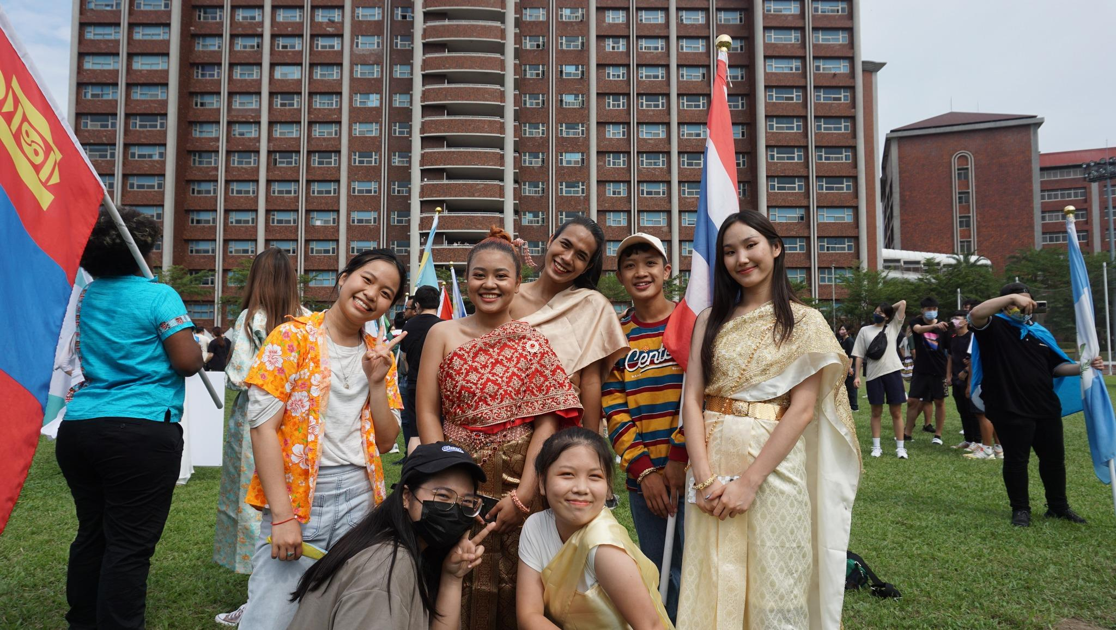
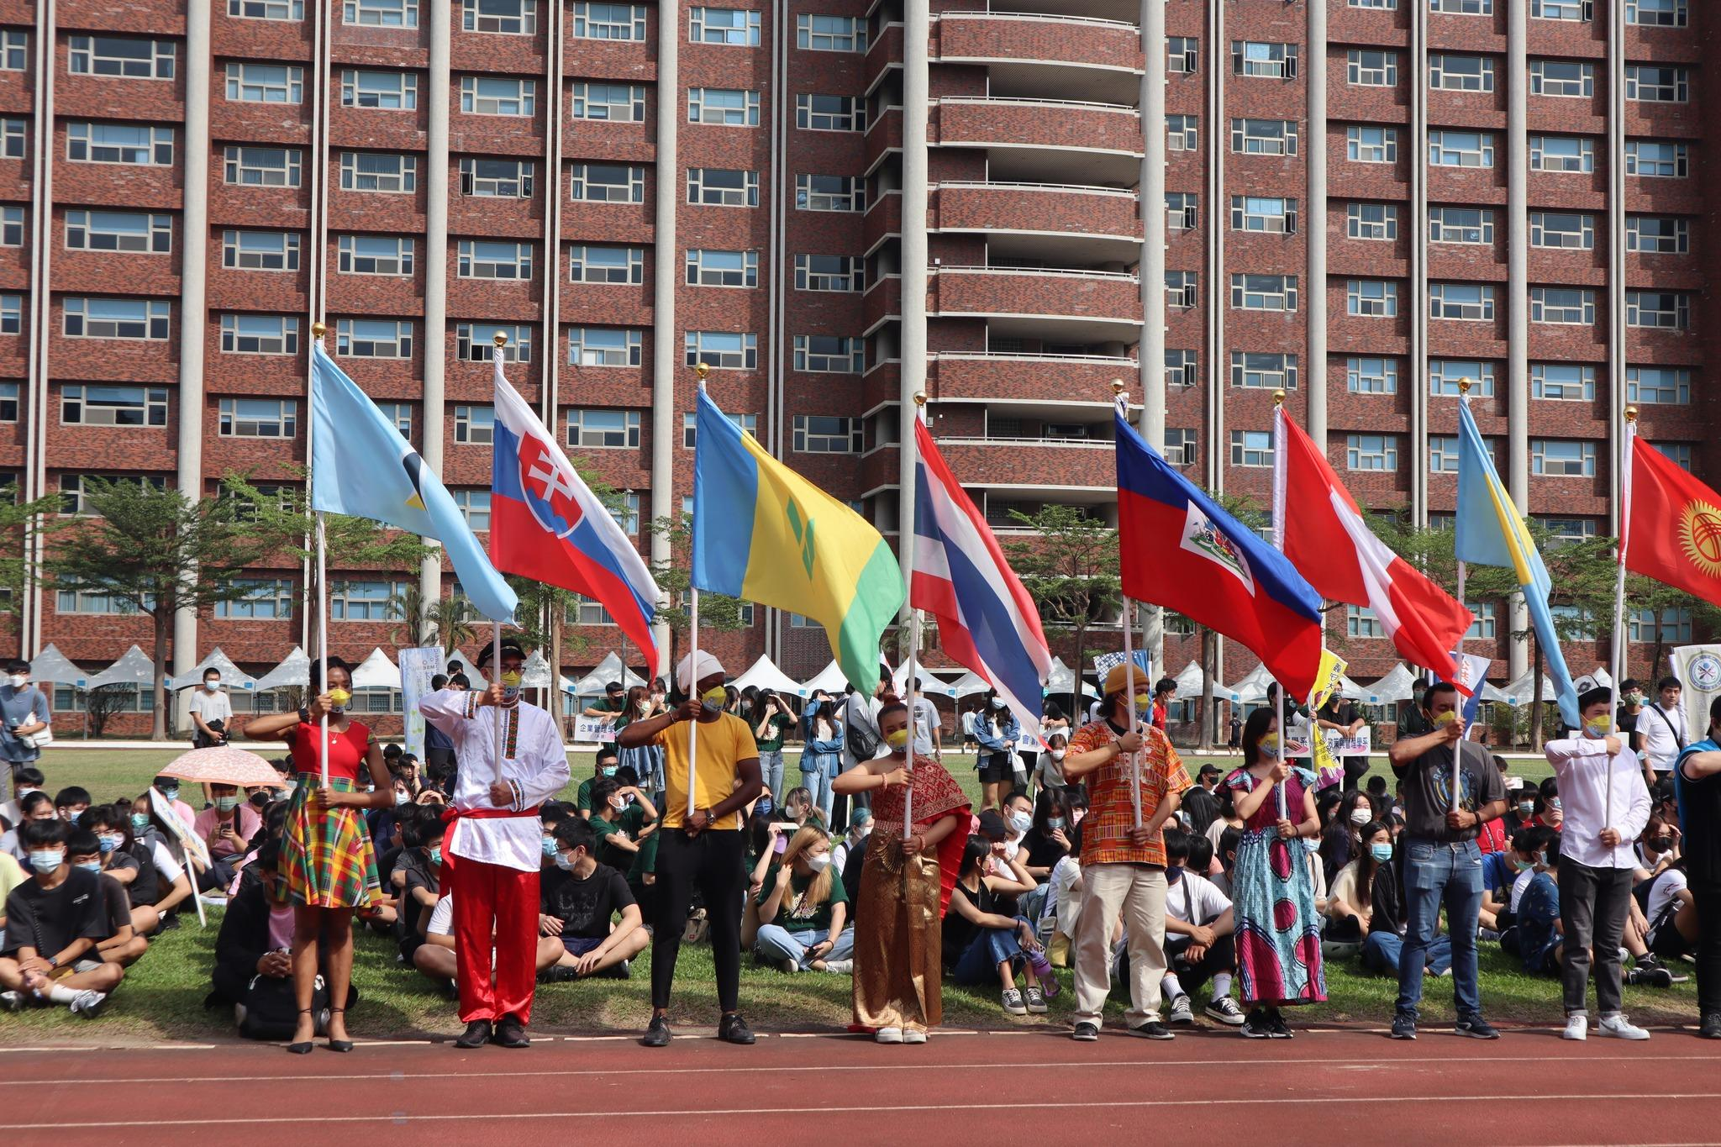
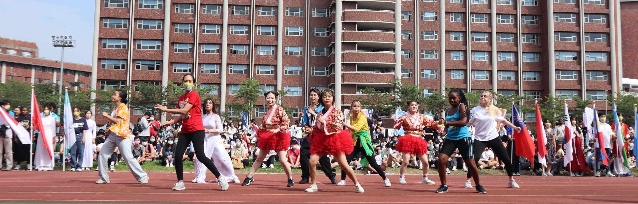

Slide 23
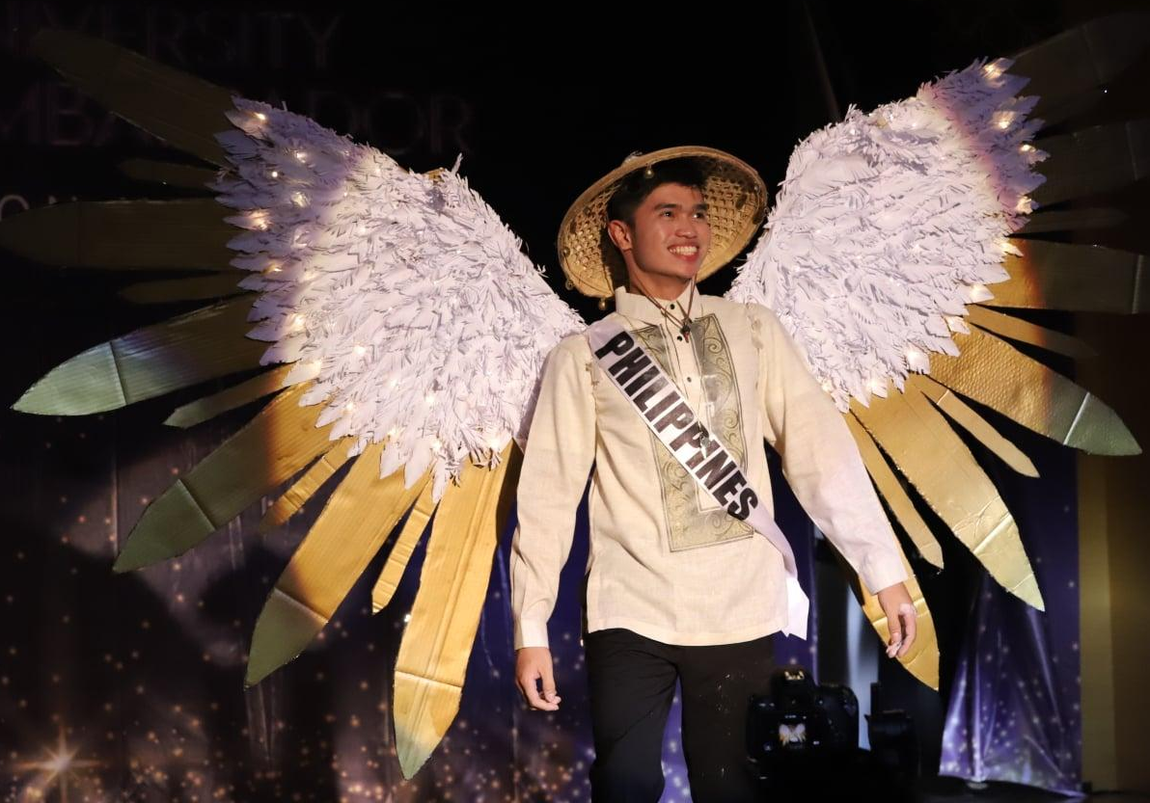
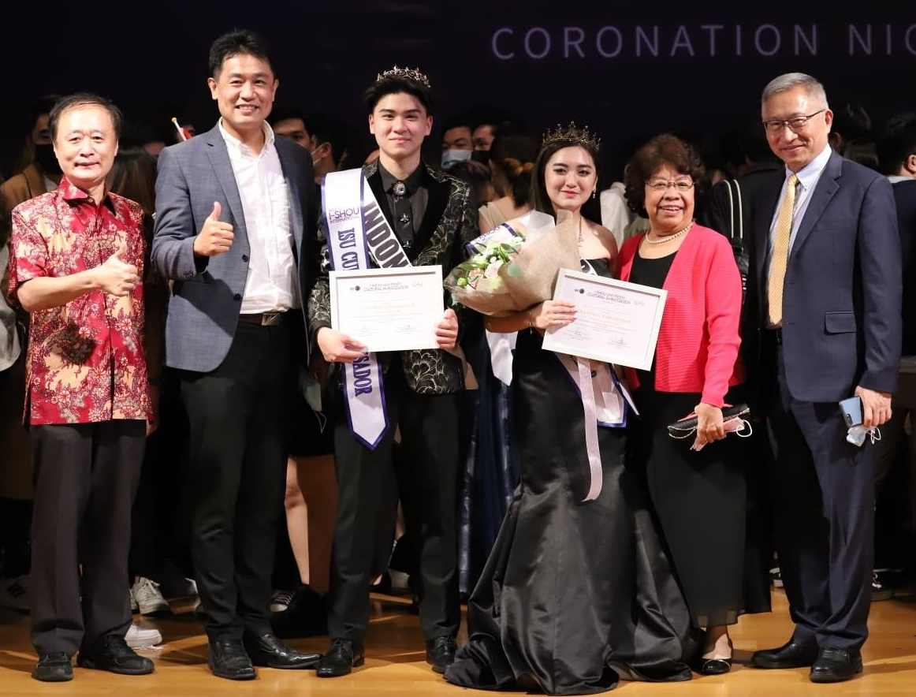
CULTURAL AMBASSADOR
國際文化大使選拔

Slide 24

CULTURAL AMBASSADOR
國際文化大使選拔

Slide 25

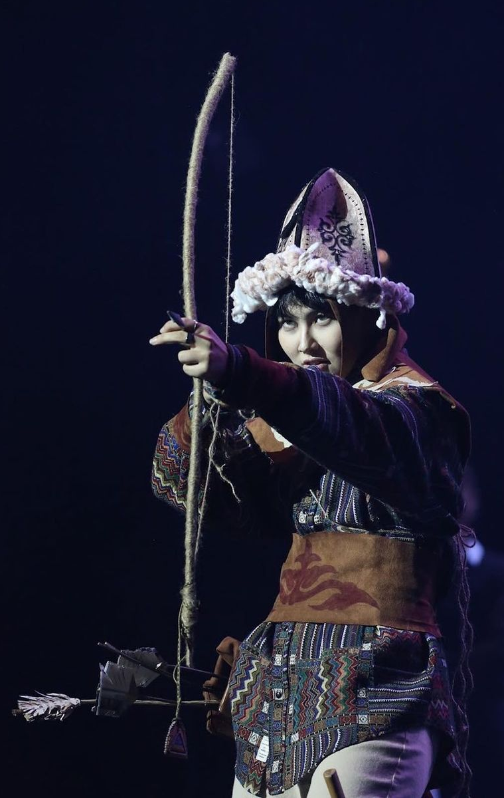


Slide 26

CULTURAL AMBASSADOR
國際文化大使選拔
See you in May, 2024!

Slide 27
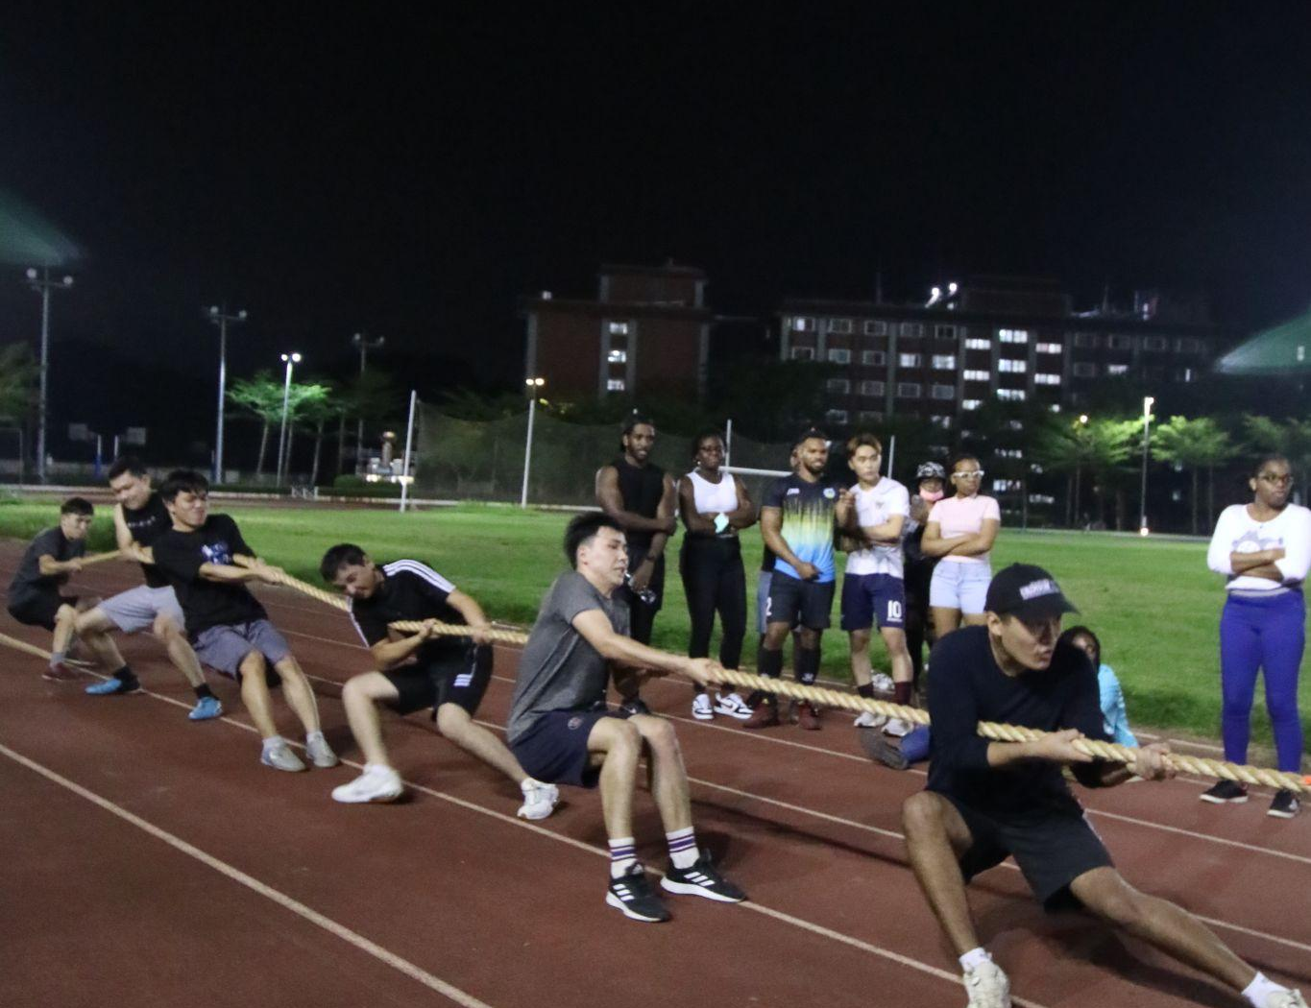
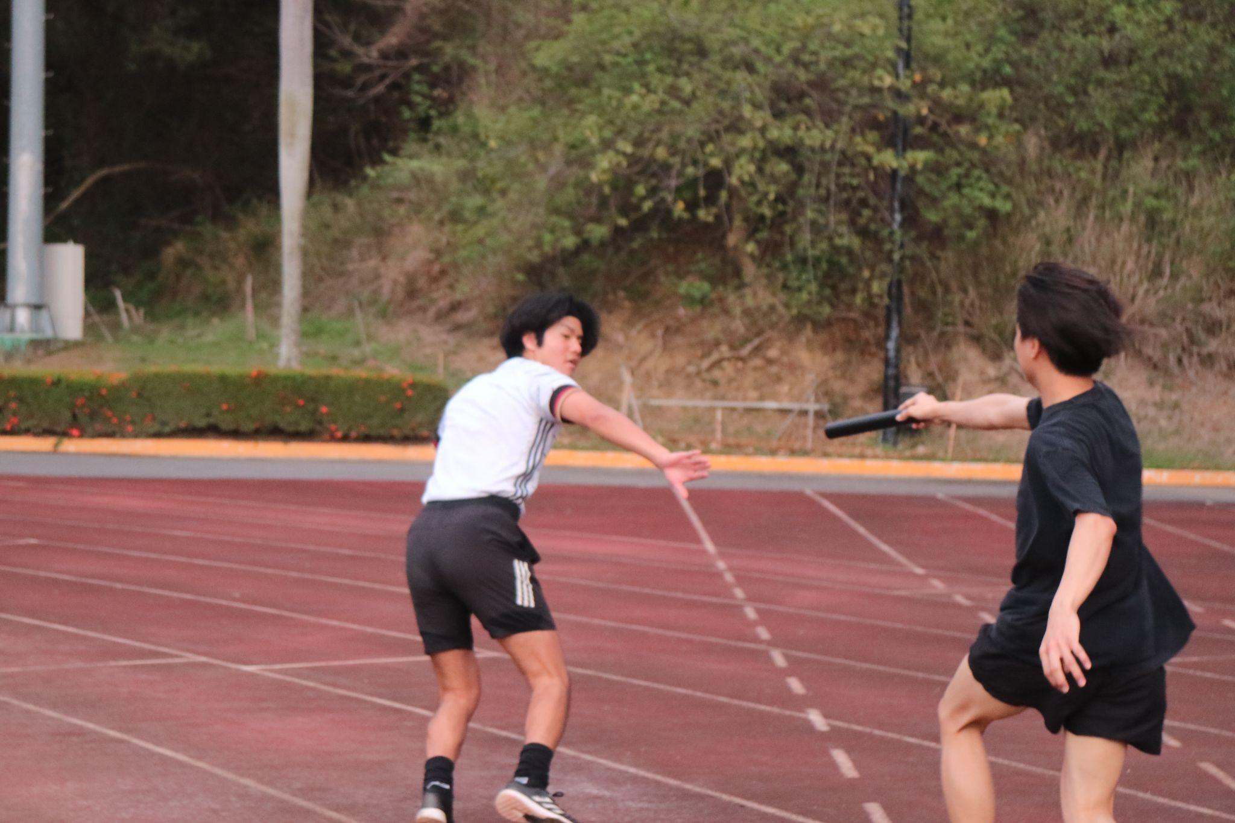
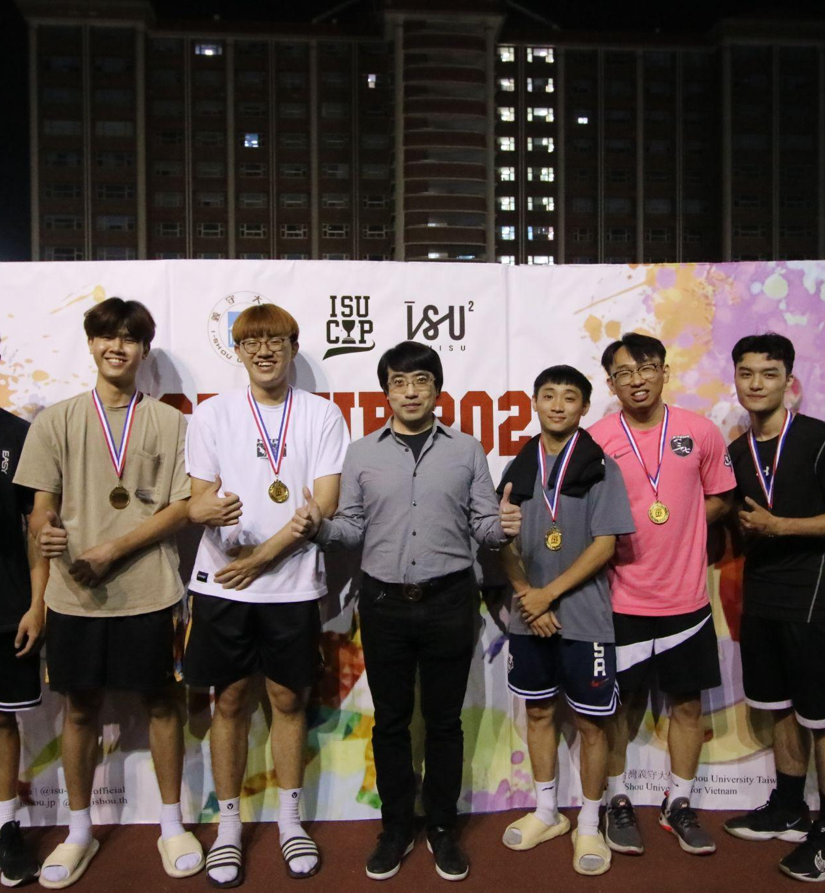
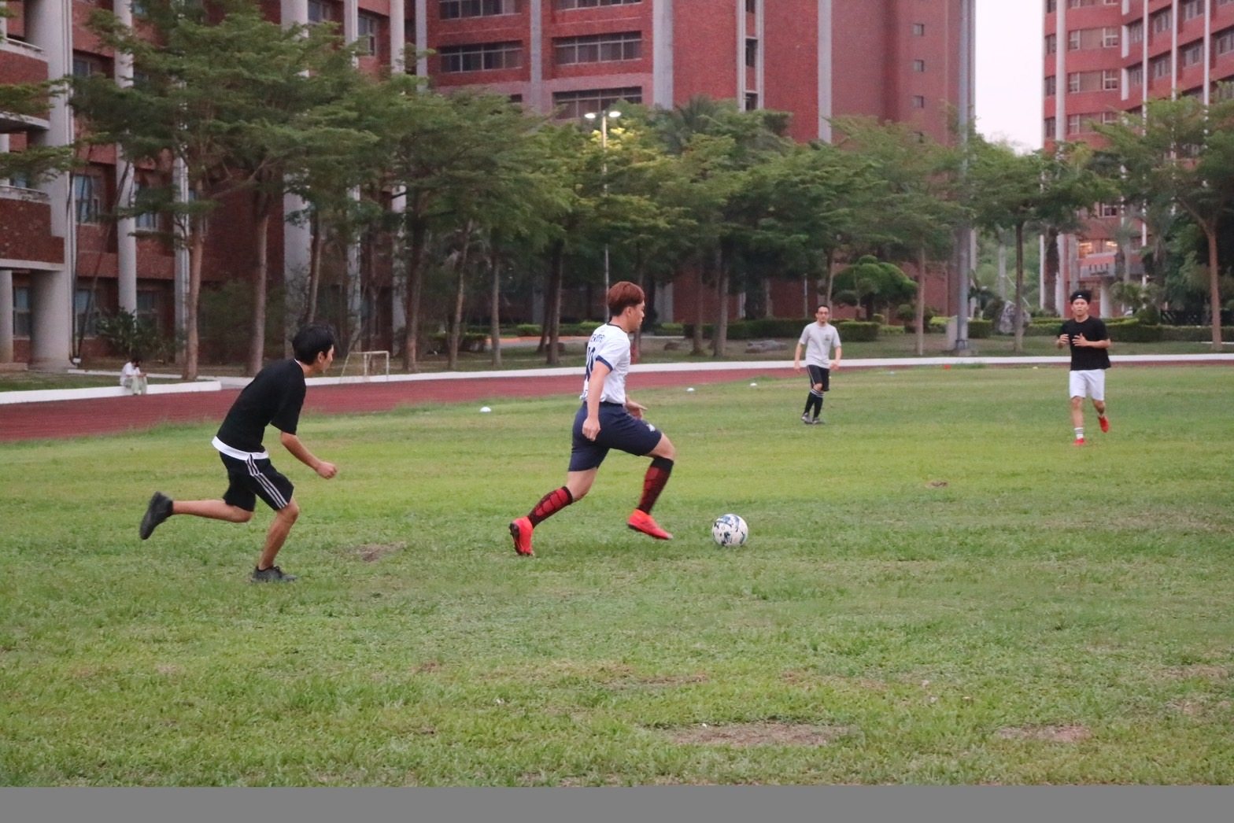
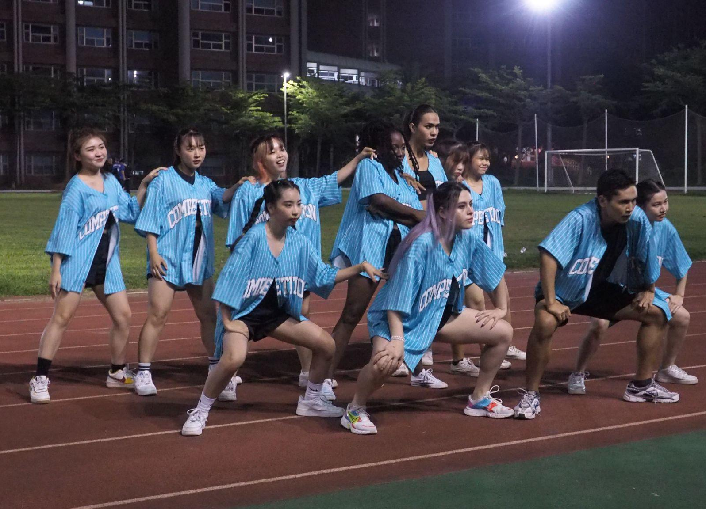
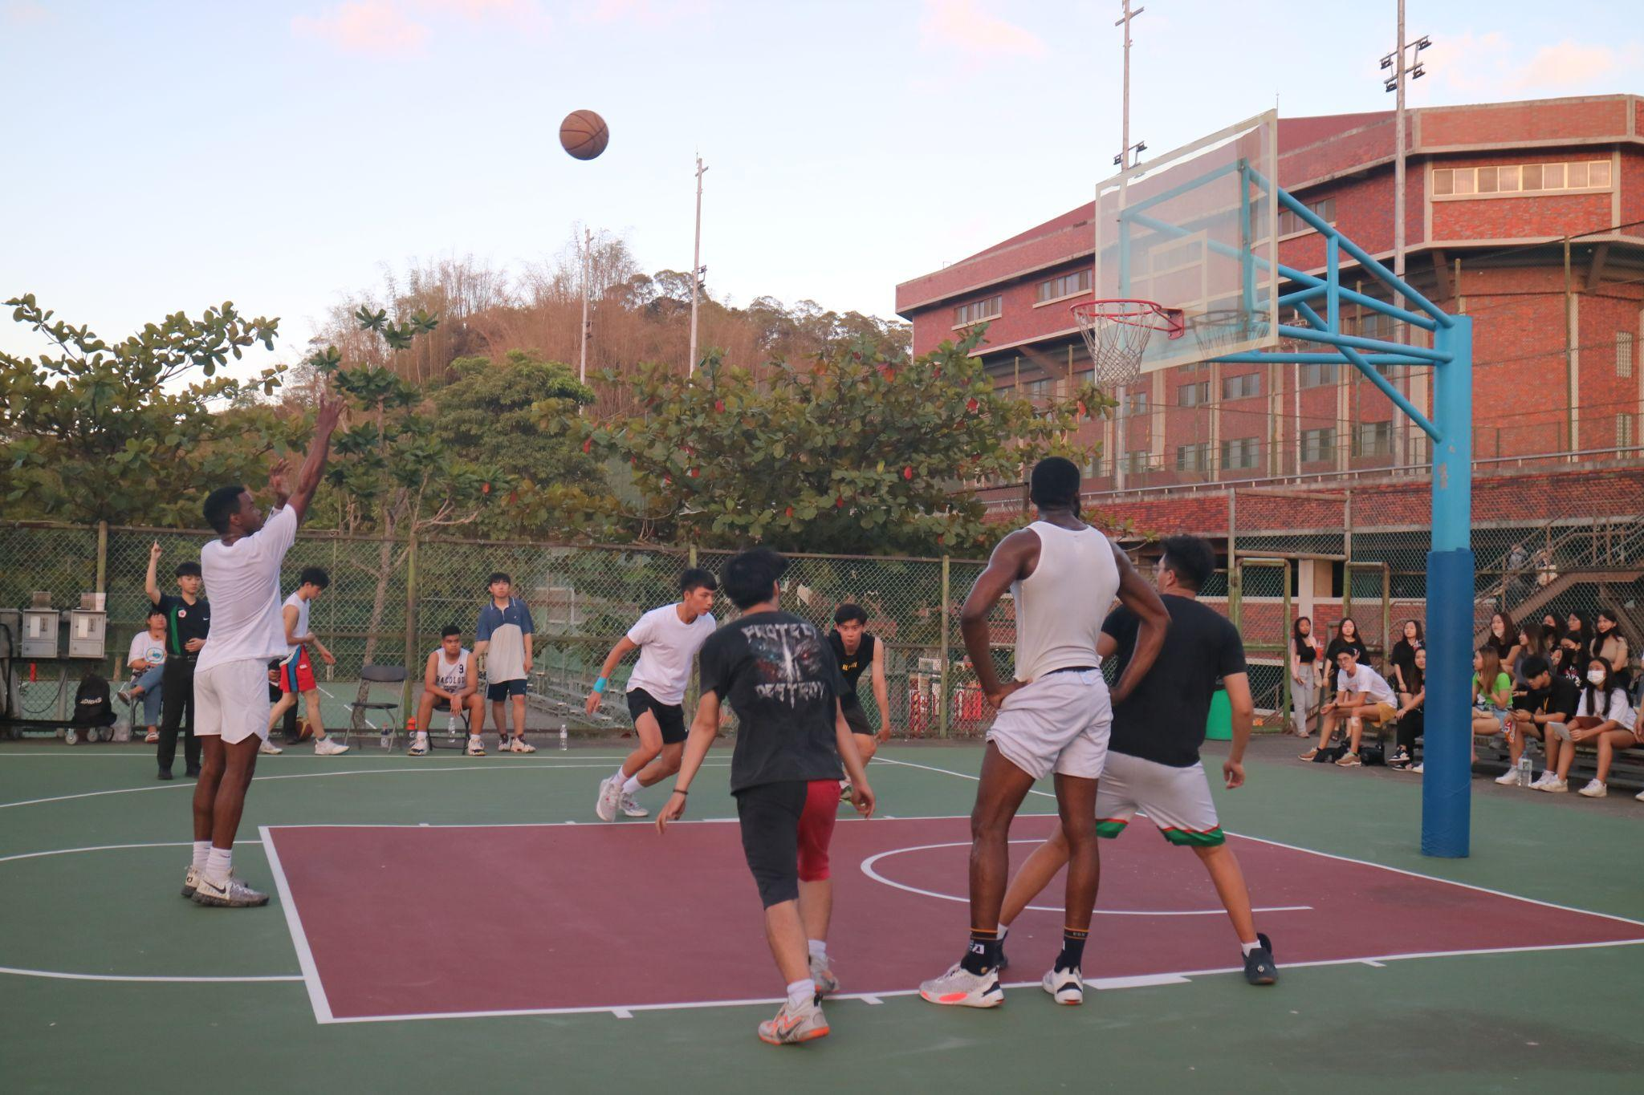
ISU CUP
無國界奧林匹克

Slide 28
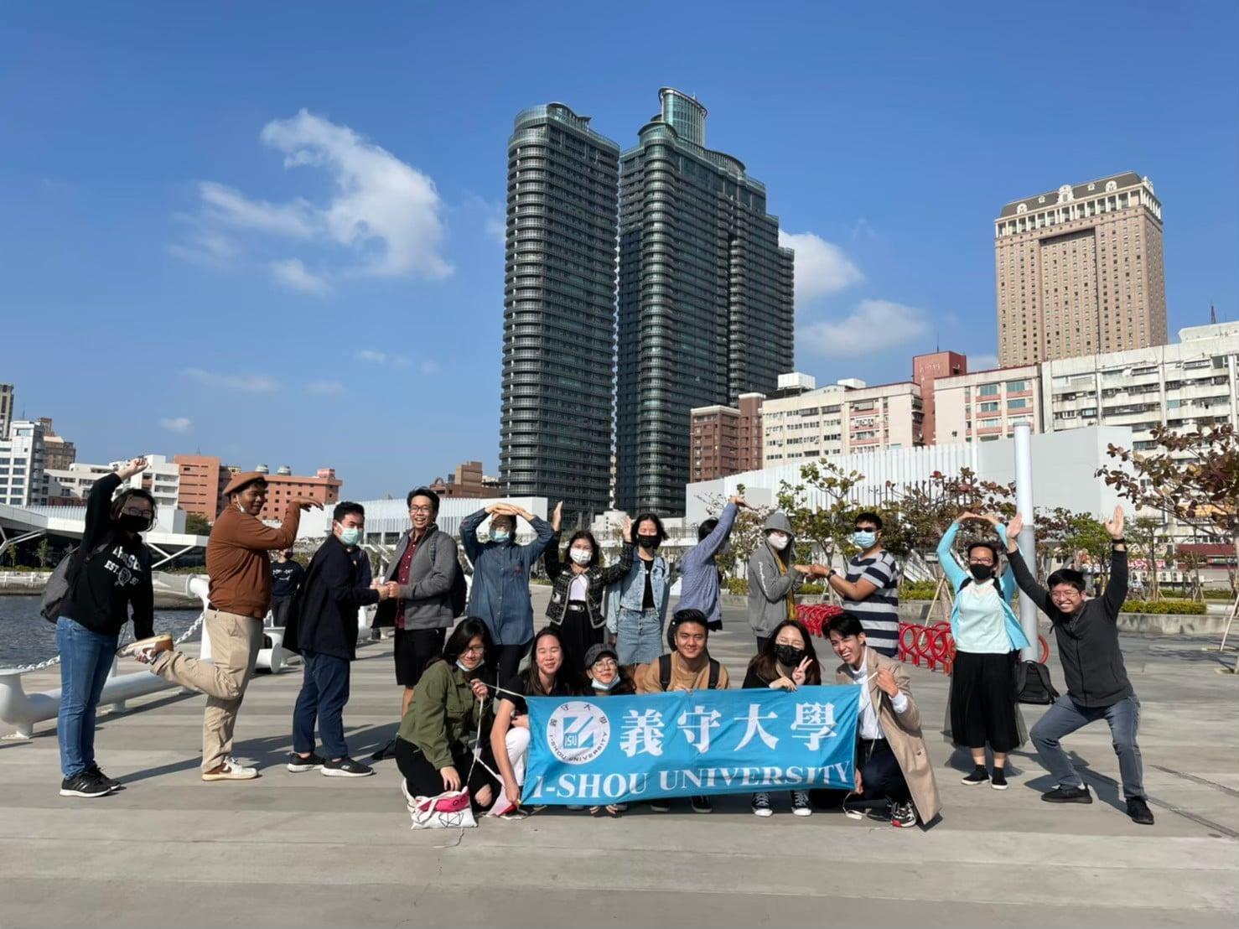
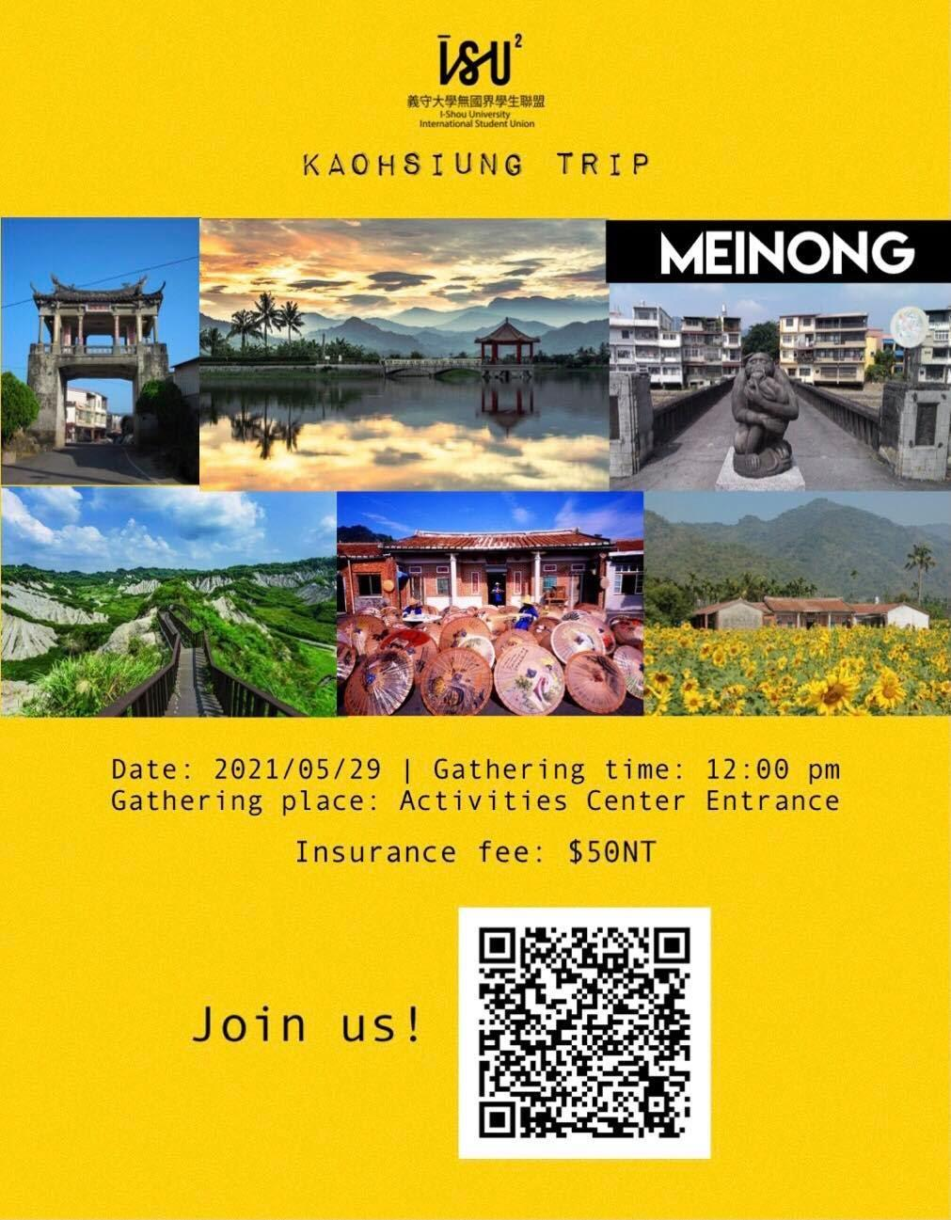
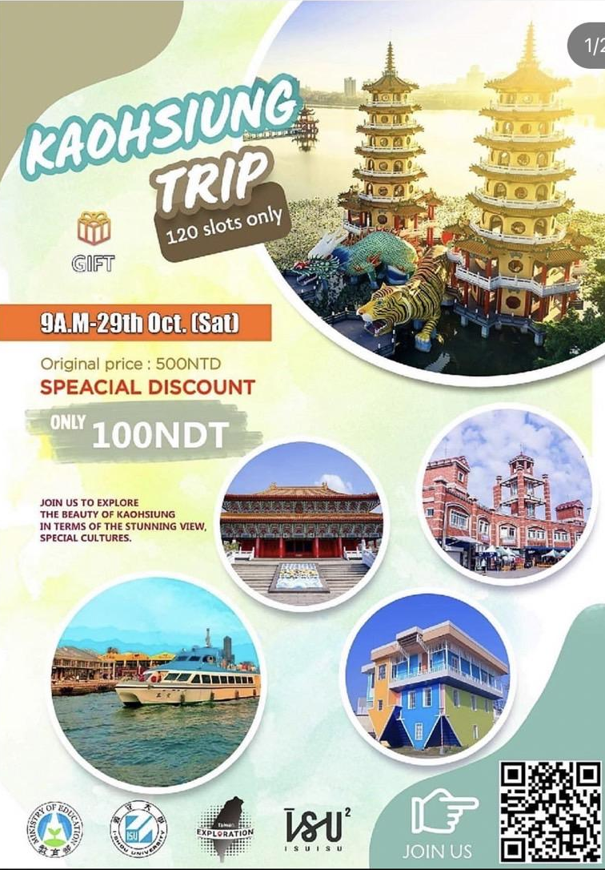
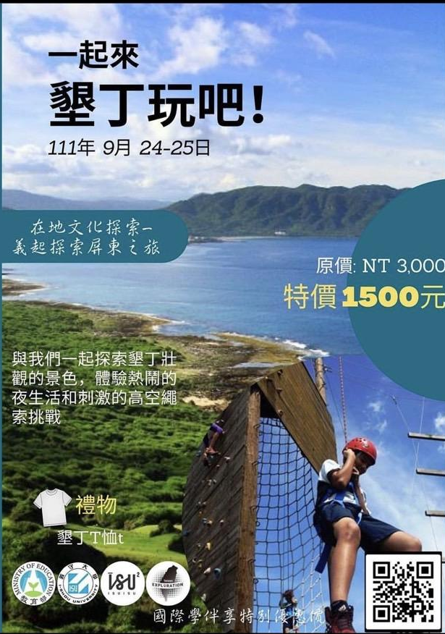

探索台灣
Taiwan Exploration

Slide 29
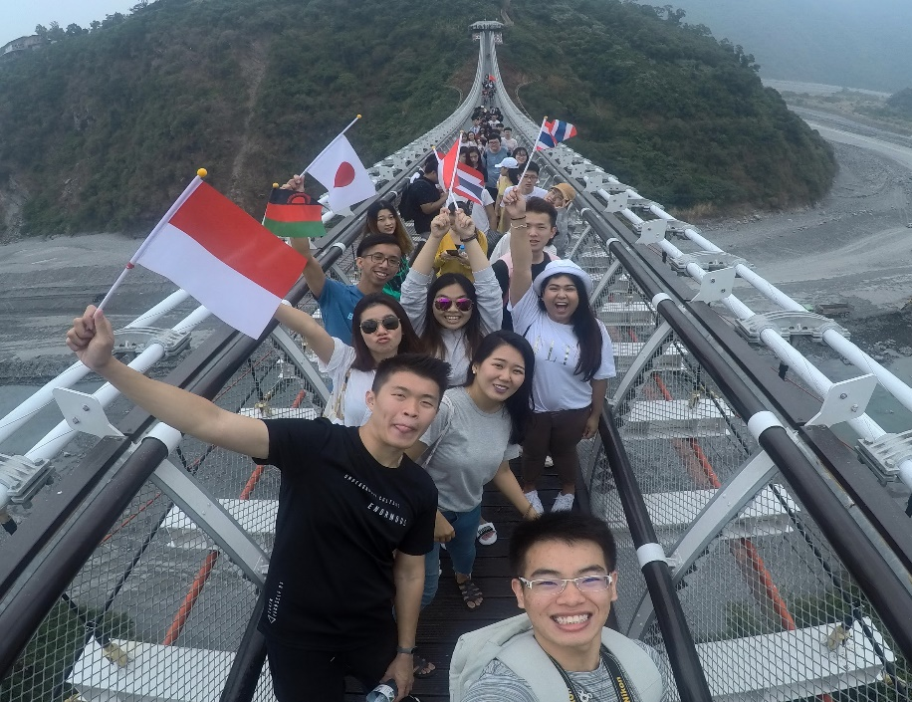
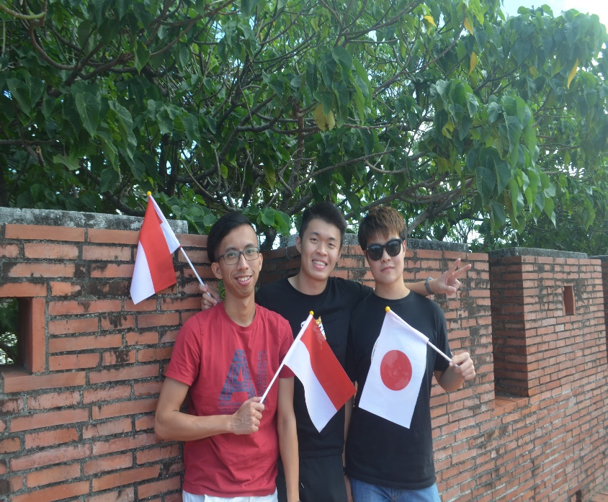
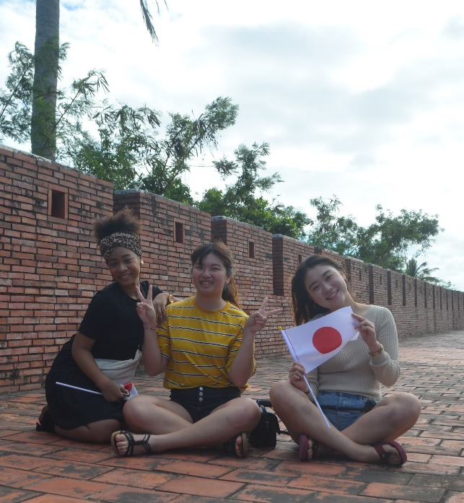
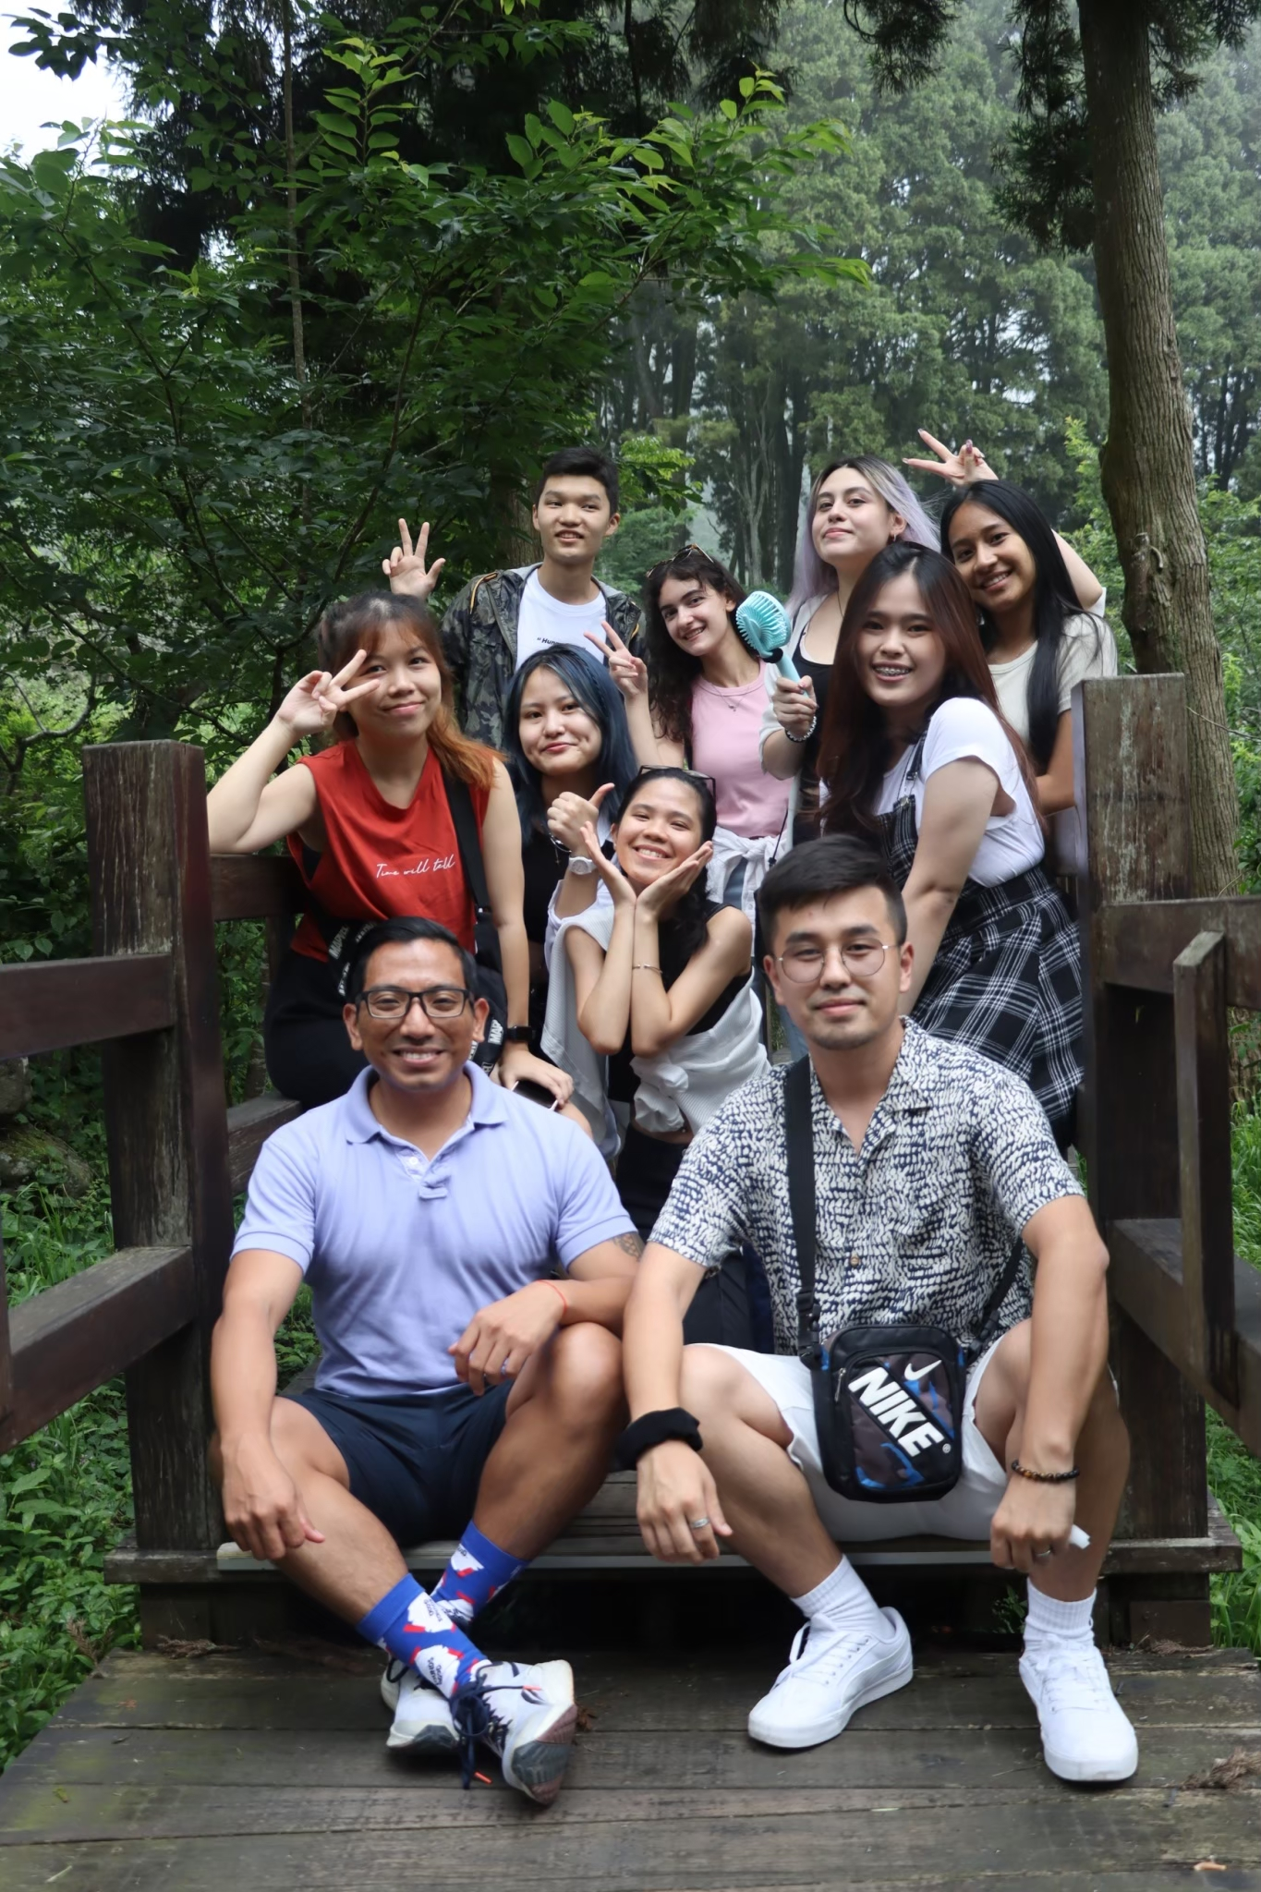

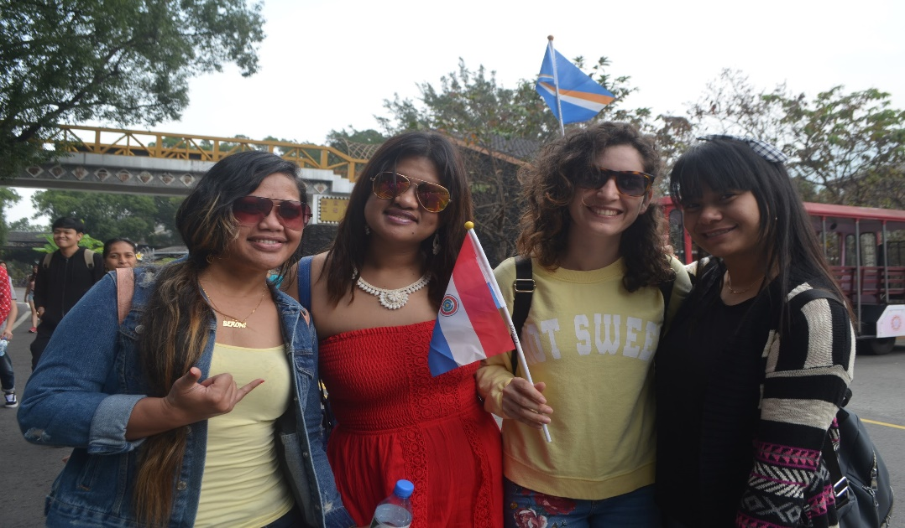
Taiwan Exploration

Slide 30
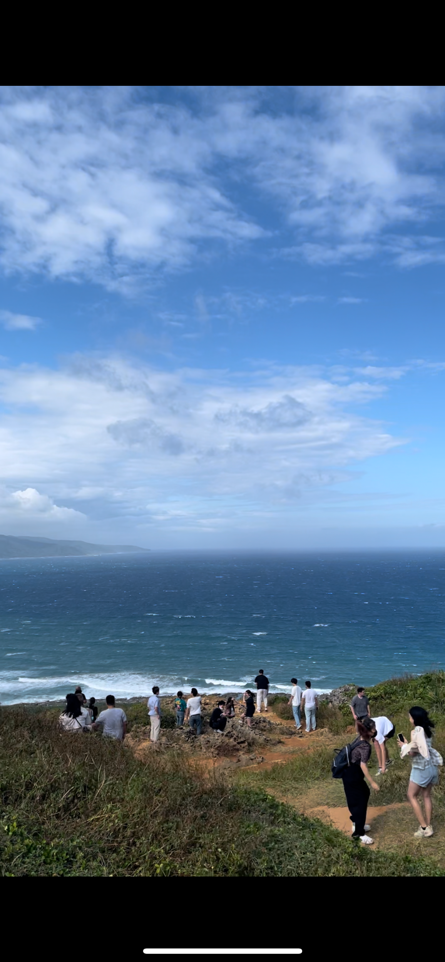




Taiwan Exploration

Slide 31

Scan this QR Code and Join Us as a Member!

Slide 32
Academic Affairs Team
學術活動部

Slide 33






世界咖啡廳
Global Lounge

Slide 34

本活動旨在培養學生「德」的核心能力。希望透過此次的活動可以讓學生們認識生 命、培養同理心，重新檢視生活倫常道德的價值，進而積極地參與社會事務。The purpose of Global Lounge activities is to encourage engagement between international students and Taiwan students through immerse learning activities. By fostering appreciation and sharing of culture, and traditions. Respect for diversity is promoted, and tolerance and inclusion are fostered.

Slide 35





TEDxIShou University

Slide 36
TEDx talks are local events where people give short speeches about interesting and important topics. These talks are similar to the famous TED talks you might have seen online. TEDx events are organized by people in different cities and communities around the world, and they aim to share inspiring ideas and spark meaningful discussions. The "x" in TEDx stands for "independently organized," meaning these events are not run by the main TED organization but follow the same format. So, you can think of TEDx talks as mini TED talks that happen in various places with a wide range of topics.

Slide 37
Audit Team
集合部

Slide 38

ISUISU

Slide 39



Slide 40


Slide 41

美宣部

Slide 42


Slide 43


Slide 44


Slide 45


Slide 46


Slide 47


Slide 48


Slide 49




Individual Price:
T-Shirt-300NT$
Hoodies-600NT$
Bundling Packages
Tote Bag + T-Shirt NT$ 495 (Ori: NT$ 550)
Tote Bag + Hoodie NT$ 765 (Ori: NT$ 850)
Tote Bag NT$ 149 (Ori: NT$ 250)
Available in 3 colours:

Slide 50


Slide 51


Slide 52




2023 - 2024
ISUISU 財務部
FINANCE TEAM
International College

Slide 53





What we do
01
Keeping Financial records Updated
Our team maintains financial records, oversees the ISUISU bank account, secures funds for activities, and manages budgeting and reimbursements
Managing ISUISU Bank Account
02
03
Raising Funds for the ISUISU Activities
Budget Allocation and Reimbursement
04

Slide 54






BENEFITS
Objective 01
Gain hands-on experience in financial management
Objective 02
Enhance your budgeting skills
Objective 03
ISUISU Finance
Contribute to ISUISU activities
Objective 04
Develop a global perspective on financial operations

Slide 55





DELIVERING DIVERSITY
  Enhance your skills
Volunteer Hours
Certificate
Valuable addition to your CV
Joining our team would provide students with volunteer hours that can be used to apply for scholarships, international study, and commendations.
Certificates will also be provided. These certificates can serve as valuable additions to your portfolio, highlighting your involvement and contributions.
Becoming a part of our team would significantly enhance students’ CVs, showcasing their practical financial management skills and dedication to organizational success.

Slide 56







Our Current Team Members
Tracey
Nomin
Velan
Kate
Nina
Vice President
Deputy
Event Coordinator
Member
Member
Manager

Slide 57


ISUISU Finance Team
While we welcome all new members, individuals with bilingual proficiency in both Chinese and English will be particularly valued. Thank you.

Slide 58
Membership Team
會員組織部

Slide 59




Our Current Team
Iris (IBA-2)
Vice President
Nicole (IBA-3)
Deputy
Abel (IMEM-2)
Secretary
Annie (AE-3)
Assistant

Slide 60


ISR
International Student Representative
各國學生代表
Notes:
Each country has one person to represent the country. The duty of isr is lead and help your county’s student. Also isr need to attend monthly meeting. you can report your problem or give an idea to your representatives, so isr can share it at monthly meeting. we are here for you to listen. so do not hesitate to ask us for help.

Slide 61






ISR Functions
International Student Representative=Key Opinion Leader
Settling
Before arrival: Contact New Students, Answer inquiries
Upon arrival : Freshmen Week—Pickup, Campus Tour, Orientation, Welcome Trip ​
Alumni Network
Expand international connection
Supporting
Recruiting
Building Community and Sense of belonging:
Information dissemination
ISU refine movement participation (admin. academic)
Intercultural activities: cultural festival, I-Buddy, Hands together, cultural ambassador, overseas volunteering
Word of mouth (marketing)- WOM(M)​
@education fair
@school visit
@social media
@promotion material
Notes:
‹#›

Slide 62

General Volunteers
Welcome all students to join our volunteers group

Slide 63
GROUP PHOTO
“SMILE TO MY BRIGHT FUTURE”

Slide 64
NEXT
EXCHANGE STUDENT
Please move to designated venue for orientation

Slide 65
校園生活
Smooth Transition into Life at ISU
112-1 義守大學秋季外國新生入學説明會
2023 Fall Semester International Student Orientation
國際及兩岸事務處
Office of International and Cross-Strait Affairs

Slide 66
健康保險 Health Insurance

Slide 67
健康保險 Health Insurance
轉入本校代辦健康保險情形:
新入境新生，在臺居留未滿6個月須參加團保，費用為每月新臺幣500元（內容類似全民健保），6個月共計新台幣3,000元。入境當月1日起投保。
新入境新生，且已在臺居留滿6個月，國際及兩岸事務處會協助辦理健保IC卡申請事宜。費用為每月新臺幣826元， 6個月共計新台幣4,956元。
According to National Health Insurance Act, any foreigner staying in Taiwan over six months is obligated to underwrite an insurance policy under NHI.
For newly arrived students who have NOT been in Taiwan for 6 months, should enroll to group medical insurance on the first day of the month (which is similar to NHI) for a fee of TWD 500 per month, total TWD 3,000 per semester.
The cost of National Health Insurance (NHI) should be included in the tuition fee every semester if you are eligible to underwrite an insurance policy under NHI. The cost is TWD 826 each month (according to the fee criteria set by NHI), so payment per semester is TWD 4,956 (from September to February and March to August).

Slide 68
團保理賠 Insurance Claimant
Reimbursement procedure：
  You need to pay the full fee for the treatment yourself first. Make sure to get both the payment receipt and your certificate of diagnosis.
未有健保前適用。
請至合法登記之診所或醫院就醫。
申請團保理賠請至國際及兩岸事務處填寫申請書
    Diagnosis at the clinic or hospital
至診所或醫院就診
先自行付費
  Reimbursement Application:
  * Original receipt of payment
  * Original certificate of diagnosis
  * Photocopy of Post Office passbook cover
  * Compensation Application Form
  * Photocopy of Passport
  * Photocopy of ARC
檢附收據正本 、診斷證明、護照影本、ARC影本及存褶封面影印本，至國際處填寫理賠申請書
* Please note: For the same symptoms, the insurance company covers only one visit per day. The maximum coverage per visit is TWD 1,000。

Slide 69



Slide 70
Mailing & Banking Service

Slide 71
地址寫法
Letter/mailing/registering a car/motorcycle
校內收信地址請註明
  系別班級或
  正確宿舍號碼，
畢業或休學離開台灣前，記得到監理所，將你的汽、機名字註銷，以免牌照、燃料稅單一直寄給你
For address on campus, please Specify
  Your department and class, or
  Your exact dorm room number
Please cancel your registration of the vehicle after you graduate or leaving Taiwan.

Slide 72

郵局 Post Office
營業時間 (Opening hours): Mon.~ Fri. 08:30-12:30 13:00-16:30
Mail service
Banking service
Visa Debit card 金融卡

Slide 73
貨幣兌換/提款 Money Exchange/Withdrawal
你可以至義大購物中心A區服務櫃檯進行貨幣兌換或至學校所設之土地銀行ATM提款機進行提款
如持銀行信用卡或提款卡，請事先於當地銀行開通【海外提領現金功能】，則可於校內外各銀行之提款機(Auto Teller Machine)使用。
You can exchange money at E-Da Outlet Mall (zone A Information Desk) or withdraw money from ATM of Land Bank on campus.
Please activate the function of overseas cash withdrawal first. Then you can withdraw cash from any Auto Teller Machine in Taiwan.

Slide 74
如何辦理郵局(銀行)開戶? How to open the bank account?
到校取得居留證/中華民國統一證號及印章後，可於義守大學郵局開設儲蓄帳戶，存取所攜現金.
郵局只接受新臺幣存款，無法提供外幣兌換服務。
請至國際及兩岸事務處辦理印章申請，並繳交50元刻印章費用。
開戶前，所攜現金亦可暫交本校國際及兩岸事務處代為存入出納組保險箱保管。
After obtaining your ARC or ROC Uniform ID No and Seal, you can open a savings account in Chunghwa Post ISU-campus-branch (post office).
Chunghwa Post only accepts New Taiwan Dollar in cash. No foreign currencies are accepted.
Please come to OICA and bring TWD 50 to apply for making seal.
The University provides temporary safe deposit box before you open a savings account. (OICA staff will assist students to go to the Cashier section to deposit cash.)

Slide 75
學生證 Student ID Card

Slide 76

義守大學學生證
Add cash value to your card at any convenient stores, or Metro stations.
各便利商店、捷運站可加值。
一卡通功能
I-Pass

Slide 77

高雄捷運（一卡通）Kaohsiung M.R.T (I-PASS)
義守大學學生證可開通一卡通功能，可使用於搭乘捷運上。
必須於學歷驗證後，才會拿到學生證。
請務必記得將學歷證明上傳至應用系統。
The ISU student ID card is available to activate I-PASS for using public transportation.
Only students who verify their academic qualifications can get their student ID.
Please remember upload your academic qualifications to Information System.

Slide 78
交通 Transportation

Slide 79

Railway(I-Pass)
Types of train:
Tze-Chiang Limited Express
Chu-Kuang Express
Fu-Hsing Semi Express
Local train/Fast Local Train
Ordinary train
Where you can take railway?
Kaohsiung Main Station
Zuoying High Speed Rail
Taiwan Railways Administration Wbsite:
http://www.railway.gov.tw/en/index.aspx

Slide 80


高鐵 High Speed Railway
哪裡你可以搭乘高鐵呢? Where can you take the High Speed Railway?
左營高鐵站 Zuoying High Speed Rail Station
台灣高鐵官方網站Taiwan High Speed Railway Website:
https://www.thsrc.com.tw/index.html?force=1

Slide 81

Bus(I-pass)
How to go to Kaohsiung downtown?
Take EDA bus 8501 at EDA mall Zone C.
Zuoying High Speed Rail is the last stop, you could go to most of popular attractions by MRT.
Kaohsiung City Real Time Bus Arrival Information System
http://122.146.229.210/bus/BusRoute.aspx

Slide 82
住宿
Housing

Slide 83

校安專線
Campus Safety
24 hrs Emergency Call ：0911885115

Slide 84
Campus Safety
★Do not drink and drive. If you violate the law, you will be fined NT$15,000 to NT$120,000 and you will be charged with your driving license. You may even be sentenced to prison.
1.Prevention of Internet Scam:
Please don’t provide your personal info including ID no., account no., password and so on.
Please be careful and think twice before you remit money to other people.
Please keep your valuables carefully.
29

Slide 85
Campus Safety
Non-Smoking Campus:
Students who smokes in the campus will be punished and fined by law.
本校為無菸校園，全區(含宿舍)禁止吸菸

Slide 86

諮商輔導
Counseling and Guidance

Slide 87




Making a Counseling / Psychiatric Consultation Appointment
If you need to make a counseling / psychiatric consultation appointment, please scan the QR code and fill out the application form. Or, you can just contact our English-speaking counselor, Cindy Cheng.
07-6151100*3235
suikar@isu.edu.tw

Slide 88
獎助學金
Scholarship

Slide 89
義守大學外國學生獎助學金
ISU Scholarship for International Student
獎助學金獎勵補助對象及金額
外國學生新生:最高核予第一學年免 除學雜費及新臺幣二萬元宿舍費補助，經由本校外國學生獎助學金委員會審議後核定，分二學期核發。
外國學生在學生:視在學表現，經由獎助學金委員會審議後核定，最高核予一學期免除學雜費。
Scholarship types and amounts
New International Students: The maximum amount of scholarship is the exemption from tuition and miscellaneous fees and a subsidy of NT$20,000 in dormitory fees for the first academic year will be approved by the International Student Scholarship Committee of our school and will be issued in two semesters.
Continuing International Students: Depending on the academic performance, it will be reviewed and approved by the Scholarship Committee, and the maximum amount of tuition and miscellaneous fees will be waived for one semester.

Slide 90
義守大學外國學生獎助學金
ISU Scholarship for International Student
獲本校核發外國學生獎助學金者，本校將以獎助學金抵學雜費應繳費用，並採取多退少補方式。
例：
獎助學金新台幣60,000元
學雜費新台幣77,421元
須補繳新台幣17,421元
OICA will help the scholarship recipients to conduct the exemption from the tuition fees. If the amount of the scholarship is less than the total fees payable to the University, the scholarship recipients shall pay for the difference.
However, the remaining scholarship will be returned to the recipients if the amount of the scholarship exceeds the total fees payable to the University.
For example:
Scholarship: TWD 60,000
Tuition and Other Required Fee: TWD 77,421
Then, you’ll have to pay for TWDNTD 17,421

Slide 91
義守大學外國學生獎助學金
ISU Scholarship for International Student
受核定獎助之學生因無不可抗拒之因素當學期前九週缺席率達30%，或有小過以上懲處紀錄者，取消並追回其當學期及之後已核定之獎助學金，學生需繳清本獎助學金補助之費用，以維持其學籍。
Scholarship recipients will not receive the scholarship if his/her absence rate reach 30% for the first nine weeks of the current semester without compelling reasons, or has a record of minor demerits punishment.
If one student’s scholarship has been canceled, he/she shall pay the full tuition fee and any other required fees in order to maintain his/her status as a student of the University.

Slide 92
義守大學外國學生獎助學金
ISU Scholarship for International Student
Scholarship application period and requirements:
Application period: Apply to OICA from the 17th week to the 18th week of the semester (Master applicants must submit with application form)
Application requirements:
The student who has been ranked among the top 40% in his/her class in terms of the average semester grade in the previous semester.
Having received a personal conduct score of 85 or higher, and having no record of minor demerits or even severer punishment in the previous semester.
Take at least 9 credits in previous semester.
申請本獎助學金時間、申請條件、審查項目
申請時間:於學期第十七週至第十八週向本處提出申請(碩士班申請者始需繳交本申請表)
申請條件: 前一學期班級排名為前百分之四十者、操行成績需達八十五分以上，且無小過以上懲處紀錄。前一學期修課數至少九學分以上。

Slide 93
義守大學外國學生獎助學金
ISU Scholarship for International Student
審查項目Review Items：
前一學期成績(班排名/班級人數) Academic Performance (class ranking/class number of student)
服務學習 Service Learning (上限60小時/積點 max. 60 hours/points)
海外志工 Overseas Volunteer、競賽得獎證明 Competition Award、社團幹部參與 Student Activity (上限40積點 max. 40 points)
義守大學外國學生獎助學金設置辦法 https://www2.isu.edu.tw/upload/654/internation%20student%20scholarship.pdf
Regulations for International Student Scholarship at I-Shou University：https://www.isu.edu.tw/upload/654e/3/ISU%20Regulations%20on%20Scholarship%20for%20International%20Students.pdf

Slide 94


其他獎助學金 Other Scholarships
獎助學金相關訊息可上課外活動組網頁查詢 More information about scholarships can be found at: https://www.isu.edu.tw/2018/showpage_v01.php?dept_mno=605&dept_id=5&page_id=36510 (student activity section).

Slide 95
請假規定
Leave of Absence Notice

Slide 96
Leave of Absence Notice
Students who intend to take sick leave, personal leave, bereavement leave, postnatal leave, prenatal leave or miscarriage leave should fill out and submit a leave application on the Information System with supporting documents.
Students who intend to take leave of absence from assembly (departmental/college assemblies or student activities) or final exam should apply with a leave record card, which is sold at the convenient store on campus.
The procedure for applying for leave of absence is not completed until the card is approved by the responsible faculty members and submitted to the Student Campus Life Guidance Section/Division of Continuing Education.
Please refer to the following websites for more detailed information.
https://www.isu.edu.tw/newsite/showpage.php?dept_mno=802&dept_id=5&page_id=46606

Slide 97
Leave of Absence Notice
4. Guidelines for disease prevention leave application：
Leave application：
Leave Type | Notes | Supporting Documents | Leave Type
Disease Prevention Leave | Testing positive with a rapid antigen test: moderate and severe cases | The number of days of disease prevention leave is based on the date indicated on the Notice for Isolation Treatment. | Notice for Isolation Treatment
 | Those who are diagnosed with a communicable disease reported by the health authorities/Those who are advised by the Health Section to conduct health monitoring | The number of days of disease prevention leave is decided by the Health Section. | A medical receipt or a certificate of diagnosis

Slide 98
Leave of Absence Notice
Mental health leave：
Students who have difficulty attending classes due to psychological or mental health conditions may apply online for mental health leave. Once a student applies for mental health leave, the system will automatically notify the course instructor(s), his/her advisor, and the chair of his/her department. Students may be referred to counselors if necessary. A certificate issued by a medical institution or a counseling document is required if a student has already taken three days of mental health leave.

Slide 99
義守大學獎懲&操行規定
Regulations for Student Rewards and Punishments at I-Shou University and conduct scores

Slide 100
Types of student rewards and punishments are as follows
1.Rewards:
a. Commendations;
b. Minor merits;
c. Major merits;
2.Punishments:
a. Admonitions;
b. Minor demerits;
c. Major demerits;
d. Academic probation;
e. Expulsion; and
f. Dismissal.
For more information about the Regulations for Student Rewards and Punishments at I-Shou University, please visit
https://www.isu.edu.tw/newsite/showpage.php?dept_mno=802&dept_id=5&page_id=46607

Slide 101
服務教育
Service Education

Slide 102
Service Education
All of the new students must take the service education courses in the first year when they study at ISU. Although students can’t get any credits from the courses, students still have to take the required courses before graduating from the university.
Service education course is composed of 3 parts, including lectures, daily studying and living environment maintenance, public service participation organized by on/off campus units, and, lastly, online feedback of service conduction.

Slide 103
Service Education
Unit I: 12 hours lecture organized by Service education section. For more details about the courses, please visit http://moodle.isu.edu.tw/->Service Education-Fundamental Knowledge
Unit II: 16 hours public service participation on campus; 8 among them must be services organized by Administrative Unit. If you do NOT apply for participating in public service activities in advance, all the hours you have fulfilled before application will NOT be recognized. Please apply at least 3 working days before the beginning of your service.
Unit III: Online feedback and questionnaire on service education conduction. Question 2 at least 100 words. It must contains 100 Words, and should be 100 “Words” but not “letters”.

Slide 104

Unit II Application Procedure
50

Slide 105
應用資訊系統 Information System:
https://netreg.isu.edu.tw/Wapp/Wap_indexmain2.asp
【操作說明】應用資訊系統:
【Instructions】Information System: https://is.gd/TM2MJU
服務教育組Service Education Section:
https://is.gd/sMQ639

Slide 106
外語文中心
Foreign Language Center

Slide 107



主要業務 Main Duties
外語相關課程活動 Foreign Language Related Activities
辦理學生之英文檢定 English Proficiency Test
通識英文課程實施分級授課 General English Courses
國際學院1樓 International College 1F
https://www.isu.edu.tw/newsite/homepage.php?dept_mno=859

Slide 108
學生英語能力畢業資格檢定標準
The Standard of English Proficiency Graduation Threshold
項次 | 英檢考試類別 | 英文名稱 | 全校統一及格標準 Passing Score
1 | 全民英檢 | GEPT | 中級初試 (Intermediate Level: Listening and Reading)
2 | 托福外語能力測驗 | TOEFL | ITP/457 IBT/57
3 | 多益 | TOEIC | 550
4 | 國際英語語言測驗/ 雅思 | IELTS | 4
5 | 網路全民英檢 | NETPAW | 中級聽力與閱讀 (Intermediate Level: Listening and Reading)
6 | 大學校院英語能力 測驗 | CSEPT | 170+
7 | 外語能力測驗 | FLPT | 150+
8 | 劍橋大學英語能力認證分級測驗 | Cam. Main Suite | PET 140+
9 | 劍橋領思職場英語測驗/實用英語測驗 | Linguaskill Business/General | Level 2 140-149
10 | 全球英檢 | GET | B1
‹#›

Slide 109
申請免修大一通識英文必修課程標準
The Standard of Exemption from English in Practice (I) (II)
Test Items | 實用英語<一> English in Practice (I) | 實用英語<二> English in Practice (II)
GEPT | Intermediate level (Speaking and Writing) | Upper Intermediate level (Listening and Reading)
TOEFL | ITP/543 IBT/79 | ITP/550 IBT/87
TOEIC | 700 | 750
IELTS | 5.5 | 6.0
CSEPT | Level 1 200+ | Level 2 240+
FLPT | 195+ | 240+
Cam. Main Suite | PET 153+ | PET 160+
Linguaskill Business/Linguaskill General | 153+ | 160+
申請時間：2/19/2024(一)~2/26/2024(一)
Application Date: 2/19/2024(Mon.)~2/26/2024(Mon.)
※免修申請時間為每學期開學第一週
The application for exemption from English in Practice (II) or (IV) should be completed during the first week of each semester.
‹#›

Slide 110
申請步驟：
一、資訊應用系統申請⭢學生抵免/英語免修申請作業
二、系統填寫免修申請資料並上傳英檢成績或證照正本電子檔
提醒： 免修申請約需3至7個工作天審核，可至系統查詢審核狀態，如外語文中心 審核結果為「符合通識英文免修課程」，則無需進教室上課，預計第3週 免修之通識英文課程將自動退課；期末該科成績單顯現NR(1學分)。
Steps:
1. Apply online at the Information System
2. Fill out the application form online and upload electronic files of the original English test results or certificates.
Reminder:
The inspection for exemption application takes about 3 to 7 working days. If the inspection status shows that the application is qualified, you do not need to go to the classroom. The General English Course will automatically withdraw in the third week of the semester. The course transcript will show NR (1 credit) at the end of the term.
‹#›

Slide 111




義守大學
國際移動力中心
I-SHOU University
Global Mobility Center

Slide 112



國際大樓1F 進門左轉就會看到喔!
Global Mobility Center

Slide 113
大學生涯-II
Supporting Academic Success-II
112-1 義守大學秋季外國新生入學説明會
2023 Fall Semester International Student Orientation
國際及兩岸事務處
Office of International and Cross-Strait Affairs

Slide 114

Information System
1. Your personal account:
your student ID
2. Password:
Please get the preset password from
International Office and you may reset
a new one.
http://www.isu.edu.tw/en1/
Current Students
Information System
http://netreg.isu.edu.tw/wapp/
3

Slide 115
Service Provided by the Information System
1. Your personal information
2. Course syllabus
3. Course selection and withdrawal
4. Tracking your attendance
5. Reminding of failing the course
6. Checking teachers’ office hours
7. Academic guidance and assistance
8. The survey of teaching performance
9. Your academic record
4

Slide 116
Course Selection Procedure
1. Add and Drop :
Feb. 19 (09:00) ~ Feb. 25 (24:00)
2. Conditional correction: fill the form and get the signature from your head of department to get the confirmation.
3. Minimum and Maximum Credits :
Undergraduate : 15 – 25
Graduate : at least 1 (course selection must be approved by advisor)
4. Extra fees has to be paid for extra selected credits.
8

Slide 117

Course Withdrawal Application
1. Via Information System
2. From Week 12 to 13 (May 6, 2024 ~ May 17, 2024)
3. You have to meet the minimum required
9

Slide 118
The Survey of Teaching Performance
1. Survey time:
Mar 16~ Apr 12(before Mid-Term Exam)
May 13~Jun 14 (before Final Exam)
2. Survey has to be completed for the following courses: professional courses, physical education courses, course taught in English, and practicum/internship courses.
13

Slide 119
The Survey of Teaching Performance
3. Survey will be undertaken anonymously.
4. Survey results will be beneficial for teachers’ improvement.
5. Real-time Learning Diagnostics:
Course instructors can provide up-to-date information on students’ learning diagnostics.
14

Slide 120
Grade
1. Grades will be given by percentage; the full mark is 100%.
2. The passing score for undergraduate is 60%; students who receive less than 60% won’t be able to get the credits.
3. The passing score for postgraduate is 70%; students who receive less than 70% won’t be able to get the credits.
4. Students may check their scores via the Information System.
5. Score review should be applied for within ten days after the announcements of results.
15

Slide 121

ISU Mail Account
Student mail account formation
  isu + student number
  if student number is 11001001a then the mail account is isu11001001a, according the rules others may be isu11001001m, isu11001001d ….
The original password is student ID with upper alphabetic character . For example : 11001001A
Email address :
isu11001001a@cloud.isu.edu.tw
Notes:
‹#›

Slide 122
Mail setting
Choose “Exchange”
Domain name : cloud.isu.edu.tw
Login : isuxxxxxx@cloud.isu.edu.tw

Slide 123

ISU Cloud Web Mail Service
The entry website: http://e-mail.isu.edu.tw

Slide 124

Select Language & Time Region
First time login
Language
save
Time(+8:00)

Slide 125

Change Password

Slide 126
Instructions on ISU Wi-Fi Connections
The ISU wireless local area network (WLAN) supports network access for mobile devices (Microsoft, iOS or Android system)
Two sets of SSIDs are available if the Wi-Fi connection is enabled:
  ISU
  ISU-secure: The encryption in transmission is enabled.
Open browse software(IE, Firefox, Chrome…)
Login email account and password

Slide 127

ISU Wireless Login
Notes:
‹#›

Slide 128

Learning System
Moodle Learning System (http://moodle.isu.edu.tw/?lang=en)

Slide 129
工讀/就業 Working in Taiwan

Slide 130
工讀 Work Study Employment
外國留學生、僑生及港澳生其申請工作許可，許可期間最長為6個月，其工作時間除寒暑假外，每星期最長為20小時。
未依前項規定者，本會得依就業服務法規定廢止其工作許可，而未依規定申請工作許可，即受聘僱為他人工作者，依就業服務法規定，處新臺幣3萬元以上15萬元以下罰鍰。
依據「雇主聘僱外國人許可及管理辦法」規定，來臺就讀正式學制之僑生、港澳生及外國留學生，入學後經學校許可，可向本會申請，惟來臺學習語言課程之外國留學生，則須修業1年以上，方可提出申請。
步驟一 連結申辦網址: https://ezwp.wda.gov.tw
The maximum work hours are 20 hours per week, except during summer and winter vacation.
According to Employment Services Act, if you work without a work permit, you will be fined from NT 30,000 to NT150,000.
According to the "Regulations on the Permission and Administration of the Employment of Foreign Workers", you can apply for the student work permit only if you are officially enrolled as a degree student in any university or have taken one-year language course in Taiwan.

Slide 131

居留證 Alien Resident Certificate (ARC)
居留簽證
Resident Visa
停留簽證
Visitor Visa
申請居留簽證
Switch to Resident Visa
入境15日内申請ARC
Apply for ARC within 15 days after arrival
入境連續居留（居留證核發）
180後可申請加入全民健保
After ARC Being Issued for 180 days,
You are eligible to enroll
In the National Health Insurance Program

Slide 132
NOTICE
延長居留證，需要在居留證到期前三十日內，在線上提出居留證延期申請。
Those who need to extend their stay in Taiwan shall extend ARC online within 30 days before the ARC expires.
寒暑假返國期間居留證到期者，請先繳交下一學期學費，完成註冊後，於應用系統下載下一學期的在學證明。於線上申請延期居留證。
Those who go back during summer/winter break and need to extend ARC, please pay tuition for next semester, and then download the enrollment certificate for next semester in the Information System. Use this certificate as study status to apply for ARC Extension online.

Slide 133
NOTICE
如果居留證上資料有異動（如：更換護照、更改居住地），在線上提出資料異動申請。
  The foreign students who need to change their residence permit content (i.e. change passport or living place) shall apply for a residence permit alteration online.

Slide 134
居留證 ARC – 初次申請 How to apply ARC
2吋照片
2-inch photo taken within 6 months
護照及居留簽證
Passport and Resident Visa
學生證或在學證明書
Original Student ID Card or Enrollment Certification
新臺幣1000元
TWD1,000

Slide 135

居留證證件繳交
ARC Documents Submission
請將護照基本頁、簽證頁(含入境章)及照片，通過QR Code上傳至雲端，國際及兩岸事務處將協助辦理居留證事宜。請用學號作為檔案名。
Please upload your Passport Basic Page, Visa Page (including the entry stamp), one photo through scanning the QR code to the Google Drive and name the document by your student ID. The OICA staff will help you to apply your ARC.

Slide 136



Entry Stamp
簽證頁
Visa Page with entry stamp
護照基本頁
Passport Basic Page

Slide 137



大頭照格式大小需用小畫家調整，否則無法上傳
Use Microsoft Paint to Adjust the size of the photo.
Passport-size photograph(At least 3.2cm from head to chin, with white background, taken within 3months.)
1

Slide 138

ARC Photo Size
居留證照片規格

Slide 139


Slide 140

健保卡申請表 NHI card Application form

Slide 141


Slide 142



Slide 143




Home Address
School address
家裡的地址
學校宿舍地址
Must fill out
Home Address
必填!!!!

Slide 144
新生基本資料填寫說明
進入學校首頁 點選「新生入學」→「大學部&研究所」
或進入網址 http://www.isu.edu.tw/dept/freshman
點選「應用資訊系統」輸入
帳號、密碼說明：第一次登入「應用資訊系統」以預設帳號密碼進入，更改密碼後，請重新登入「應用資訊系統」。
請點選「新生基本資料填寫」
核對、填寫個人相關資料及上傳照片、身分證、學歷證明等文件
確認所填寫與上傳的個人資料無誤後暫存資料
執行送出【確認資料】
恭喜您成為義守大學新鮮人!

Slide 146
健保卡申請表 NHI card Application form

Slide 149
Home Address
School address
家裡的地址
學校宿舍地址
Must fill out
Home Address
必填!!!!

Slide 150
新生基本資料填寫說明
進入學校首頁 點選「新生入學」→「大學部&研究所」
或進入網址 http://www.isu.edu.tw/dept/freshman
點選「應用資訊系統」輸入
帳號、密碼說明：第一次登入「應用資訊系統」以預設帳號密碼進入，更改密碼後，請重新登入「應用資訊系統」。
請點選「新生基本資料填寫」
核對、填寫個人相關資料及上傳照片、身分證、學歷證明等文件
確認所填寫與上傳的個人資料無誤後暫存資料
執行送出【確認資料】
恭喜您成為義守大學新鮮人!

Slide 151


Slide 152

READ MORE

Slide 153
THANK
YOU

