Slide 1
校園生活
Smooth Transition into Life at ISU
112-1 義守大學秋季外國新生入學説明會
2023 Fall Semester International Student Orientation
國際及兩岸事務處
Office of International and Cross-Strait Affairs

Slide 2
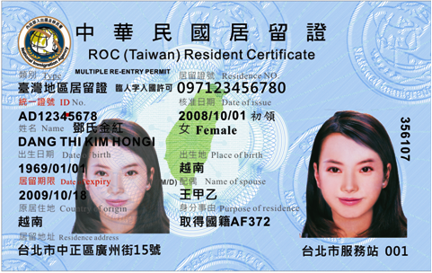
居留證 Alien Resident Certificate (ARC)
居留簽證
Resident Visa
停留簽證
Visitor Visa
申請居留簽證
Switch to Resident Visa
入境15日内申請ARC
Apply for ARC within 15 days after arrival
入境連續居留（居留證核發）
180後可申請加入全民健保
After ARC Being Issued for 180 days,
You are eligible to enroll
In the National Health Insurance Program

Slide 3
NOTICE
延長居留證，需要在居留證到期前三十日內，在線上提出居留證延期申請。
Those who need to extend their stay in Taiwan shall extend ARC online within 30 days before the ARC expires.
寒暑假返國期間居留證到期者，請先繳交下一學期學費，完成註冊後，於應用系統下載下一學期的在學證明。於線上申請延期居留證。
Those who go back during summer/winter break and need to extend ARC, please pay tuition for next semester, and then download the enrollment certificate for next semester in the Information System. Use this certificate as study status to apply for ARC Extension online.

Slide 4
NOTICE
如果居留證上資料有異動（如：更換護照、更改居住地），在線上提出資料異動申請。
  The foreign students who need to change their residence permit content (i.e. change passport or living place) shall apply for a residence permit alteration online.

Slide 5
居留證 ARC – 初次申請 How to apply ARC
2吋照片
2-inch photo taken within 6 months
護照及居留簽證
Passport and Resident Visa
學生證或在學證明書
Original Student ID Card or Enrollment Certification
新臺幣1000元
TWD1,000

Slide 6
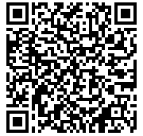
初次入學由國際處代辦
OICA will apply on your behalf upon your first arrival to Taiwan
居留證證件繳交
ARC Documents Submission
請將你的護照基本頁、簽證頁(含入境章)及照片，通過QR Code上傳至雲端，由國際及兩岸事務處協助辦理居留證。Please upload your Passport Basic Page, Visa Page (including the entry stamp) and photo through scanning the QR code to the Google Drive. The OICA staff will help you to apply for your ARC.
移民署審核後須線上繳費，請見下頁說明。Refer to next pages for payment.

Slide 7
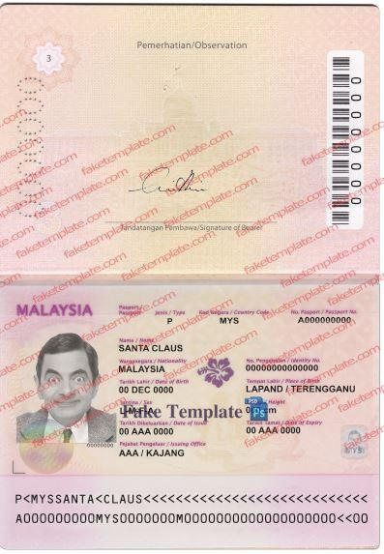
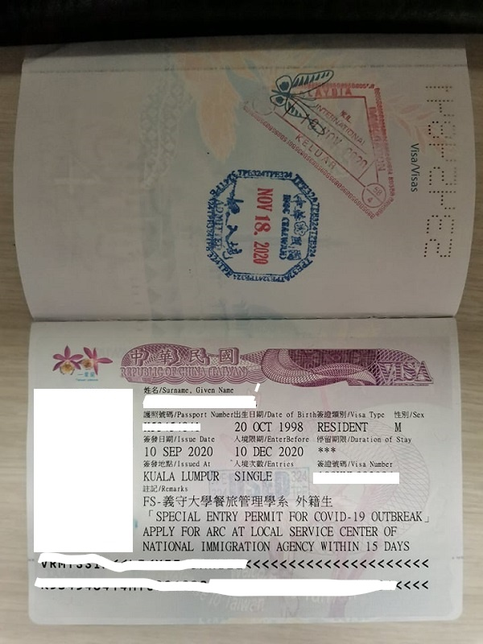
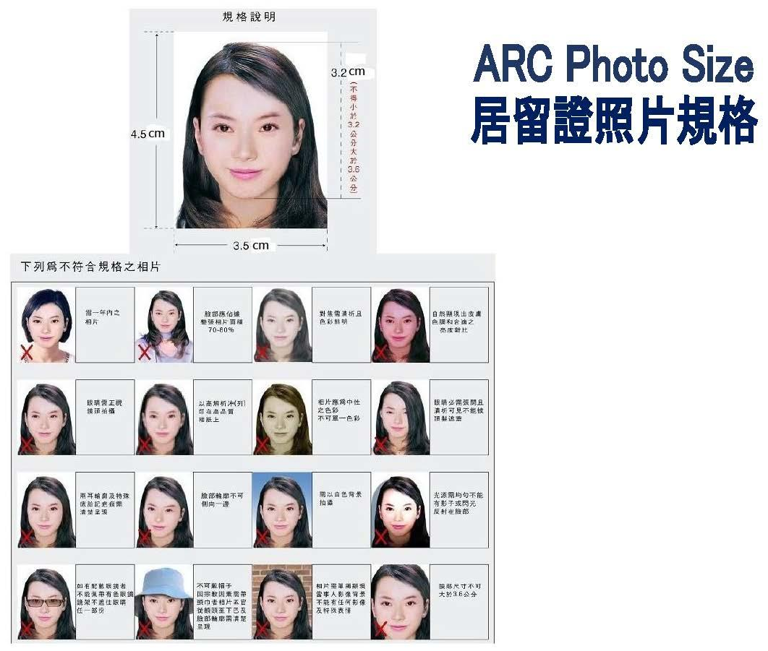
簽證頁
Visa Page with entry stamp
護照基本頁
Passport Basic Page

Slide 8
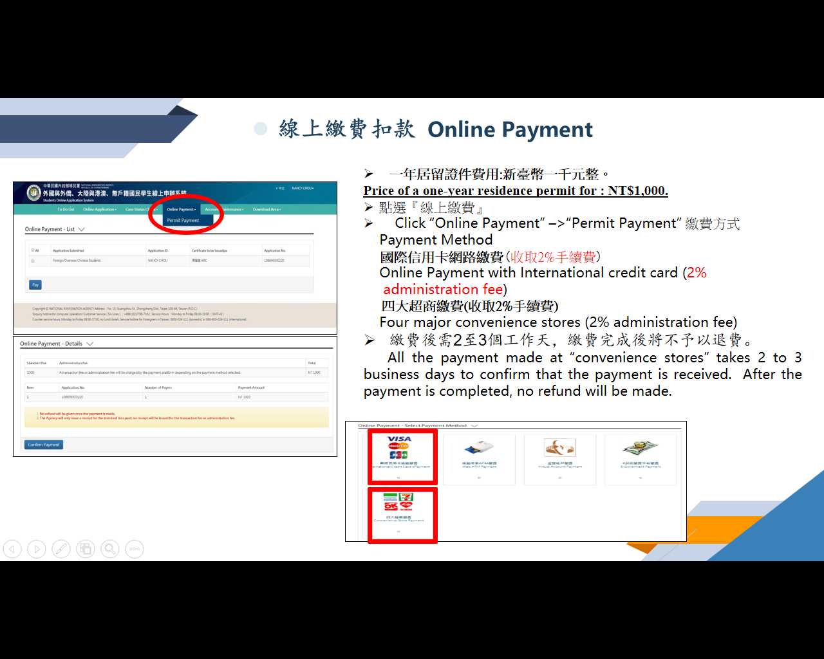

Slide 9
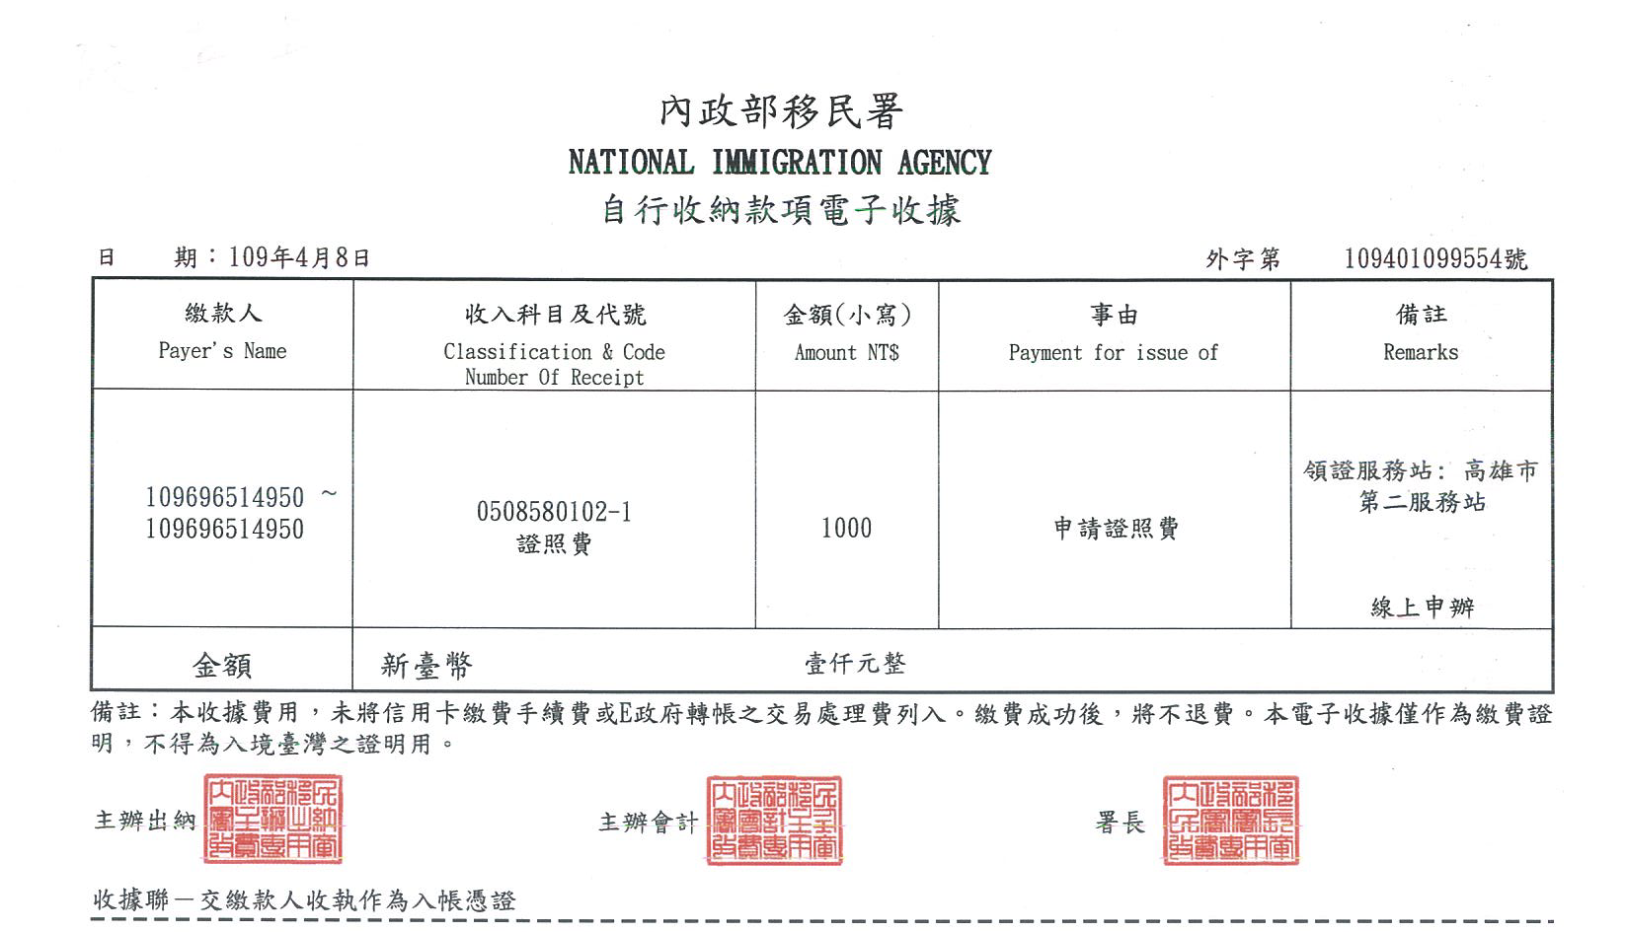

Slide 10

外國學生居留證
線上申辦系統
ARC Online Application System Platform For Foreign Students
Notes:
For reference only. Check online PPT later.

Slide 11
申請流程 Application Process
帳號註冊
Create Account
1.個人資料輸入 Fill in required information
2.信箱驗證 Verify E-mail
3.登入網站 Log-in to website
1.點選線上申請🡪居留證首次申請 Click online application 🡪First-time ARC application
2.填寫上傳所需資料文件
Fill in and upload required document
3.送出審核 Send out for inspection
申請
Application
審核
Inspection
1.審核通過後繳費 Online Payment
2.等待製證 Being Processed
3. 製證完成 ARC ready for collect.
完成申請
Finished application

Slide 12
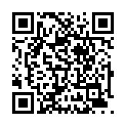

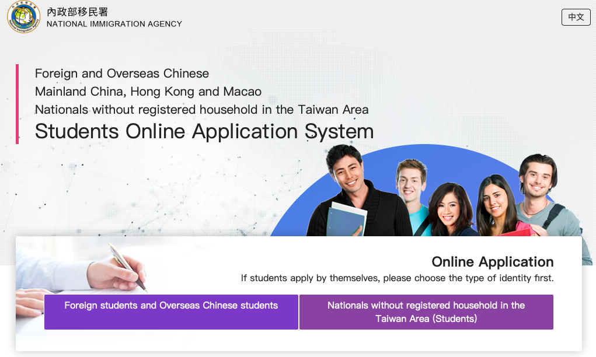

INSTRUCTIONS FOR USE
進入申請網站 Application website:
https://coa.immigration.gov.tw/coafrontend/student/entry
點選『外國與外僑學生』
Click 『Foreign students and Overseas Chinese Student』

Slide 13
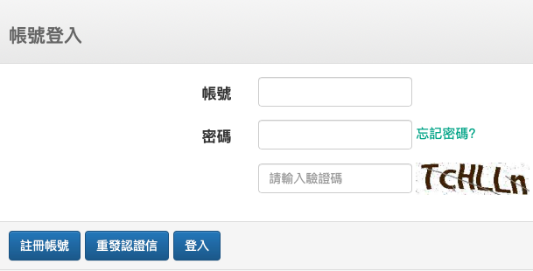
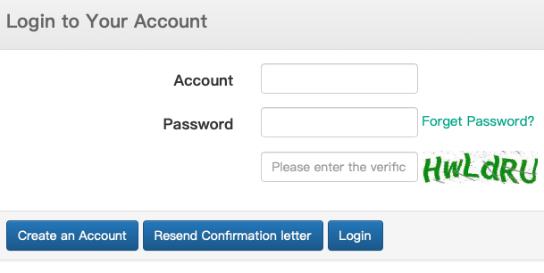
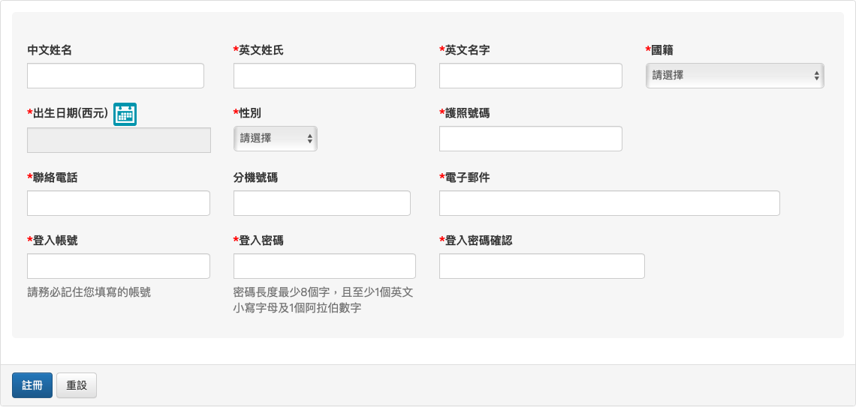
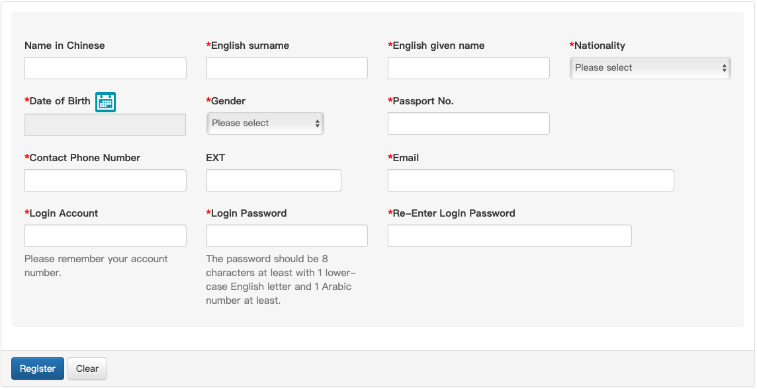
首次登入註冊 Create an Account
登入帳號及密碼需填寫學號：isu+your student ID
(ex: isu12345678a)並確認電子郵件正確無誤
Login Account & Password are student number：isu+your student ID(ex: isu12345678a)
Please make sure the Email is correct.
Must fill in
Must
fill in
    中文姓名必填 Must fill in your Chinese Name.
    英文姓名順序需與護照相同
    Name in English should be same order as passport.

Slide 14
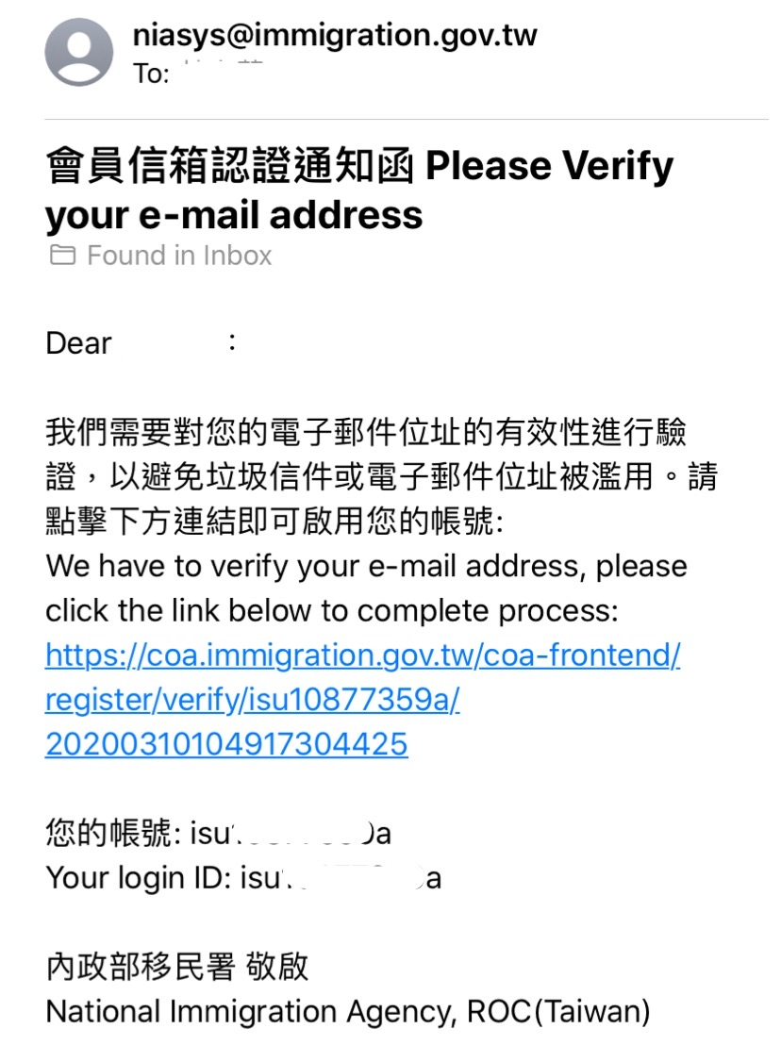
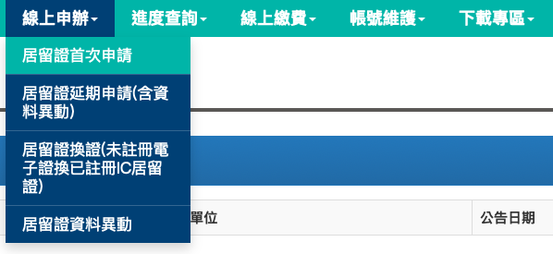
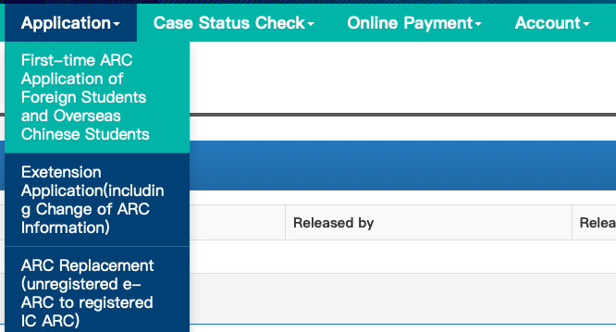
信箱認證 Verify Email Account
點選『線上申請』🡪 『居留證首次申請』
Click『 Online Application 』🡪『First-time ARC Application of Foreign Students and Overseas Chinese Students』
點擊啟用帳號
Click the link to activate your account

Slide 15
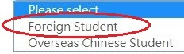
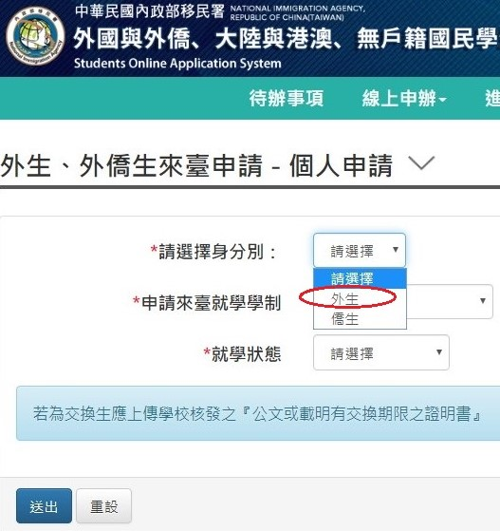
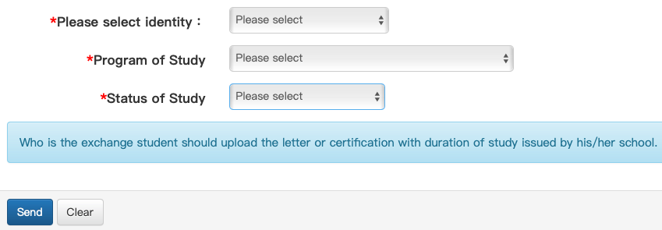
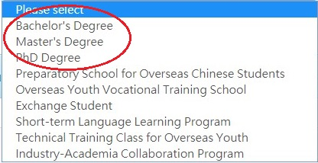
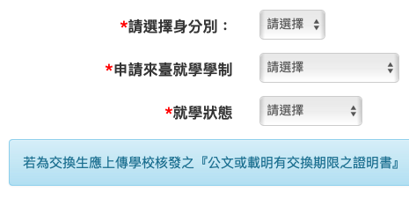
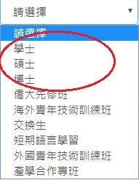


居留證首次申請
First-time ARC Application of Foreign Students and Overseas Chinese Students
1
1
2
2
1
3
2
3
3

Slide 16
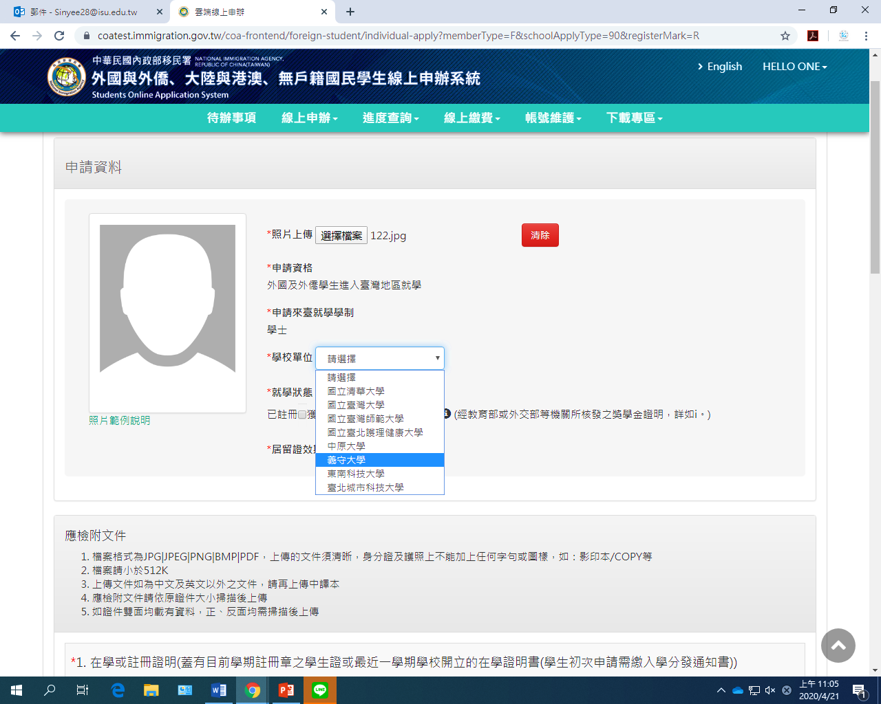
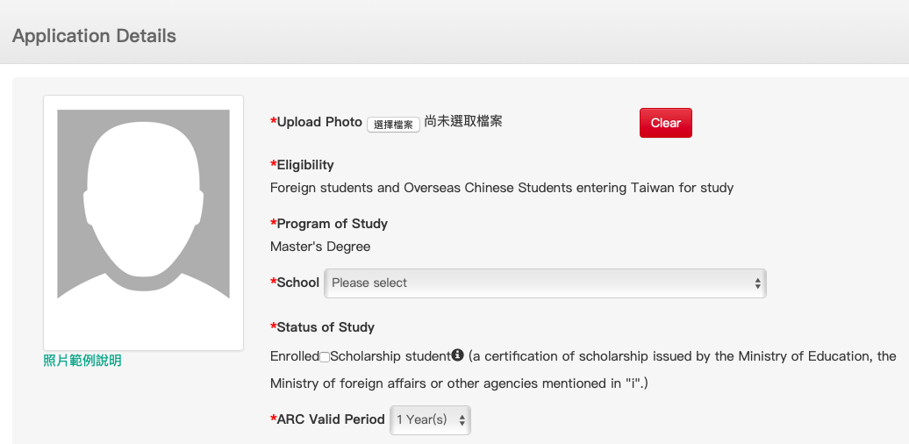
上傳照片Upload Profile Picture
1
2
義守大學
1
You need to fill in the details below:
1.Upload Photo
2.Choose which school you study.
2
I SHOU UNIVERSITY

Slide 17
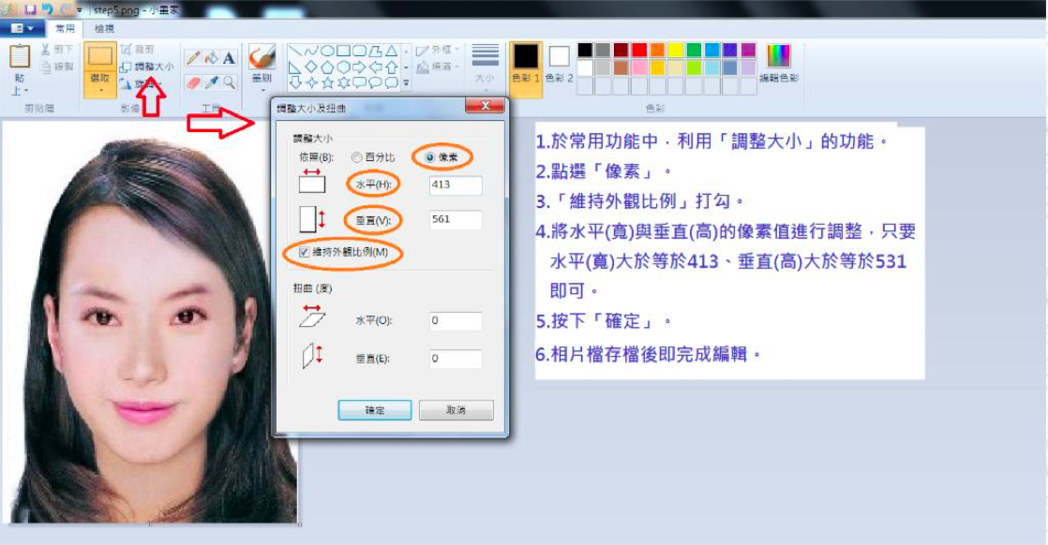
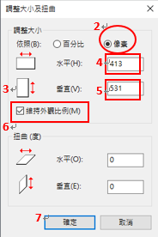
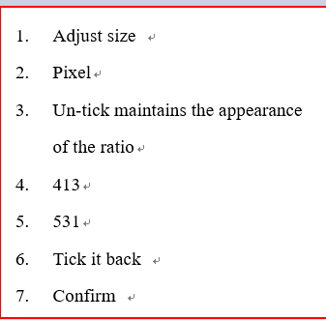
大頭照格式大小需用小畫家調整，否則無法上傳
Use Microsoft Paint to Adjust the size of the photo.
Passport-size photograph(At least 3.2cm from head to chin, with white background, taken within 3months.)
1

Slide 18
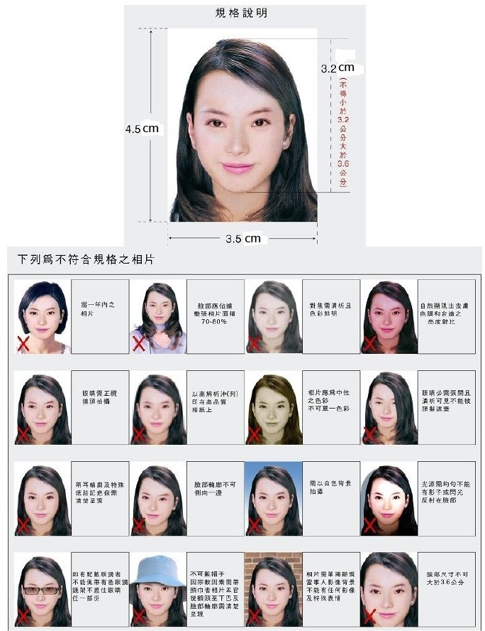
ARC Photo Size
居留證照片規格

Slide 19
請注意上傳檔案只能500KB，否則不能上傳。（例:照片、簽證頁、護照頁、在學證明、房屋契約）
Please note that the upload file can only be 500KB, otherwise it cannot be uploaded.（Exp: Photo, Visa Page, Passport with basic information, Proof of Enrollment, Housing Contract）
If the document more than 500KB, you can use Microsoft paint to adjust the size.

Slide 20
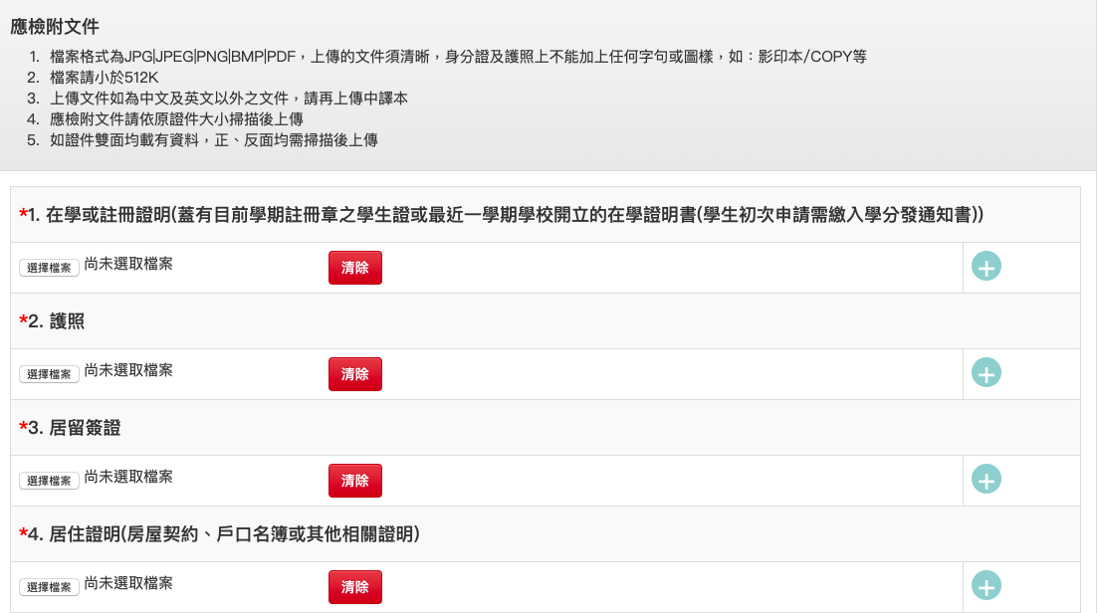
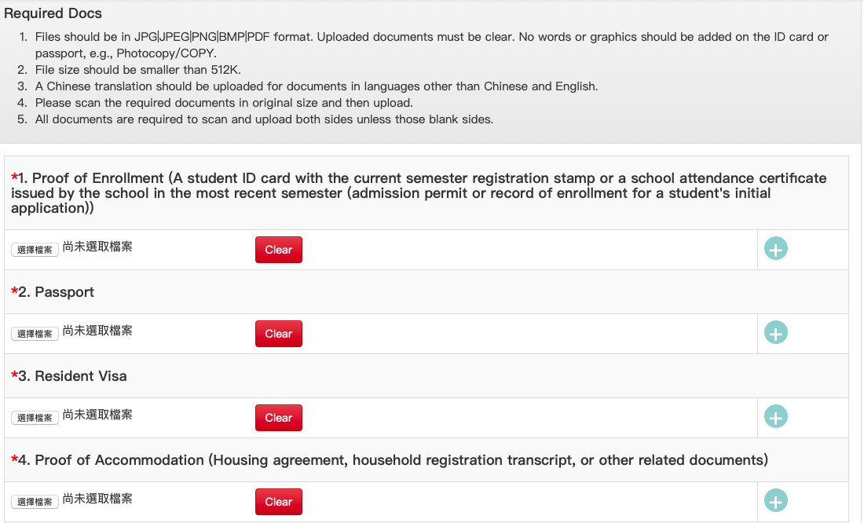
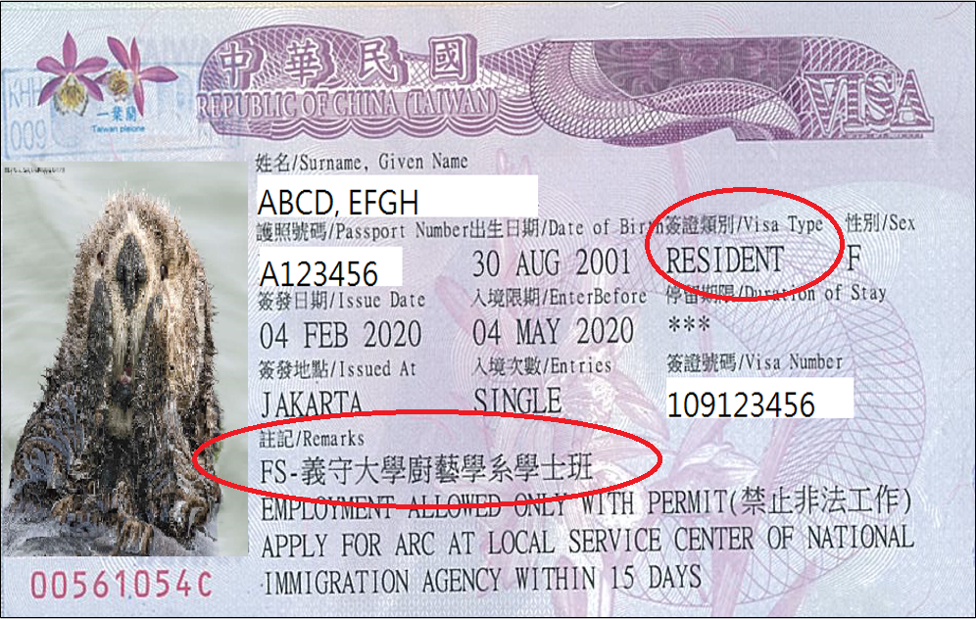

上傳文件 Upload Required Document

Slide 21
上傳文件 Upload Required Document
如果住在學校宿舍，用在學證明代替；如果住校外，則必須上傳租房合約。
    If students stays in the university dorm, Certificate of Enrollment is required.
    If students lives off campus, the housing contract is required.

Slide 22
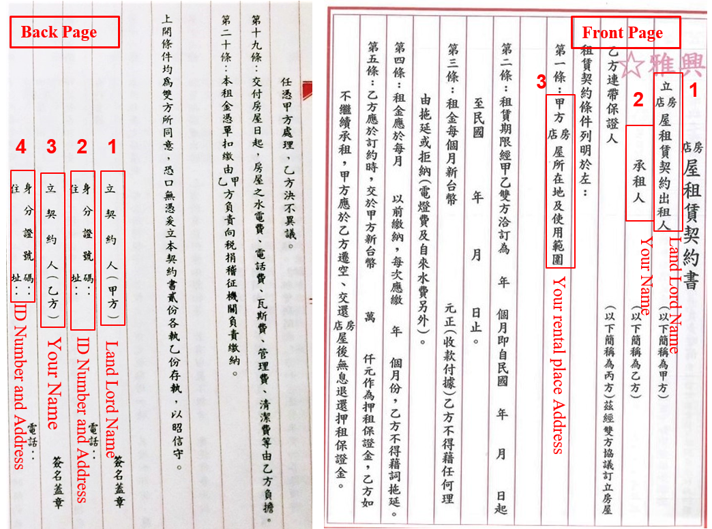
上傳文件 Upload Required Document
Note: Contract front page and back page that include
Landlord Name, Tenant Name(Your Name) and Address.

Slide 23
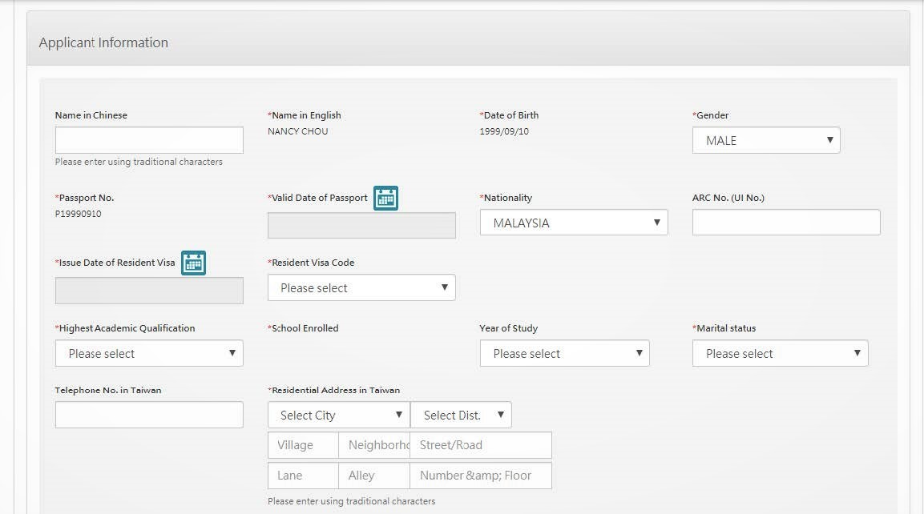
Note:
1.Chinese Name
2.Passport Number
3.Issue Date of Visa Resident
4.Resident Visa Code in Visa Page “Remark” (FS)
5.Telephone Number in
Taiwan(07-6577711) 6.Residential Address:
No.1, Sec. 1, Syuecheng Rd., Dashu District, Kaohsiung City 84001,Taiwan, R.O.C.
840高雄市大樹區學城路一段一號
1
Must fill in Chinese Name
2
3
4
FS
5
6
07-6577711
Residential Address:
No.1, Sec. 1, Syuecheng Rd., Dashu District, Kaohsiung City 84001,Taiwan, R.O.C.
    英文姓名順序需與護照相同
    English Name must be same order as your passport.

Slide 24
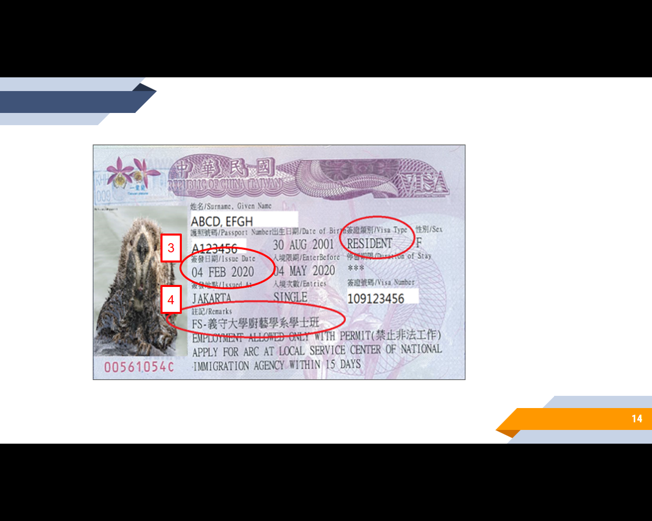
1
Must fill in Chinese Name
2
3
4
FS
5
6
07-6577711
Residential Address:
No.1, Sec. 1, Syuecheng Rd., Dashu District, Kaohsiung City 84001,Taiwan, R.O.C.
    英文姓名順序需與護照相同
    English Name must be same order as your passport.

Slide 25
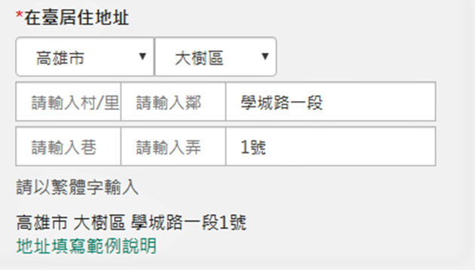
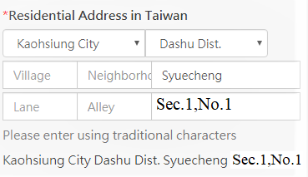

Slide 26
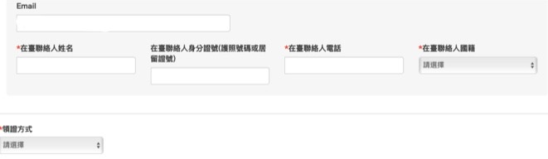
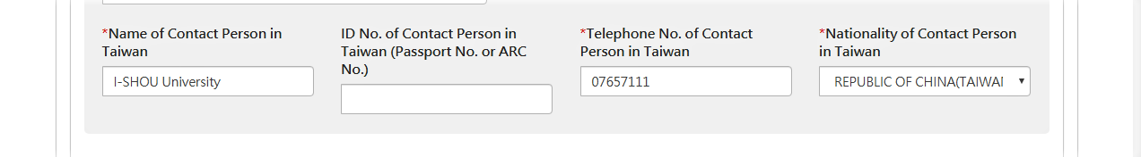
在臺聯絡人資料與領證 Contact Person in Taiwan Information and Collection
1.在臺聯絡人姓名(Name of Contact
Person):
義守大學(I-SHOU University)
2.在臺聯絡人電話(Telephone No. of
Contact Person)：07-6577711
3.在臺聯絡人國籍(Nationality of
Contact Person)：
中華民國(台灣)
REPUBLIC OF CHINA (R.O.C)
1
2
3
義守大學
07-657-7711
中華民國
1
2
3

Slide 27
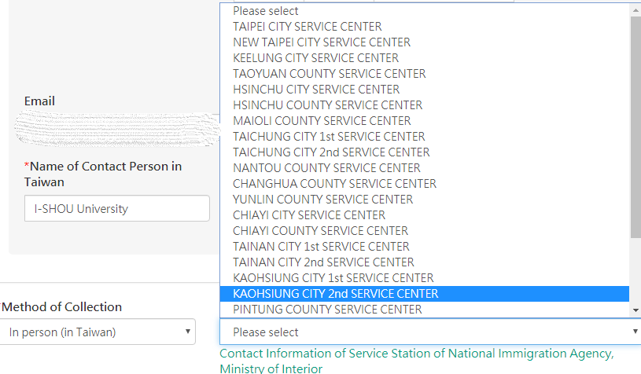
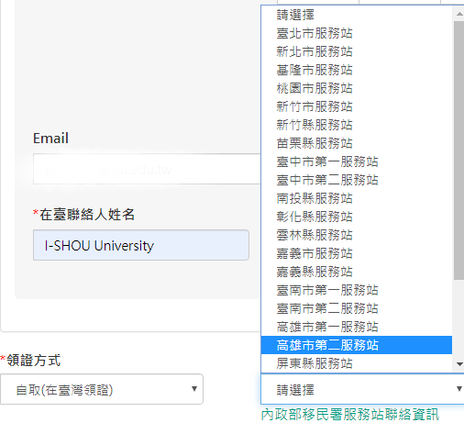
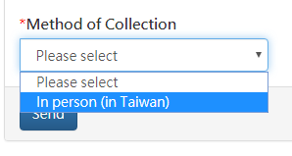
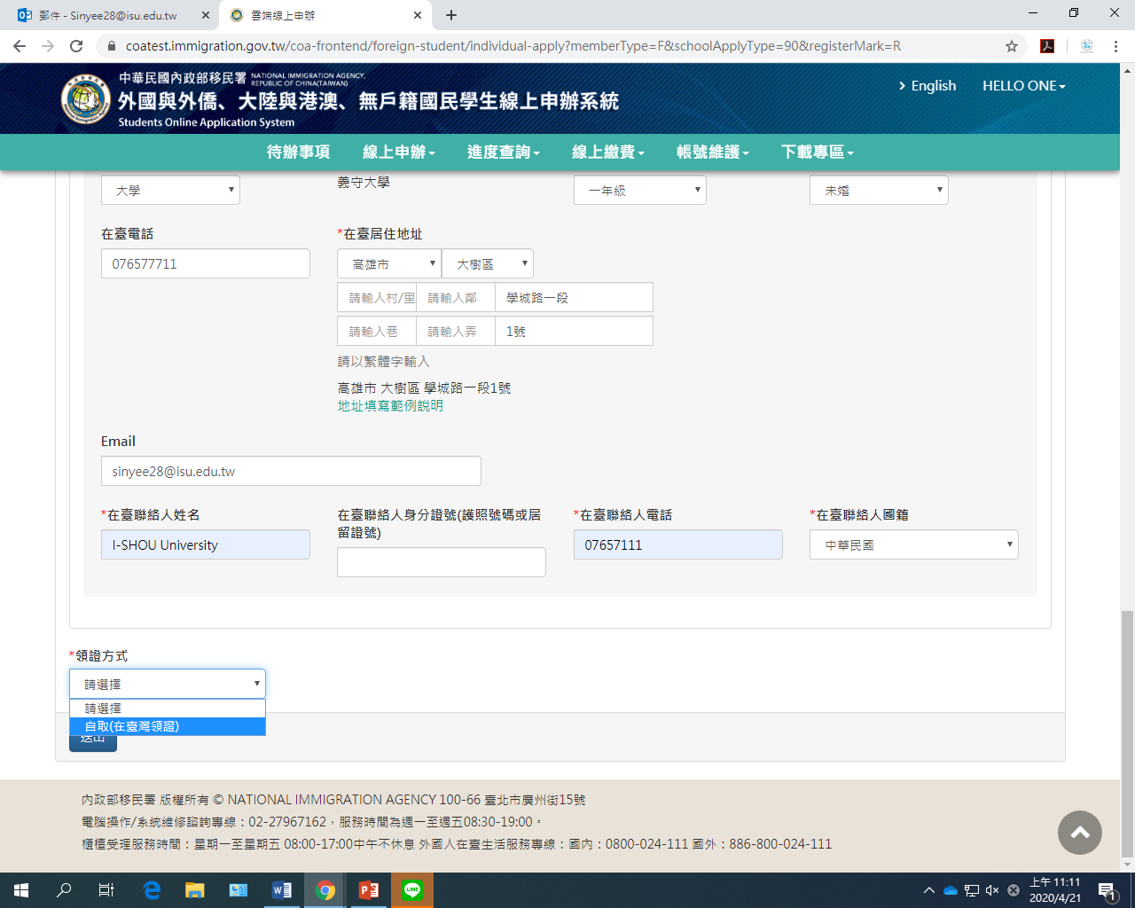
4.領證方式(Method of Collection):
自取(In Person )
5. Location of Collection:
選擇高雄市第二服務站 (Kaohsiung city 2nd Service center)
4
5
4
5
送出資料後可至代辦事項查看
After click “send out”, you can see your application status in the “To Do List”

Slide 28
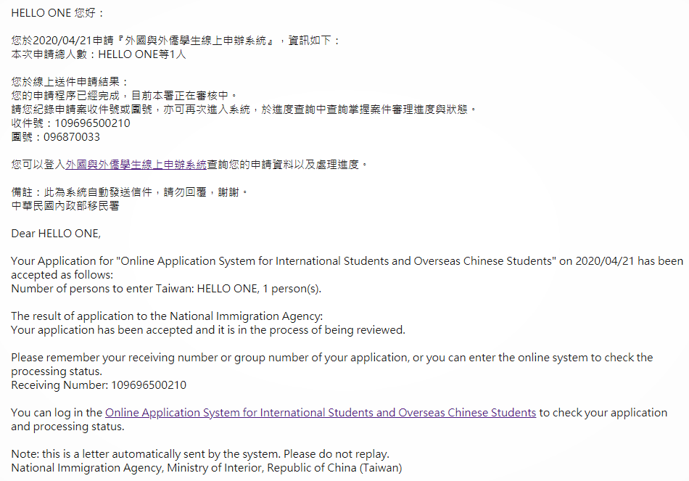
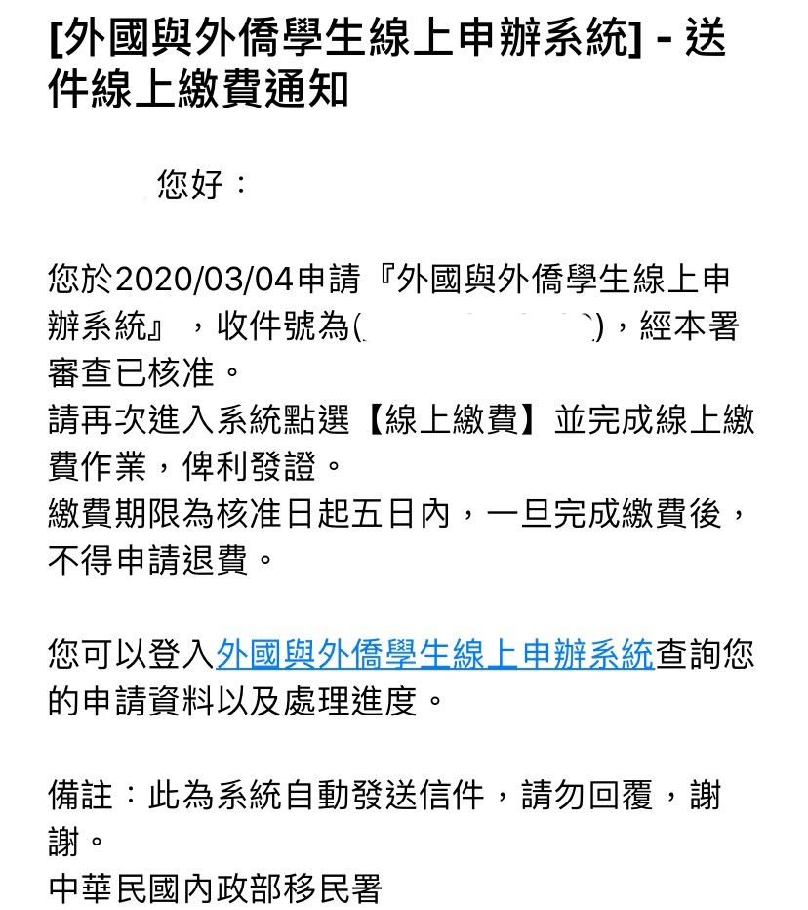
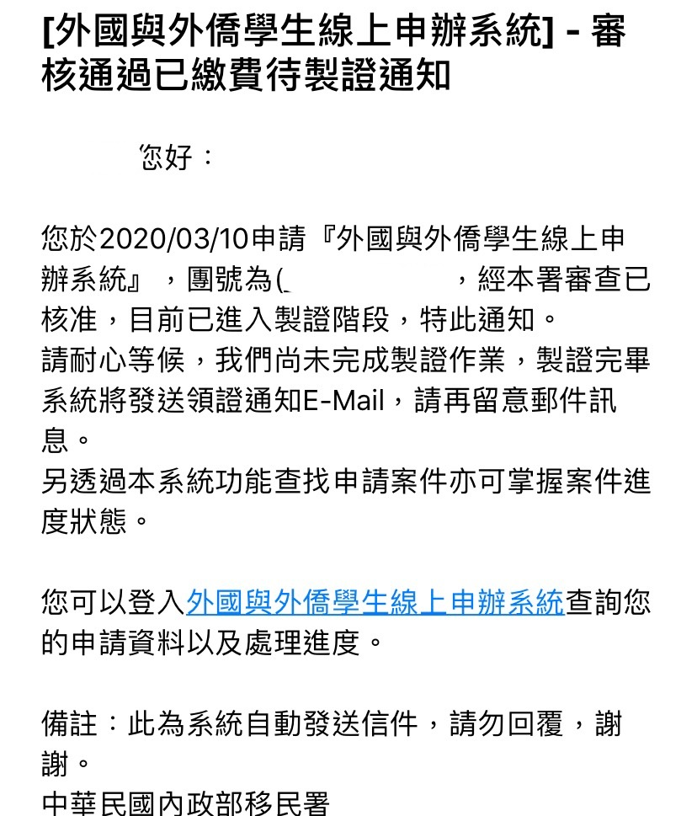
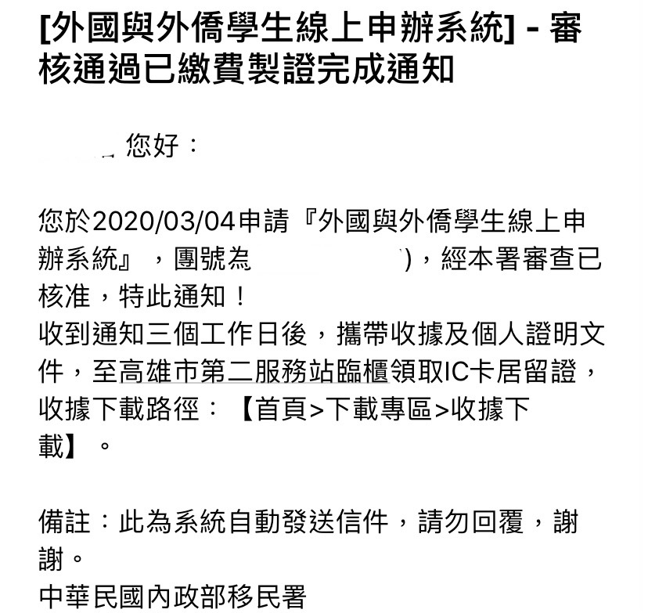
送出後流程 Process after send out the application
送出申請
Send out application
Receive an Email
審核
Under inspection
2-3 Working Days
以Email通知線上繳費：
審核通過線上繳費通知
Notify Online Payment
Download the Payment Slip
已繳費通知
Notify Online Payment Approved
以Email通知已繳費待製證：
After Payment download the Receipt
以Email通知製證完成：
製證完成通知
Notify Ready for collection

Slide 31
居留證 ARC – 畢業後延期
Extend ARC after Graduation
應屆畢業生持畢業證書可向移民署申請居留證延期6個月
Graduates seeking employment in Taiwan are required to provide a graduation certificate to extend their period of stay. The maximum extension is 6 months, starting from the month of graduation.
  例如: 6月畢業者，居留證可延至12月。
  EX.: ARC can be extended till December when you graduated in June.

Slide 32
More Information
https://www2.isu.edu.tw/2018/homepage_v01.php?dept_mno=654e

Slide 33
健康保險 Health Insurance

Slide 34
健康保險 Health Insurance
轉入本校代辦健康保險情形:
新入境新生，在臺居留未滿6個月須參加團保，費用為每月新臺幣500元（內容類似全民健保），6個月共計新台幣3,000元。入境當月1日起投保。
新入境新生，且已在臺居留滿6個月，國際及兩岸事務處會協助辦理健保IC卡申請事宜。費用為每月新臺幣826元， 6個月共計新台幣4,956元。
According to National Health Insurance Act, any foreigner staying in Taiwan over six months is obligated to underwrite an insurance policy under NHI.
For newly arrived students who have NOT been in Taiwan for 6 months, should enroll to group medical insurance on the first day of the month (which is similar to NHI) for a fee of TWD 500 per month, total TWD 3,000 per semester.
The cost of National Health Insurance (NHI) should be included in the tuition fee every semester if you are eligible to underwrite an insurance policy under NHI. The cost is TWD 826 each month (according to the fee criteria set by NHI), so payment per semester is TWD 4,956 (from September to February and March to August).

Slide 35
團保理賠 Insurance Claimant
Reimbursement procedure：
  You need to pay the full fee for the treatment yourself first. Make sure to get both the payment receipt and your certificate of diagnosis.
未有健保前適用。
請至合法登記之診所或醫院就醫。
申請團保理賠請至國際及兩岸事務處填寫申請書
    Diagnosis at the clinic or hospital
至診所或醫院就診
先自行付費
  Reimbursement Application:
  * Original receipt of payment
  * Original certificate of diagnosis
  * Photocopy of Post Office passbook cover
  * Compensation Application Form
  * Photocopy of Passport
  * Photocopy of ARC
檢附收據正本 、診斷證明、護照影本、ARC影本及存褶封面影印本，至國際處填寫理賠申請書
* Please note: For the same symptoms, the insurance company covers only one visit per day. The maximum coverage per visit is TWD 1,000。

Slide 36
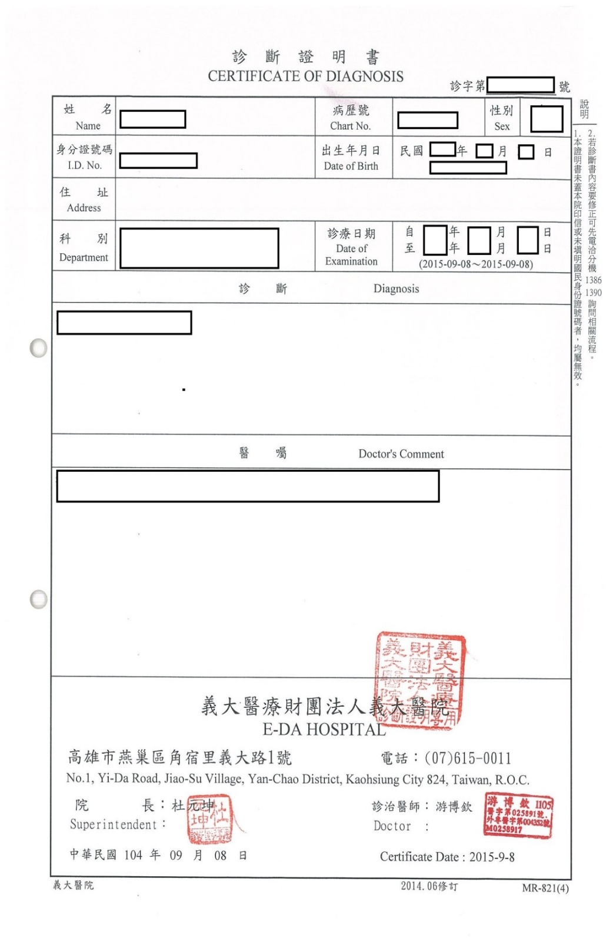
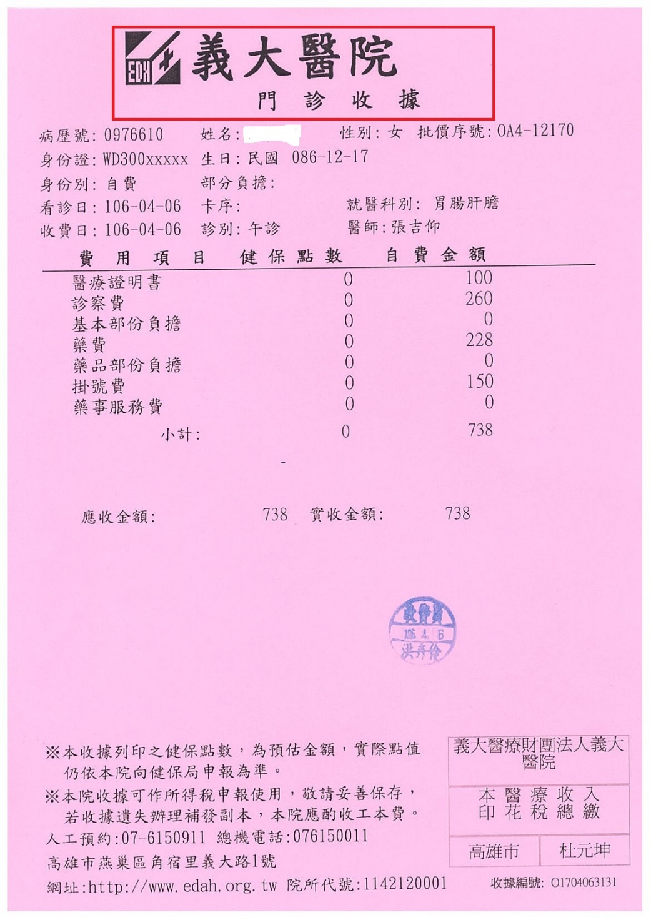

Slide 37
工讀/就業 Working in Taiwan

Slide 38
工讀 Work Study Employment
外國留學生、僑生及港澳生其申請工作許可，許可期間最長為6個月，其工作時間除寒暑假外，每星期最長為20小時。
未依前項規定者，本會得依就業服務法規定廢止其工作許可，而未依規定申請工作許可，即受聘僱為他人工作者，依就業服務法規定，處新臺幣3萬元以上15萬元以下罰鍰。
依據「雇主聘僱外國人許可及管理辦法」規定，來臺就讀正式學制之僑生、港澳生及外國留學生，入學後經學校許可，可向本會申請，惟來臺學習語言課程之外國留學生，則須修業1年以上，方可提出申請。
步驟一 連結申辦網址: https://ezwp.wda.gov.tw
The maximum work hours are 20 hours per week, except during summer and winter vacation.
According to Employment Services Act, if you work without a work permit, you will be fined from NT 30,000 to NT150,000.
According to the "Regulations on the Permission and Administration of the Employment of Foreign Workers", you can apply for the student work permit only if you are officially enrolled as a degree student in any university or have taken one-year language course in Taiwan.

Slide 39
工讀 Work Study Employment
上學期申請者，工作許可證之期限至次學期3月31日止;
下學期申請者，工作許可證之期限至同年9月30日止；
惟跨學期或學年度申請工作證，檢附經學校註冊組加蓋申請期間次學期註冊章之學生證影本或提供註冊證明者。
從事課程相關之研究助理、教學助理，得無需申請工作證，相關規定請見教育部來函。
For applications made in the Fall semester, the work permit is valid until March 31th of the next year;
For applications made in the Spring semester, the work permit is valid until September 30th of the same year. The period validity of work permit is 6 months at most. No matter when you apply, it will maximum issue 6 months at most each time.
The international students can’t work in Taiwan unless they have a valid work permit. Please notice that Taiwanese employers must help their employees to enroll in the labor insurance program.
In addition, please don’t do any dangerous job when you are tired.

Slide 40
工作證 Working Permit Application
For international students, who wish to work in Taiwan (either on campus or off campus), you are required to apply for and obtain the work permit before starting work.
Please note that if you hold a job without applying for the work permit, you may be fined for NT$30,000 to NT$150,000!
Required Documents for Work Permit Application
  One copy of student ID card with the registration stamp
  One copy of passport
  One copy of ARC
  The receipt of examination fee from post office (the amount is NT$100)
申辦工作許可應提供以下資料:
蓋有當學期註冊章的學生證 影本
護照 影本
居留證 影本
工作證100元費用 收據

Slide 41
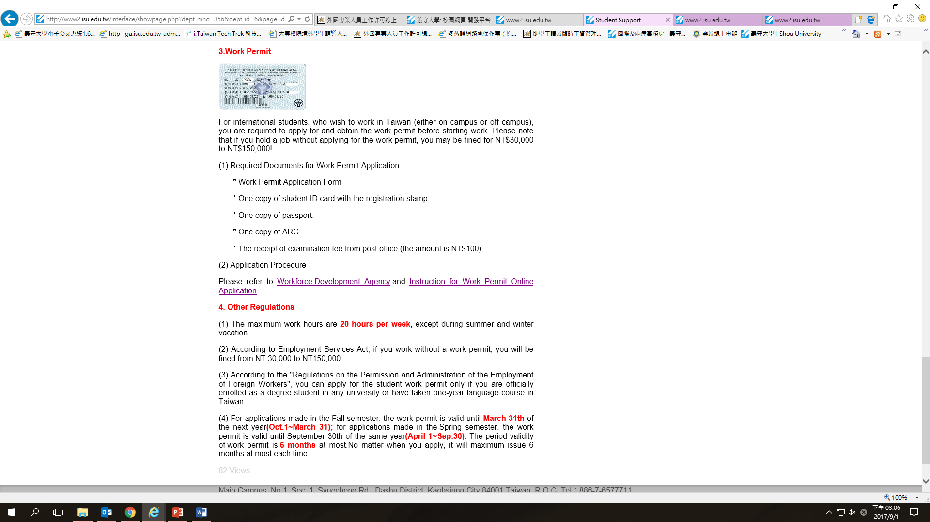

工作證 Working Permit On-line Application 1/5
Step 1. Link to http://www2.isu.edu.tw/interface/showpage.php?dept_mno=356&dept_id=6&page_id=23076

Slide 42
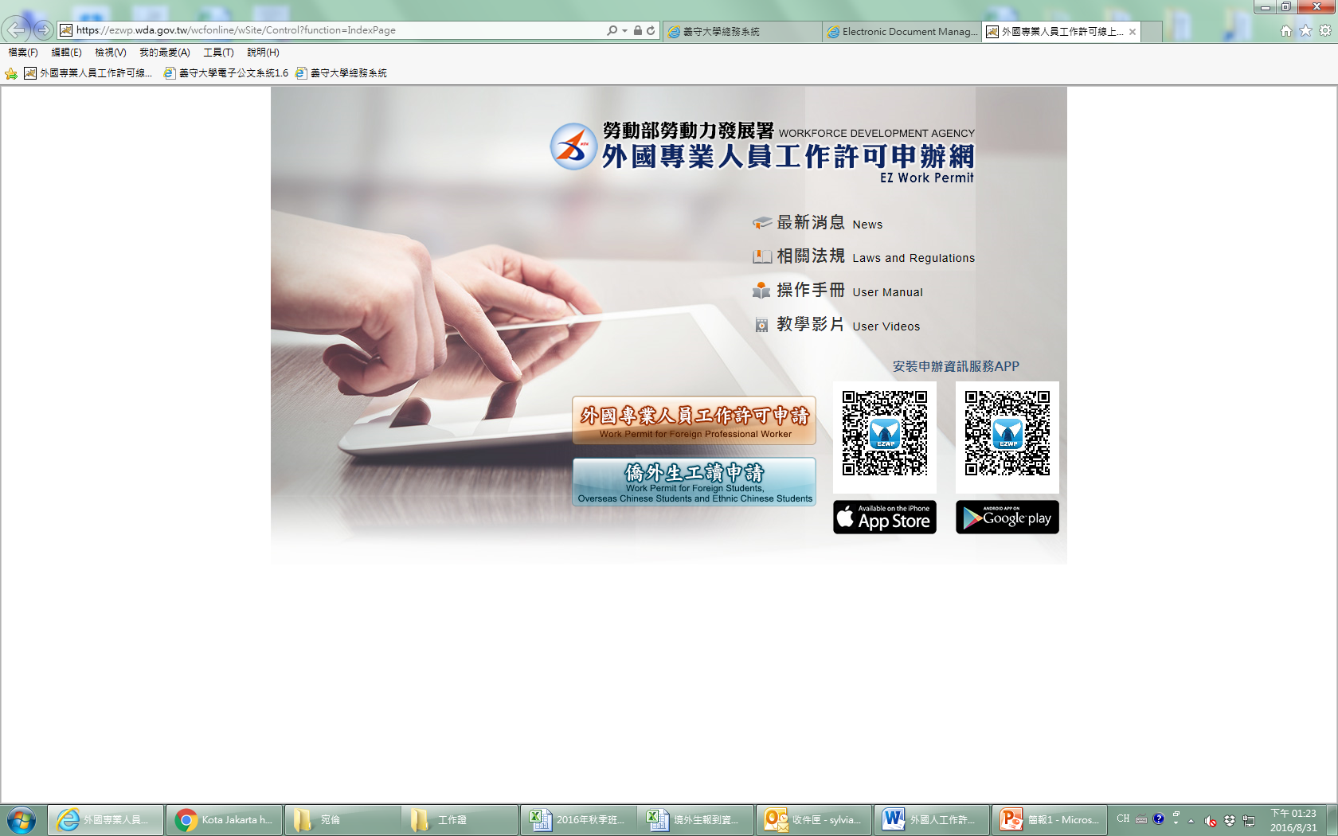
工作證 Working Permit On-line Application 2/5
Step 2. Click “Work Permit for Foreign Students, Oversea Chinese Students and Ethnic Chinese Students”

Slide 43

工作證 Working Permit On-line Application 3/5
Step 3. Click “Application for account”

Slide 44

工作證 Working Permit On-line Application 4/5
Step 4. Enter all required columns (with a red asterisk *shown in front), CAPTCHA and click “Confirm” to complete the application for an account.

Slide 45
工作證 Working Permit On-line Application 5/5
Step 5. After logging in to the website, click “Case management> Add students’ application”. The webpage for adding applications will appear.
Step 6. Click “Add” and complete the application form. After pay fee via post office, enter revising “transaction date”, entering “office code” and “receipt number”.
Step 7. Click the tab “Upload the file” to upload related required documents, and click “Send the application to school” to check the application.
  Student ID card ( both sides)
  Passport (page of Basic information )
  ARC ( both sides)

Slide 46
畢業僑外生留臺工作 Working after Graduation
勞動部自103年7月3日新增「僑外生留臺工作評點新制」，該制度不再單以聘僱薪資作為資格要求，而係改以學經歷、薪資水準、特殊專長、語言能力、成長經驗及配合政府產業發展政策等8項目進行評點，累計點數超過70點者，即符合資格。
更多詳請請參閱勞動部資料:僑外生在臺工作相關法規及注意事項-勞動部勞動力發展署。
雇主向勞動部勞動力發展署申請聘僱許可時，除由雇主及僑外生填具申請表自評外，並需要檢附相關文件，如畢業證書、勞動契約、工作經驗及語文能力證明文件。「評點配額機制」之評點項目及應備申請文件詳如附件(請按此下載)，相關資訊請參考勞動部勞動力發展署「在臺畢業僑外生專區」(https://ezworktaiwan.wda.gov.tw/en/Content_List.aspx?n=ACB934E235E89133 )

Slide 47
畢業僑外生留臺工作 Working after Graduation
All Overseas Chinese, Hong Kong and foreign students who desire to seek employment after graduating from a University in Taiwan (including students graduating this year) will be evaluated via a point system.
The point system includes academic records, salary levels, work experience, job qualifications, Chinese language and other foreign language abilities as well as growth experience.
The student applicant must accrue at least 70 points, fall within the set quota and be able to provide a valid work permit.
Apply by New Scoring Criteria for Foreign and Overseas Chinese Students to Work in Taiwan
Assessed based on criteria, including education, salary, work experience, Chinese and other language proficiency, background, and collaborative support for governmental industrial developmental policies, etc.

Slide 48


聘僱在臺畢業僑外生工作評點表
Overseas Chinese/Foreign Student Graduated in Taiwan Comment System Form

Slide 49

More Information
EZ Work Taiwan 外國人在臺工作服務網：https://ezworktaiwan.wda.gov.tw/en/cp.aspx?n=8E87472D9CB255FF

Slide 50
畢業後實習
Internship after Graduation

Slide 51
畢業後實習 Internship after Graduation
僑外生具有下列資格之一，並取得擬實習機構同意實習文件（包括實習內容、津貼及期程等），至遲應於居留效期屆滿之二個月前，向學校提出畢業後實習之申請：
畢業當學期可取得碩士以上學位，在學期間無退學情形者。
畢業當學期可取得大學學位，在學期間無退學情形，且歷年學業成績總平均達七十分以上，經所就讀學系主管書面推薦者。
畢業當學期可取得學士以上學位，在學期間曾參加國際性或全國性之技能競賽或科技展覽，獲得獎項，或有其他領域特殊優異 表現，經就讀學校或國內具公信力機構，檢具相關證明文件書面推薦者。
畢業當學期可取得學士以上學位，在學期間無退學情形，且已通過第一階段醫師國家考試，申請接受一般醫學訓練者。
欲知詳細條文，請連結教育部網站。
As many graduates want to obtain internships in Taiwan, Taiwan’s Ministry of Education ( MOE ) has announced new regulations for those who wish to extend their ARC for internship opportunities.
For more details, please refer to :http://edu.law.moe.gov.tw/EngLawContent.aspx?Type=E&id=207

Slide 52
ISU Career Development Center
The Career Development Center (CDC) assists students in providing services for planning in further education, preparing and developing future careers, career counseling, and alumni networks.

Slide 53
PART 01
Introduction to Work-Study Program and Internships

Slide 54

Documents Required for Work-Study Jobs
工作完成情况
工作完成情况
请在此处输入文本内容可根据需要修改文字的小和数字请在此处输入请在此处请在此处输入
请在此处输入文本内容可根据需要修改文字的小和数字请在此处输入请在此处请在此处输入
https://ezwp.wda.gov.tw/wcfonline/wSite/Control?function=IndexPage

Slide 55
PART 02
On-campus Work-Study Opportunities

Slide 56
https://www.ypppt.com/
2.1 On-Campus Study-Work
Please register first.
You can search for on-campus available work-study opportunities by the link https://reurl.cc/M8Egrv

Slide 57
https://www.ypppt.com/
2.2 Work-Study Opportunities
Released by Departments
Department offices
Department bulletin boards
Recruitment by
faculty members

Slide 58
PART 03
Off-campus Work-Study Opportunities

Slide 59



https://www.ypppt.com/
3.1 Job Search Entry
Work study and employment opportunities released by business entities and E United Group.
https://reurl.cc/kXAWN3

Slide 60

3.2 RICH (Ministry of Education website )
https://www.ypppt.com/
RICH program provides diverse workplace experience programs in collaboration with universities and colleges, private businesses, public sectors, and NPOs. https://rich.yda.gov.tw/rich/#/
https://www.facebook.com/rich.gov

Slide 61

3.3 Taiwan Jobs website
https://www.ypppt.com/
An official government platform helps you find employment, get training, and acquire certificates.
https://www.taiwanjobs.gov.tw/home109/index.aspx

Slide 62

3.4 Contact TAIWAN
https://www.ypppt.com/
To create a network with international professionals and encourage them to work, live, and invest in Taiwan.
https://www.contacttaiwan.tw/main/index.aspx

Slide 63
PART 04
Internships

Slide 64

4.1 Internship Search Entry
https://www.ypppt.com/
Internship opportunities released by business entities and E United Group.
https://www.isu.edu.tw/newsite/showpage.php?dept_mno=811&dept_id=19&page_id=49465

Slide 65

4.2 Global Internship Facilitation of Taiwan, GIFT
https://www.ypppt.com/
https://www.gift.org.tw/

Slide 66


4.3 OICA: Internships & Career
https://www.ypppt.com/
https://www.isu.edu.tw/2018/homepage_v01.php?dept_mno=654

Slide 67

Thank You

Slide 68
Mailing & Banking Service

Slide 69
地址寫法
Letter/mailing/registering a car/motorcycle
校內收信地址請註明
  系別班級或
  正確宿舍號碼，
畢業或休學離開台灣前，記得到監理所，將你的汽、機名字註銷，以免牌照、燃料稅單一直寄給你
For address on campus, please Specify
  Your department and class, or
  Your exact dorm room number
Please cancel your registration of the vehicle after you graduate or leaving Taiwan.

Slide 70

郵局 Post Office
營業時間 (Opening hours): Mon.~ Fri. 08:30-12:30 13:00-16:30
Mail service
Banking service
Visa Debit card 金融卡

Slide 71
貨幣兌換/提款 Money Exchange/Withdrawal
你可以至義大購物中心A區服務櫃檯進行貨幣兌換或至學校所設之土地銀行ATM提款機進行提款
如持銀行信用卡或提款卡，請事先於當地銀行開通【海外提領現金功能】，則可於校內外各銀行之提款機(Auto Teller Machine)使用。
You can exchange money at E-Da Outlet Mall (zone A Information Desk) or withdraw money from ATM of Land Bank on campus.
Please activate the function of overseas cash withdrawal first. Then you can withdraw cash from any Auto Teller Machine in Taiwan.

Slide 72
如何辦理郵局(銀行)開戶? How to open the bank account?
到校取得居留證/中華民國統一證號及印章後，可於義守大學郵局開設儲蓄帳戶，存取所攜現金.
郵局只接受新臺幣存款，無法提供外幣兌換服務。
請至國際及兩岸事務處辦理印章申請，並繳交50元刻印章費用。
開戶前，所攜現金亦可暫交本校國際及兩岸事務處代為存入出納組保險箱保管。
After obtaining your ARC or ROC Uniform ID No and Seal, you can open a savings account in Chunghwa Post ISU-campus-branch (post office).
Chunghwa Post only accepts New Taiwan Dollar in cash. No foreign currencies are accepted.
Please come to OICA and bring TWD 50 to apply for making seal.
The University provides temporary safe deposit box before you open a savings account. (OICA staff will assist students to go to the Cashier section to deposit cash.)

Slide 73
高雄旅遊 Travel in Kaohsiung

Slide 74

高雄好所在 Beautiful Kaohsiung

Slide 75
學生證 Student ID Card

Slide 76

義守大學學生證
Add cash value to your card at any convenient stores, or Metro stations.
各便利商店、捷運站可加值。
一卡通功能
I-Pass

Slide 77

高雄捷運（一卡通）Kaohsiung M.R.T (I-PASS)
義守大學學生證可開通一卡通功能，可使用於搭乘捷運上。
必須於學歷驗證後，才會拿到學生證。
請務必記得將學歷證明上傳至應用系統。
The ISU student ID card is available to activate I-PASS for using public transportation.
Only students who verify their academic qualifications can get their student ID.
Please remember upload your academic qualifications to Information System.

Slide 78
交通 Transportation

Slide 79

台鐵(一卡通)
火車車種:
自強號
莒光號
復興號
區間車/區間快
普快車
哪裡你可以搭乘火車呢?
高雄火車站
左營高鐵站
交通部台灣鐵路管理局官方網頁:
http://www.railway.gov.tw/tw/

Slide 80
Railway(I-Pass)
Types of train:
Tze-Chiang Limited Express
Chu-Kuang Express
Fu-Hsing Semi Express
Local train/Fast Local Train
Ordinary train
Where you can take railway?
Kaohsiung Main Station
Zuoying High Speed Rail
Taiwan Railways Administration Wbsite:
http://www.railway.gov.tw/en/index.aspx

Slide 81


高鐵 High Speed Railway
哪裡你可以搭乘高鐵呢? Where can you take the High Speed Railway?
左營高鐵站 Zuoying High Speed Rail Station
台灣高鐵官方網站Taiwan High Speed Railway Website:
https://www.thsrc.com.tw/index.html?force=1

Slide 82

巴士(一卡通)
如何去高雄市區?
在義大購物廣場搭乘義大客運8501。
左營高鐵站為終點站，可透由捷運抵達大部分的熱門地點。
高雄市公車動態資訊官方網頁http://122.146.229.210/bus/BusRoute.aspx

Slide 83
Bus(I-pass)
How to go to Kaohsiung downtown?
Take EDA bus 8501 at EDA mall Zone C.
Zuoying High Speed Rail is the last stop, you could go to most of popular attractions by MRT.
Kaohsiung City Real Time Bus Arrival Information System
http://122.146.229.210/bus/BusRoute.aspx

Slide 84
校本部及醫學院區交通車(一)
一、交通車類別、屬性：
1.學校與義大客運簽屬往返校本部、大遠百間之教職員工專車(係稱本校校車)，本校同學搭乘校車，需使用學校乘車票券搭乘。
2.義大客運自行營運，校本部、義大世界經往高鐵、市政府
、美術館、五甲、鳳山、岡山、佛光山、義大醫院等路線
3.高雄客運自行營運，由醫學院區經往旗山、楠梓、岡山、
燕巢、捷運站等路線。
4.高雄市公車，由醫學院區經往楠梓、岡山、大社、燕巢、
捷運站等路線。
二、本校校車：
1.校車路線：從高雄三多路大遠百，沿中山路、建國路、
民族路、(捷運青埔站)、楠梓火車站、楠梓新路、興楠路、
大社中山路、學校。
2.學校校車行駛時間，自早上06:50開始到晚上10:15止。

Slide 85
ISU Public Transportation Rules and Policies
I-Shou school bus(專車): Be sure to use I-Shou school bus pass ONLY. No cash or coin is allowed.
Eda Bus: Pay your fare with exact change, or I-Shou school bus pass.
If you are going to take I-Shou school bus, please signal the bus before the bus arrives. Please inform the driver where to drop you off.
For commendations, suggestions, inquiries, or complaints, please contact Eda Bus Customer Service#：0800-352-520 (LOCAL PHONE only) or 07-657-7258
【The specification of I-Shou School bus pass and Eda bus Monthly Pass 】
Fare: TWD 26 from University to Nanzih District.
TWD 26 from Nanzih District to downtown Kaohsiung

Slide 86
校本部及醫學院區交通車(二)
3.校車售票處：
校本部同學請至活動中心便利商店、行政大樓出納組及
綜合教學大樓進修部。
醫學院區同學請至教學大樓B棟一樓總務處。
三、96路公車─為校本部與醫學院區之間往返區間車(義大客運96路公車，單程票價12元。
1.為服務本校同學，96路公車規劃為本部與分部間之區間接駁車，由學校負擔乘車車資，本校同學至校本部或醫學院區守衛室，憑學生證，填寫領取記錄，領取乘車票券免費搭乘。
2.96路公車行駛路線：義大醫院、翠屏岩、觀景山林、皇冠飯店、義守大學、義大世界。
四、校車搭乘地點：
1.校本部招呼站：理工大樓前候車亭及校門口客運站牌。
醫學院區招呼站：義大醫院對面候車亭客運站牌。

Slide 87
ISU Public Transportation Rules and Policies
6.Eda Bus offers a special monthly student pass.25% off.
7.Where to purchase the Eda bus Monthly student pass:
Eda Bus Office:
No.27, Sec.1 Syuecheng Rd., Dashu District, Kaohsiung City 84001
8.If your electric pass has been locked, you can unlock it in
two places:
A:Eda Bus Office:
No.27, Sec.1 Syuecheng Rd., Dashu District, Kaohsiung City 84001
B:Information Center at Zuoying THSR.
No.105, Gaotie Rd., Zuoying Dist., Kaohsiung City

Slide 88
校本部及醫學院區交通車(三)
2.校車沿路依照學校排定之行駛路線停靠於市公車站牌。
義大客運依照義大客運規劃之路線停靠於義大客運站牌
五、交通車時刻表：
可上學校總務處網頁查詢列印，網址：
http://www.isu.edu.tw/→行政單位→總務處
或上義大客運網站查詢列印，網址：
http://www.edabus.com.tw/index.htm
六、寒暑假期間因同學放假班次減少，請特別注意學校公告
之交通車時刻表。

Slide 89



Slide 90


Slide 91


Slide 92


Slide 93



Slide 94






高雄三多路大遠百交通車搭乘處
學校專車上下車搭乘處
(大遠百廣場對面)
(市公車站牌)

Slide 95





高雄火車站交通車搭乘處
學校專車上車搭乘處
(高雄市公車站斜對面)

Slide 96






高捷青埔站交通車搭乘處
高雄捷運青埔站
(高科大站)R22
學校專車上車搭乘處
(高捷青埔站出口處右邊)

Slide 97





楠梓火車站交通車搭乘處
下車處
上車處
下車處

Slide 98


Slide 99


Slide 100





Slide 101


Slide 102


Slide 103


Slide 104


Slide 105


Slide 106


Slide 107





醫學分部交通車乘車處
下車處
下車處
義大醫院
客運車站牌
到站下車處
校車行駛方向
校車行駛方向
客運車站牌
搭乘上車處
上車處
上車處
義守大學燕巢分部

Slide 108
住宿
Housing

Slide 109

學生宿舍管理
宿舍安全
  禁止私自留宿非住宿人員
  禁止在宿舍內打麻將或賭博
  嚴禁私帶異性進入宿舍或潛入異性宿舍

Slide 110
住宿小叮嚀(1/2)
宿舍網路流量管制時間為晚上12點~翌日中午12點。
住宿生應響應環保政策，節約水電資源；離開寢室(或公共室內)時，應隨手關閉冷氣；儲值卡請於近日前往麗文書局購買。
自行瀏覽宿舍公佈欄及學生事務處網頁各項公告。
禁止在宿舍內烹煮食物、喝酒、吸菸、賭博、餵養動物（工作犬除外），且禁止持有烹煮類電器、酒品、電子菸、麻將等賭具。

Slide 111
住宿小叮嚀(2/2)
寢室公物依正確方法使用，若損壞應報請修繕。
(http://ga.isu.edu.tw/)
遵守垃圾分類政策，倒垃圾時間週一至週五：
男生宿舍管理站:7:10~8:20，12:30~13:30。
住宿防竊：進出寢室請隨手關門上鎖，貴重物品請置於上鎖衣櫃中，勿提領過多現金於身上。
若忘記攜帶鑰匙出房門被反鎖時，可向管理站借用備用鑰匙，嚴禁攀爬宿舍欄杆、窗戶、以免發生意外。

Slide 112
Housing Regulations
It is required to move into the allocation assigned and move out by the time written on the contract; it is NOT allowed to move in or move out freely, rent to other person or change your allocation without permission.
Residents should follow the Rule of Management in Dormitory, Residence Dormitory Regulations and other related regulations. It is required to receive the supervision from dormitory supervisors and student Resident Assistant.

Slide 113
The accommodation fee of the 1st Dormitory and the dormitory on Medical campus covers water and electricity charge. Air-condition fees have to be charged through the value card. The electricity charges of other dormitories are charged from the numbers of degree which has been used, and the bill will be sent from the Cashier Section.
It is prohibited to enter the dormitory area or floor of opposite sex without permission. Hence, the control door of Female dormitory cannot be opened unless during emergency.

Slide 114
Students should use the Pass card to enter the dormitory. It is NOT allow to bring or keep relatives, friends or the person who is NOT dorm residents to stay or enter the accommodation. Lounge is available if you have guests.
Residents should ask for a leave before staying outside overnight, please register on the absent book in each dormitory.

Slide 115
Please be aware that it is NOT allowed:
To use personal electrical appliances without permission may cause safety problem.
To storage or use dangerous and forbidden items such as fireworks.
To carry out the activities which may constitute a threat to the safety of other residents (e.g. cooking, drinking wine, gambling, playing mahjong, keeping pets, engaging in dangerous and illegal activity, conducting commercial activities)
Possession of cooking appliances, alcohol, electronic cigarettes, mahjong, etc.
It is important to keep tranquil in the dorm and do not make noise. It is NOT allowed to use the laundry machine, dryer or the television in the lounge after 11:00 pm. (Last coin drop is at 10:30 pm.)

Slide 116
It is required to participate in the following activities:
dormitory resident’s discussion meeting
room representative’s meeting
training for precaution of calamities and evacuation
To love our earth, residents should save water and electricity. Turn the A/C on when the temperature reaches 28℃; it is suggested NOT to set the temperature under 26℃, and the windows and doors should be kept closed when A/C is on. Air-conditioner should be turned off when leaving the dormitory room or public indoor space.

Slide 117
Public property should be used in the right way and not to be moved freely, taken into the room or taken out of the dormitory. It is also NOT allowed to change the door lock without permission; when the facility is damaged, please apply for maintenances.
Do not prohibited to wear pajamas or underwear to stay in the balcony.

Slide 118
Rubbish recycling should be done by all residents. The residents should take the garbage to the dust-cart. Meanwhile the residents on Medical campus should take the rubbish to disposal station.
Time for garbage collection :
1st and 2nd dormitory: Mon to Fri, 07:10-08:20 am and 12:30-13:30 pm
Garbage collection is not available on holidays

Slide 119
It is NOT allowed to wear pajama when using the saloons and it is required to take way the trash, turn off the TV, AC and lights. Desks, chairs, magazines and newspapers should be returned to the original position.
Do not install illegal software on the computer or download illegal videos and games, or affect the normal use of the dormitory network.
Residents should clean up and return every item to the original position when checking out from the dormitory. TWD 500 would be chanrged if any trash is left, and residents has to agree to the University regarding the left item as waste.

Slide 120


Room key, magnetic card and etc. should be returned when checking out. Indemnification fee for improper use or damage should be charhed.
For the sake of public safety and hygiene, residents should often be aware of every announcement. For those who violate dormitory regulation will be punished depending on the condition.
Please refer to the following website for more detailed information.

Slide 121

校安專線
Campus Safety
24 hrs Emergency Call ：0911885115

Slide 122
Campus Safety
1. When you ride motorcycle:
Please wear helmet when you ride motorcycle. Please don’t ride motorcycle when you’re tired or after you drink. If you have any accidents, please stay calm and call ISU emergency hotline at
24-hour Emergency Hotline：0911-885-115

Slide 123
校園安全生活快報
一、騎乘機車：
騎乘機車時，務必戴安全帽，喝酒時或太過勞累時亦不要騎乘機車，不幸發生意外時，請保持冷靜，並儘快通報校安中心。
★請勿酒後駕駛動力交通工具，違反法律者，依法最少處新臺幣 15,000 元以上120,000元以下罰鍰 ，並吊扣其駕駛執照，甚至可能入監服刑。
24小時緊急連絡電話：0911-885-115。
二、網路購物詐騙：
不隨便提供或曝露個人身分資料、帳號及密碼，匯款前請多思考、多查證、多謹慎。
三、妥慎財物管理、防杜宵小竊取。

Slide 124
Campus Safety
★Do not drink and drive. If you violate the law, you will be fined NT$15,000 to NT$120,000 and you will be charged with your driving license. You may even be sentenced to prison.
1.Prevention of Internet Scam:
Please don’t provide your personal info including ID no., account no., password and so on.
Please be careful and think twice before you remit money to other people.
Please keep your valuables carefully.
29

Slide 125
Campus Safety
Non-Smoking Campus:
Students who smokes in the campus will be punished and fined by law.
本校為無菸校園，全區(含宿舍)禁止吸菸

Slide 126

諮商輔導
Counseling and Guidance

Slide 127

學務處諮輔組
提供專業心理諮商服務
(專任心理師/社工師、駐校精神科醫師，提供相關個別心理諮商、諮詢等心理專業服務。)
心理衛生活動推廣(生命教育/健康紓壓/性別平等教育)

Slide 128




Making a Counseling / Psychiatric Consultation Appointment
If you need to make a counseling / psychiatric consultation appointment, please scan the QR code and fill out the application form. Or, you can just contact our English-speaking counselor, Cindy Cheng.
07-6151100*3235
suikar@isu.edu.tw

Slide 129







Mental Health Promotion Activities
on Life Education/ Stress Management and Gender Equality Education
You will be informed of mental health promotion activities via school emails.
Please check your email often so that you won’t miss any interesting activities.

Slide 130
Mental Health Program Activities
on Life Education/ Stress Management and Gender Equality Education
You will be informed of mental health activities via school emails.
Please check your email often so that you won’t miss any interesting activities.

Slide 131

學務處衛保組
【服務內容】健康諮詢、健康促進、傳染病防
治、緊急救護。
【就醫資訊】身體出現不適症狀時，可於校內
理工大樓旁之乘車站搭乘義大客
運96線前往義大醫院或義大癌醫
院就醫。
【就醫優惠】本校學生就醫時出示有效之學生
證，就醫即享「免掛號費」之優
惠。

Slide 132

Hygiene and Health
Health Counseling
Health counseling:
If you have any questions regarding your health condition, please leave a message on the website of Health Section (Administration/ Office of Student Affairs/ Health Section) or visit our office from 8 am to 5 pm.
36

Slide 133


學務處課指組
Extra-curriculum Activities
課外活動學習品保-
在學四年參與系上舉辦的非課程活動的點滴紀錄

Slide 134

學務處課指組
社團—培養軟實力、企業最愛
服務性、學藝性、康樂性、體能性、
自治性、綜合性社團，共計90個。

Slide 135
Student Clubs
111 Academic year have 90 Student Clubs, Student clubs are categorized into the following six categories:
Service Clubs, established to promote social services; (10 clubs)
Academic Clubs, which refer to department- and university-level student associations; (44 clubs)
Arts & Skill Clubs, established for research and skill learning purposes; (17 clubs)

Slide 136
Student Clubs
Recreational Clubs, established to promote healthy recreational activities; (6 clubs)
Fitness Clubs, established to encourage students to exercise; (11clubs)
Comprehensive Clubs, which refer to clubs of two or more kinds of the aforesaid attributes. (8 clubs)
Please refer to the following websites for more detailed information.
https://www.isu.edu.tw/newsite/showpage.php?dept_mno=802&dept_id=4&page_id=46887

Slide 137
運動設施
Sports Facilities

Slide 138
學務處體育室
體育課程之實施
競賽活動之辦理
運動場館之管理與借用
體育學分抵免與畢業學分審查
體育助學金設置與申辦

Slide 139
Office of Physical Education
(inside the stadium)
PE course teaching
Organize sports events
Administration and management of stadium and sports equipment/facilities
PE course credit transfer/waive and review for graduation
Athletic Scholarship

Slide 140
Guidelines on Physical Education Courses at I-Shou University
ArticleⅠ According to the University regulations, students in the 2nd grade are required to take the PE course (twice a week, no credits), and students in the 3rd grade shall register the PE course (twice a week, 1 credit). The credits of PE course shall be counted as graduation requirement.
ArticleⅡ Students will be divided into different classes according to the course registration results. The division of required PE course in the 2nd grade and registered courses in the 3rd grade shall be conducted separately.
ArticleⅢ Students are not allowed to register two required PE courses in the same semester simultaneously. Students who fail the required PE course may register the course again in any semesters, yet they are not allowed to register passed courses again (including students who are required to make up the credits for the PE course).

Slide 141

Thank You for Listening

